Slide 1
Algebra 1 4+6
Probability and Compound Events

Slide 2
Probability Activity
Complete the activity page

Slide 3
Probability Activity ANSWERS

Slide 4
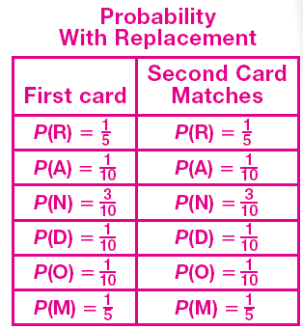
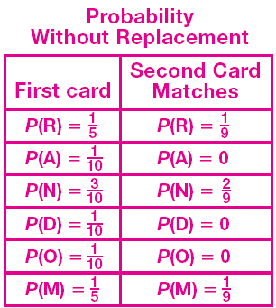
Probability Activity ANSWERS

Slide 5
Vocabulary
Independent Events – Events that do not influence one another

Slide 6
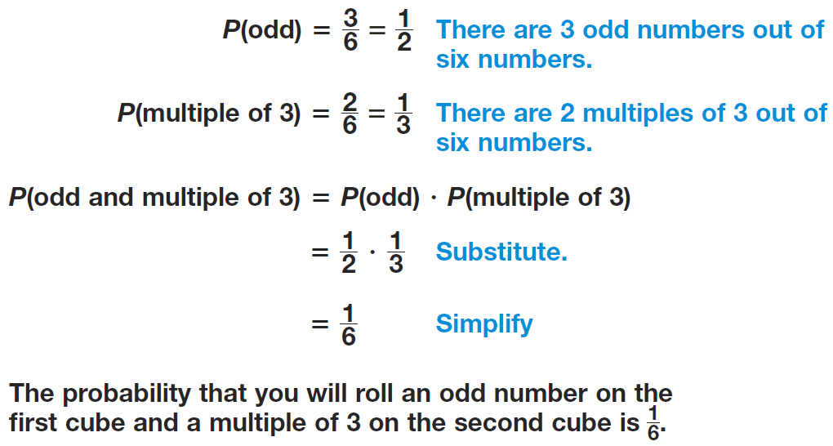
Independent Events - Example

Slide 7
Independent Events - Practice

Slide 8
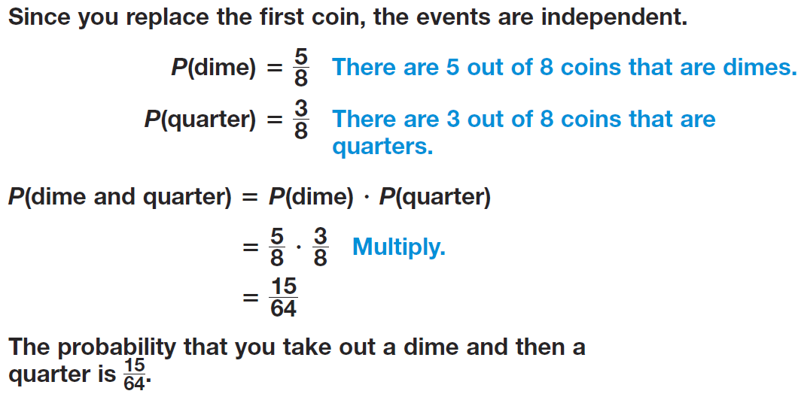
Probability - Example

Slide 9
Vocabulary
Dependent Events – Events that influence one another

Slide 10
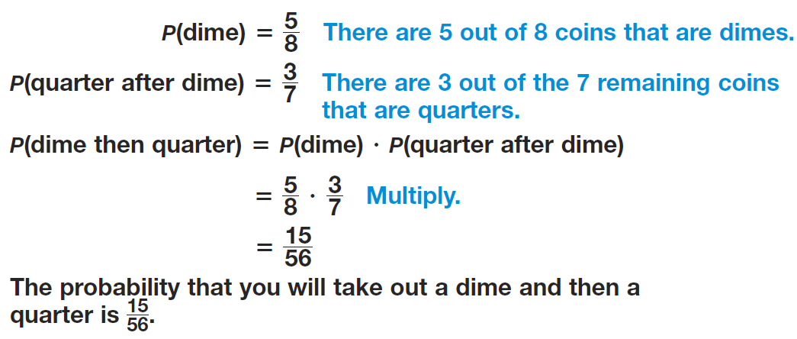
Dependent Events - Example

Slide 11
Dependent Events - Example

Slide 12
Dependent Events - Practice

Slide 13
Practice Problems

Slide 14
Practice Problems

Slide 15
Practice Problems

Slide 16
Homework
Pages 222 – 224
24, 26, 28, 29 – 31, 37 – 40, 51, 52

