Slide 1
Algebra 1 8-3 8-4
Multiplication Properties of Exponents

Slide 2
Exponents

Slide 3
Exponents

Slide 4
Example

Slide 5
Example

Slide 6
Example

Slide 7
Example

Slide 8
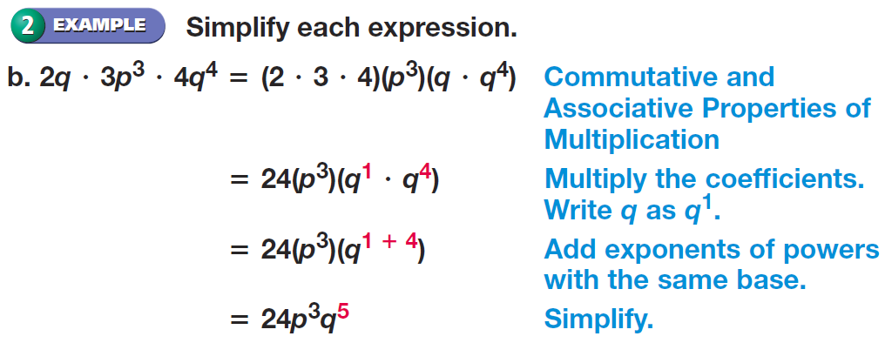
Example

Slide 9
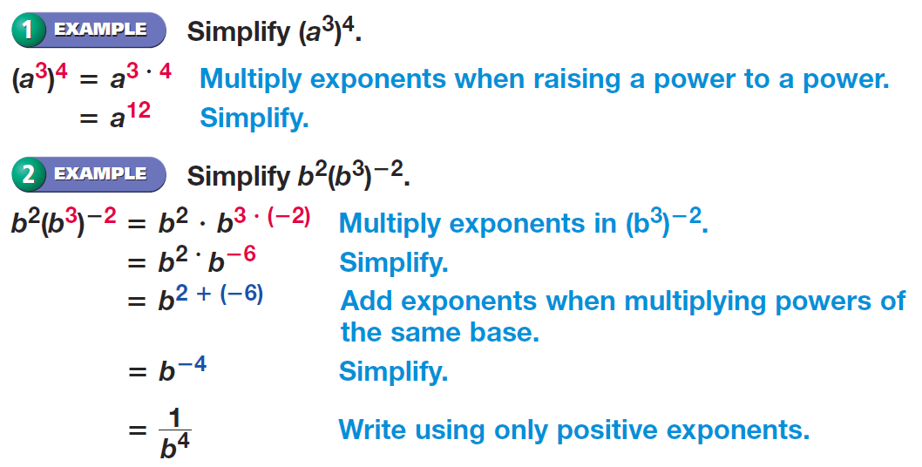
Example

Slide 10
Example

Slide 11
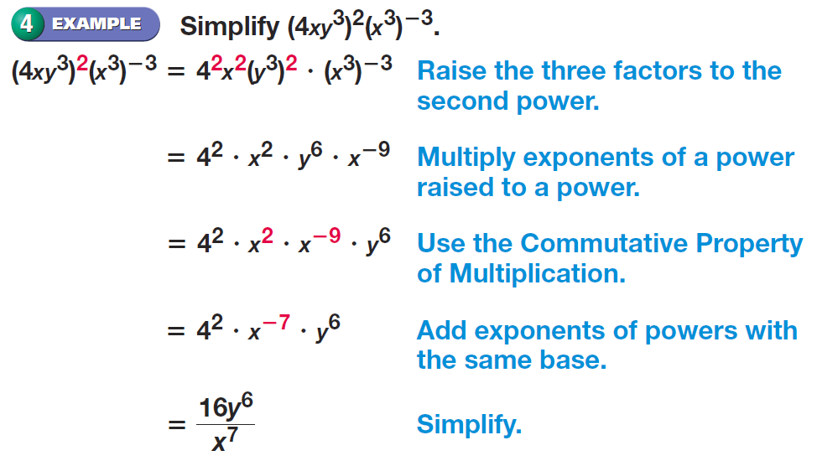
Example

Slide 12
Practice Problems

Slide 13
Practice Problems

Slide 14
Practice Problems

Slide 15
Practice Problems

Slide 16
Practice Problems

Slide 17
Practice Problems

Slide 18
Practice Problems

Slide 19
Practice Problems

Slide 20
Practice Problems

Slide 21
Homework
Pages 407 – 408
8 – 20 even, 32 – 38 even
Page 414
42 – 50 all

