Slide 1
Algebra 1 9-3
Multiplying Binomials

Slide 2
Example
Treat a binomial like a single term and distribute, then distribute again

Slide 3
FOIL

Slide 4
Example

Slide 5
Example

Slide 6
Example

Slide 7
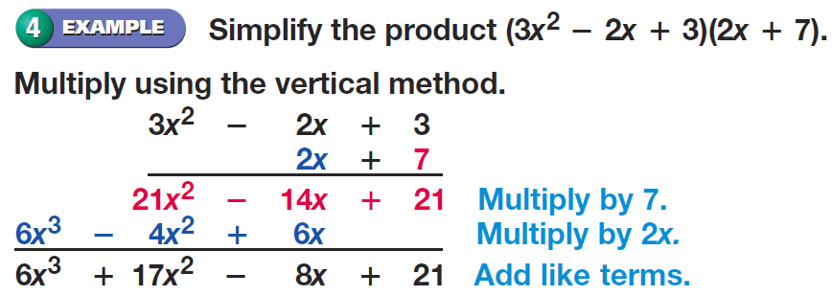
Example

Slide 8
Practice Problems

Slide 9
Practice Problems

Slide 10
Practice Problems

Slide 11
Practice Problems

Slide 12
Practice Problems

Slide 13
Practice Problems

Slide 14
Practice Problems

Slide 15
Practice Problems

Slide 16
Practice Problems

Slide 17
Practice Problems

Slide 18
Practice Problems

Slide 19
Practice Problems

Slide 20
Practice Problems

Slide 21
Practice Problems

Slide 22
Practice Problems

Slide 23
Homework
Page 470 – 471
30 – 38 all, 42, 51

