Slide 1
Algebra 1 1-4,5,6,7
Adding and Subtracting Rational Numbers
Multiplying and Dividing Rational Numbers
Distributive Property

Slide 2
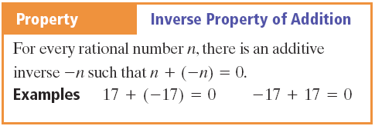
Properties

Slide 3
Vocabulary
Additive Inverse – The opposite of a number

Slide 4
Additional Rules

Slide 5
Addition - Example

Slide 6
Addition - Practice

Slide 7
Addition in Equations - Practice

Slide 8
Subtraction - Rule
Subtraction is really just adding a negative

Slide 9
Subtraction - Practice

Slide 10
Subtraction – Absolute Value

Slide 11
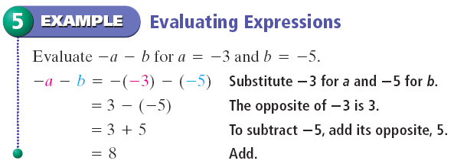
Subtraction - Example

Slide 12
Subtraction - Practice

Slide 13
Multiplying And Dividing Rational Numbers

Slide 14
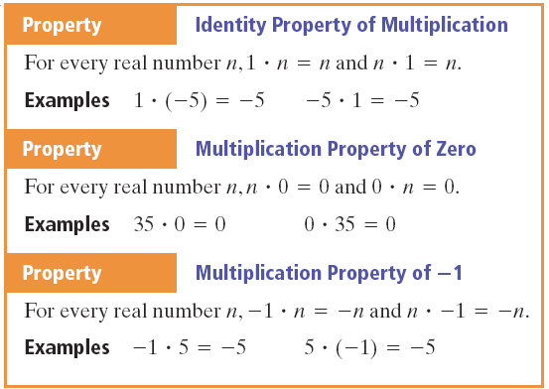
Multiplying

Slide 15
Multiplying

Slide 16
Multiplying - Example

Slide 17
Multiplying - Practice

Slide 18
Evaluating Expressions - Example

Slide 19
Evaluating Expressions - Practice

Slide 20
Exponent - Example

Slide 21
Exponent - Practice

Slide 22
Division - Rules

Slide 23
Division - Practice

Slide 24
Division - Practice

Slide 25
Evaluate Expressions - Example

Slide 26
Evaluate Expressions - Practice

Slide 27
Property

Slide 28
Reciprocal - Example

Slide 29
Reciprocal - Practice

Slide 30
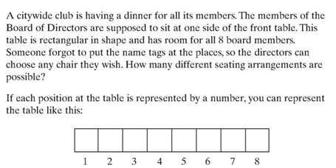
Activity
5 minutes – work with a partner to find an answer

Slide 31
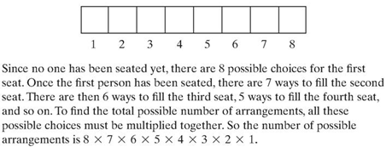
Activity
With a calculator is there a faster way to compute this

Slide 32
Activity
1! = 1
4! = 24
8! = 40,320

Slide 33
Distributive Property

Slide 34
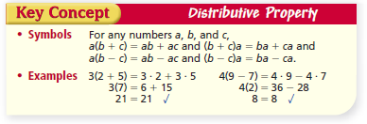
Distributive Property

Slide 35
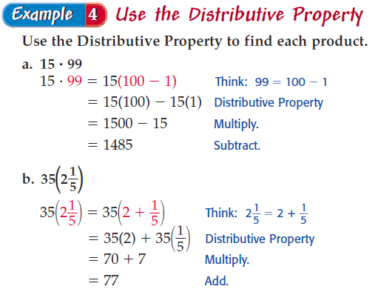
Distributive Property - Example

Slide 36
Distributive Property - Practice

Slide 37
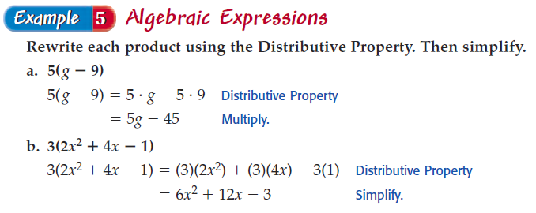
Distributive Property - Example

Slide 38
Distributive Property - Practice

Slide 39
Simplifying an Expression - Example

Slide 40
Simplifying an Expression- Practice

Slide 41
Distributive Property of -1

Slide 42
Distributive Property of -1

Slide 43
Vocabulary
Term – A number or a variable or the product of one or more products or variables

Slide 44
Like Terms
Like Terms – Terms with exactly the same variable factors

Slide 45
Like Terms
Which of the following are like terms?
3x² 4xy 19z 8xy ½ x² 23z² 42xz²
3x² 4xy 19z 8xy ½ x² 23z² 42xz²

Slide 46
Like Terms - Example

Slide 47
Like Terms - Practice

Slide 48
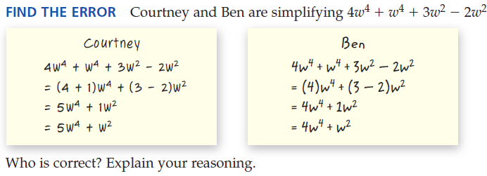
Find the Error

Slide 49
Homework
Page 35
38 – 48 even
Page 42
58 – 68 even
Page 51
74 – 84 even

