Slide 1
Algebra 1 9-1
Adding and Subtracting Polynomials

Slide 2
Monomials Review
A monomial is a number, a variable, or a product of a number and one or more variables. An expression involving the division of variables is NOT a monomial. Monomials that are real numbers are called constants.

Slide 3
Polynomial Vocabulary
Binomial – sum or difference of two monomials
Trinomial – sum or difference of three or more monomials
Monomial Degree – Sum of exponents
Polynomial degree – Greatest monomial degree in expression

Slide 4
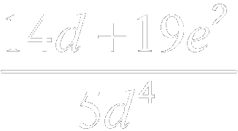
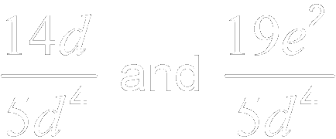
Example
State whether each expression is a polynomial. If it is a polynomial, identify it as a monomial, binomial, or trinomial.
Expression
Polynomial?
Monomial, Binomial, or Trinomial
Yes, is the difference of two real numbers.
binomial
a.
Yes, is the sum and difference of three monomials.
trinomial
b.
No. are not monomials.
none of these
c.
Yes, has one term.
monomial
d.

Slide 5
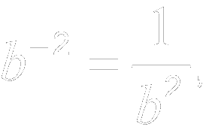
Practice
State whether each expression is a polynomial. If it is a polynomial, identify it as a monomial, binomial, or trinomial.
Expression
Polynomial?
Monomial, Binomial, or Trinomial
Yes, is the sum of three monomials.
trinomial
a.
No. which is not a monomial.
none of these
b.
Yes, The expression is the sum of two monomials.
binomial
c.
d.
Yes, has one term.
monomial

Slide 6
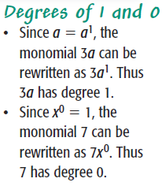
Convention
Polynomials are typically written in descending order of degrees.

Slide 7
Example

Slide 8
Example

Slide 9
Adding Like Terms - Review
3x + 4 – 2x +x – 6 = 6
3x + 4 – 2x +x – 6 = 6
2x = 8
X = 4

Slide 10
Adding Like Terms - Polynomials
All variables must have the same exponent.

Slide 11
Practice
Which of the following are like terms?
x² 3x
3 2x
¼ x 180x
-xy² +x²y
13y -y
⅞ -529
No, different exponents
No, different exponents
Yes
No, different exponents
Yes
Yes

Slide 12
Example

Slide 13
Example

Slide 14
Example

Slide 15
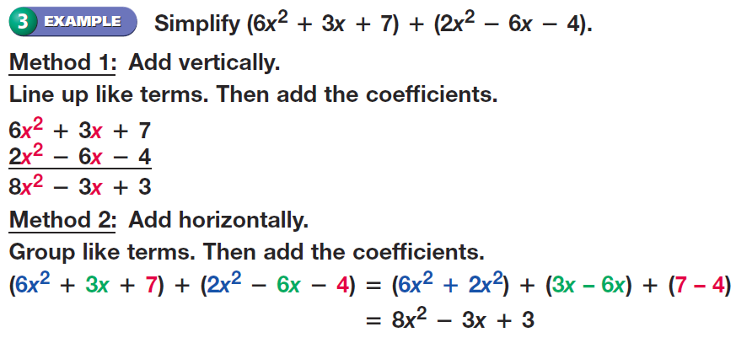
Example

Slide 16
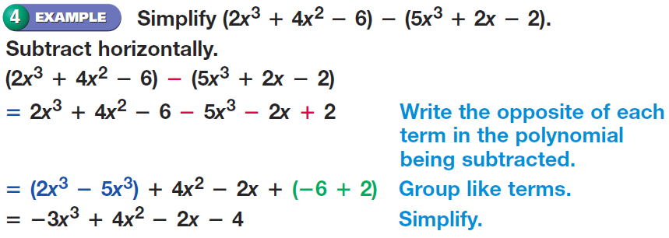
Example

Slide 17
Find the error

Slide 18
Practice Problems

Slide 19
Practice Problems

Slide 20
Practice Problems

Slide 21
Practice Problems

Slide 22
Practice Problems

Slide 23
Practice Problems

Slide 24
Practice Problems

Slide 25
Practice Problems

Slide 26
Homework
Pages 459 – 460
35 – 39 all, 41, 43 – 48 all, 53
Write out question first, then answer

