Slide 1
ECA Review
Quadratics

Slide 2
Concepts

Slide 3
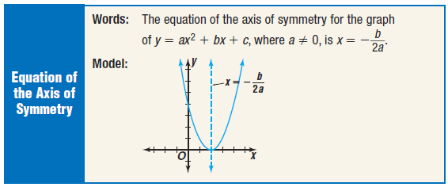
Concepts

Slide 4
Concepts

Slide 5
Concepts
Solving
First move all terms to one side of the equal sign
“set the equation equal to zero”
Try to factor, for a quick answer
Use the Quadratic Formula if you cannot factor

Slide 6
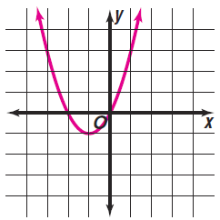
Review
Graph each quadratic equation

Slide 7
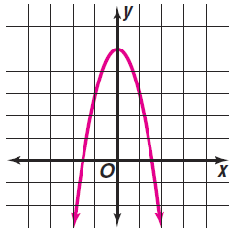
Review
Graph each quadratic equation

Slide 8
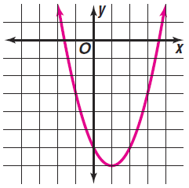
Review
Graph each quadratic equation

Slide 9
Review
Graph each quadratic equation

Slide 10
Review
Solve the equation.

Slide 11
Review
Solve the equation.

Slide 12
Review
Solve the equation.

Slide 13
Review
Solve the equation.

Slide 14
Review
Solve the equation.

Slide 15
Review
Solve the equation.

Slide 16
Review
Solve the equation.

Slide 17
Review
Solve the equation.

Slide 18
Review
Solve the equation.

Slide 19
Review
Solve the equation.

