Slide 1
Algebra 1 4-1
Ratio and Proportion

Slide 2
Proportion
Ratio – A comparison of two numbers by division
Proportion – Statement showing two ratios as equal

Slide 3
Example

Slide 4
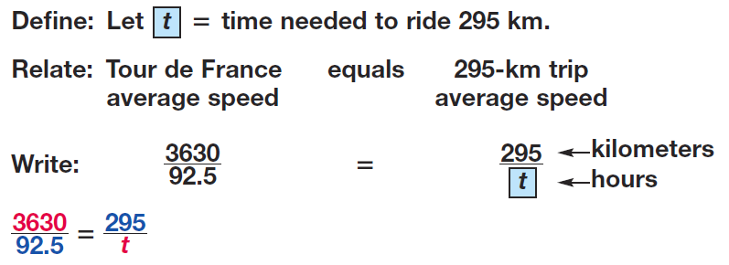
Example

Slide 5
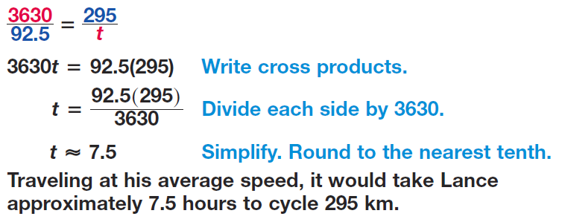
Example

Slide 6
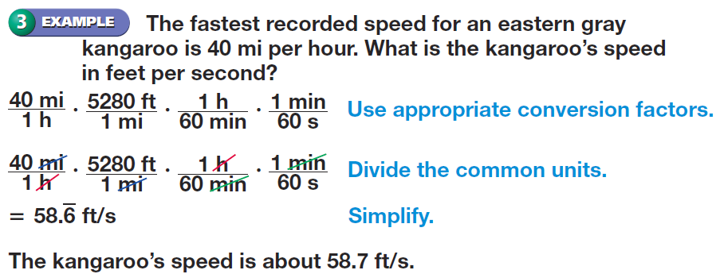
Example

Slide 7
Proportion

Slide 8
Proportion
All of these are proportions because the cross products are equal

Slide 9
Proportion

Slide 10
Example

Slide 11
Example

Slide 12
Example

Slide 13
Example

Slide 14
Example

Slide 15
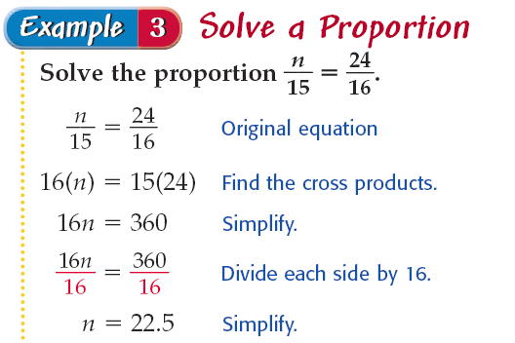
Example

Slide 16
Example

Slide 17
Example

Slide 18
Example

Slide 19
Practice Problems
Solve each proportion.

Slide 20
Practice Problems
Solve each proportion.

Slide 21
Practice Problems
Solve each proportion.

Slide 22
Practice Problems

Slide 23
Practice Problems

Slide 24
Practice Problems

Slide 25
Homework
Page 186 – 187
38 – 60 even, 62 – 64, 71, 74

