Slide 1
Algebra 1 11-2
The Pythagorean Theorem

Slide 2
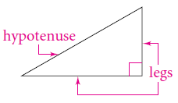
Vocabulary
Right Triangle – A Triangle with one 90° angle
Hypotenuse – The longest side of a right triangle (opposite the 90° angle)
Legs – The two sides of a right triangle adjacent to the 90° angle

Slide 3
Theorems

Slide 4
Example

Slide 5
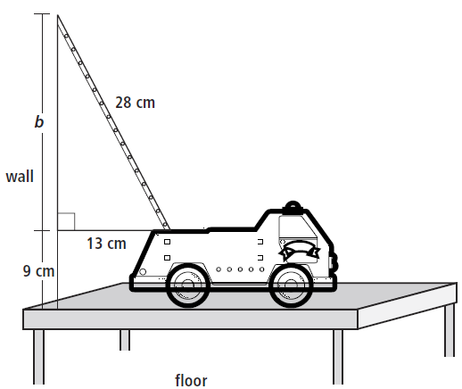
Example

Slide 6
Example

Slide 7
Example

Slide 8
Example

Slide 9
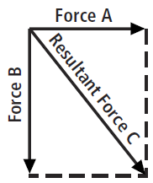
Example

Slide 10
Review Problems

Slide 11
Review Problems

Slide 12
Review Problems

Slide 13
Review Problems

Slide 14
Review Problems

Slide 15
Review Problems

Slide 16
Review Problems

Slide 17
Review Problems

Slide 18
Homework
Pages 587 – 589
26, 27, 29, 30, 34, 36, 38 – 41, 54, 68, 70

