Slide 1
Algebra 1 6-3
Standard Form

Slide 2
Standard Form
The x intercept occurs when y is zero
The y intercept occurs when x is zero

Slide 3
Standard Form

Slide 4
Standard Form

Slide 5
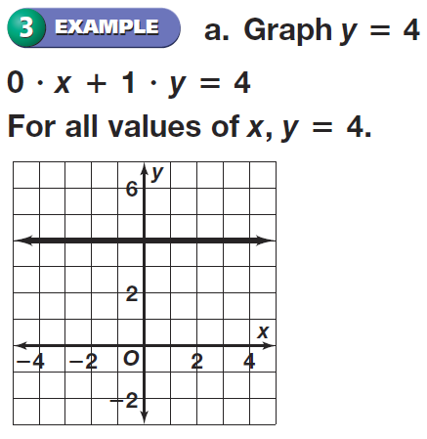
Standard Form

Slide 6
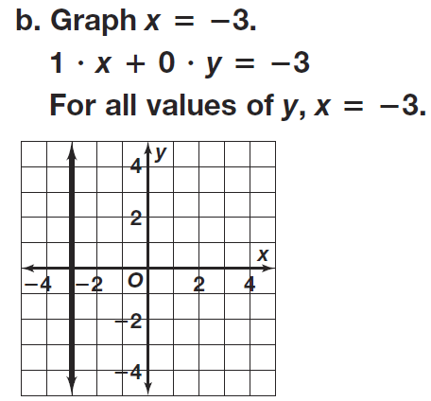
Standard Form

Slide 7
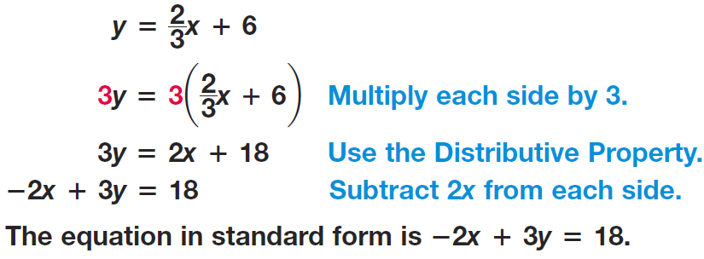
Standard Form

Slide 8
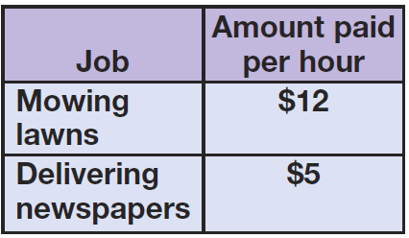
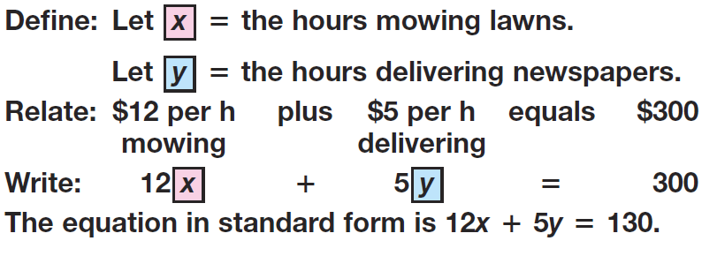
Standard Form

Slide 9
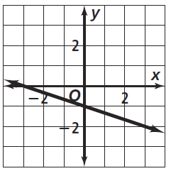
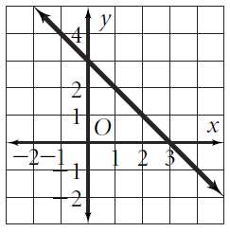
Practice

Slide 10
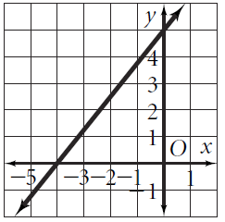
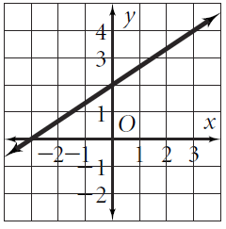
Practice

Slide 11
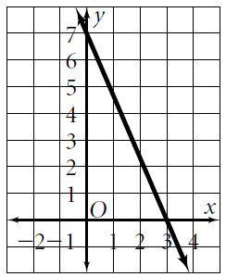
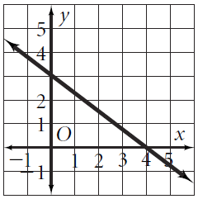
Practice

Slide 12
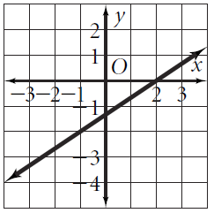
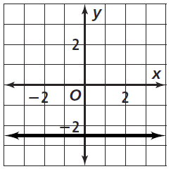
Practice

Slide 13
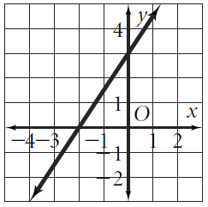
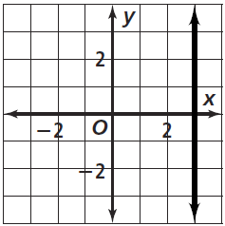
Practice

Slide 14
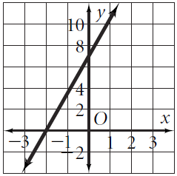
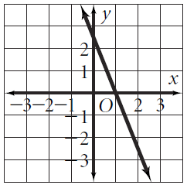
Practice

Slide 15
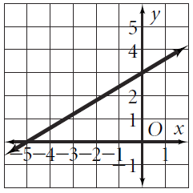
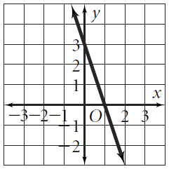
Practice

Slide 16
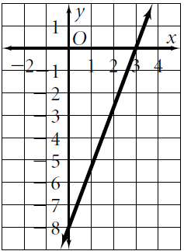
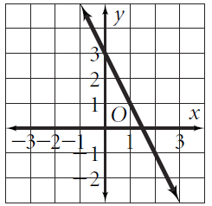
Practice

Slide 17
Practice

Slide 18
Practice

Slide 19
Practice

Slide 20
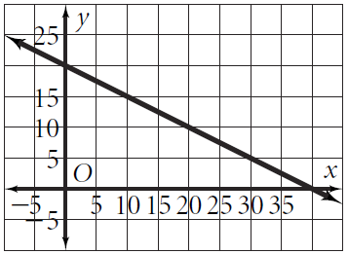
Practice

Slide 21
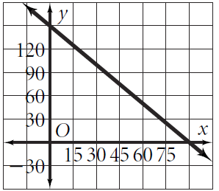
Practice

Slide 22
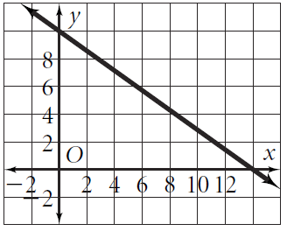
Practice

Slide 23
Activity

Slide 24
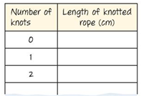
Activity
Copy the following chart into your notes with room for seven rows.

Slide 25
Practice
What your group will do
Measure the length of a piece of rope (cm)
Tie knots one at a time up to 7 knots
Re-measure the length of the rope
Graph the results (x-axis = # of knots)
Repeat for a second “rope”

Slide 26
Practice
Data Analysis – Write answers to these questions
What is the y-intercept for your data?
What is the y-intercept in words?
The rate that the rope changes is what value on the graph?
Predict, from the graph, how long each rope would be with 12 knots.
What is the meaning of the place where the data crosses the x-axis?

Slide 27
Homework
Pages 301 – 302
19 – 26, 28 – 46 even, 58 – 61

