Slide 1
PreCalculus 5-R
Unit 5 – Exponential and Logarithmic Functions

Slide 2
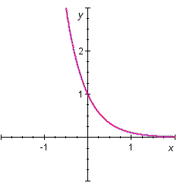
Review Problems
Graph the function
State the domain, range, and asymptote.
Domain
Range
Asymptote
1

Slide 3
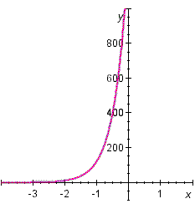
Review Problems
Graph the function
State the domain, range, and asymptote.
Domain
Range
Asymptote
2

Slide 4
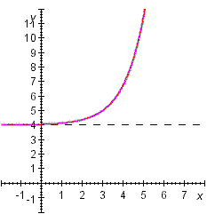
Review Problems
State the domain, range, and asymptote.
Graph the function
Domain
Range
Asymptote
3

Slide 5
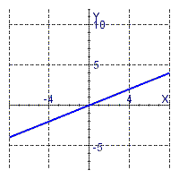
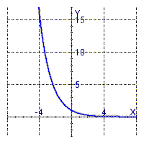
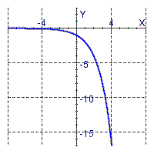
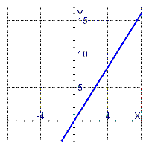
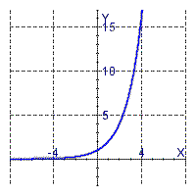
Review Problems
Identify the graph of the function
4

Slide 6
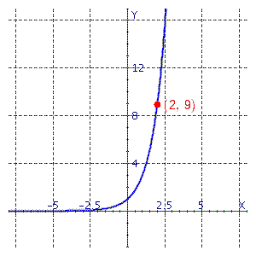
Review Problems
Find the exponential function
whose graph is given
5

Slide 7
Review Problems
State the domain of the function
6

Slide 8
Review Problems
State the range of the function
7

Slide 9
Review Problems
State the asymptote of the function
y = –9
8

Slide 10
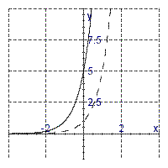
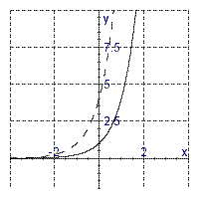
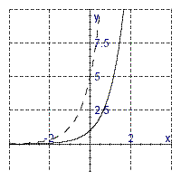
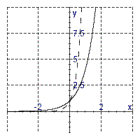
Review Problems
Select the graphs of (solid)
and ( dashed).
9

Slide 11
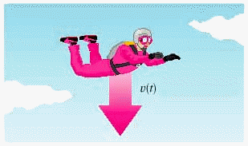
Review Problems
A sky diver jumps from a reasonable height above the ground (see the figure below). The air resistance she experiences is proportional to her velocity and the constant of proportionality is 0.4. It can be shown that the downward velocity of the sky diver at time t is given by
where t is measured in seconds and v(t) is measured in feet per second. Find the velocity after 10 s
49 feet per second
10

Slide 12
Review Problems
Express the equation in exponential form
11

Slide 13
Review Problems
Express the equation in exponential form
ln (x + 1) = 4
12

Slide 14
Review Problems
Express the equation in logarithmic form
x = –2 + ln 0.2
13

Slide 15
Review Problems
Evaluate the expression log ₇ 343
3
14

Slide 16
Review Problems
Evaluate the expression
x = 3
15

Slide 17
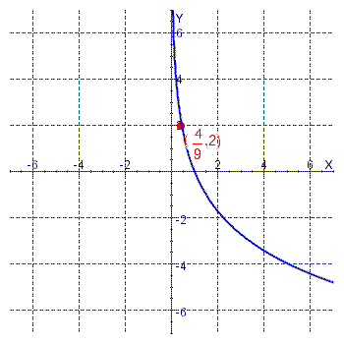
Review Problems
Find the function of the form y = log _{a} x whose graph is given
16

Slide 18
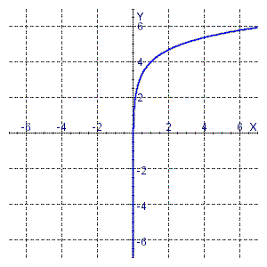
Review Problems
Find the logarithmic function whose graph is given
y = ln (x) + 4
17

Slide 19
Review Problems
Find the domain of the function
18

Slide 20
Review Problems
Find the domain of the function
[5, 11)
19

Slide 21
Review Problems
The age of an ancient artifact can be determined by the amount of radioactive carbon-14 remaining in it. If is the original amount of carbon-14 and D is the amount remaining, then the artifact's age A (in years) is given by
Find the age of an object if the amount D of carbon-14 that remains in the object is 74% of the original amount .
approximately 2500 years
20

Slide 22
Review Problems
Rewrite the expression below in a form with no logarithm of a product, quotient, or power.
log ₄ x + log ₄ (x – 9)
21

Slide 23
Review Problems
Rewrite the expression below in a form with no logarithm of a product, quotient, or power.
log ₉ x – log ₉ 8
22

Slide 24
Review Problems
Rewrite the expression below in a form with no logarithm of a product, quotient, or power.
2 log _{a} x – log _{a} y – 7 log _{a} z
23

Slide 25
Review Problems
Rewrite the expression below in a form with no logarithm of a product, quotient, or power.
24

Slide 26
Review Problems
Rewrite the expression below in a form with no logarithm of a product, quotient, or power.
25

Slide 27
Review Problems
Rewrite the expression below as a single logarithm
26

Slide 28
Review Problems
Rewrite the expression below as a single logarithm
log ₃ 2 + 2 log ₃ 2
log ₃ 8
27

Slide 29
Review Problems
Find the solution of the exponential equation below, correct to four decimal places
x = –0.1616
28

Slide 30
Review Problems
Find the solution of the exponential equation below, correct to four decimal places
x = 7.3535
29

Slide 31
Review Problems
Solve
x = 51.679
30

Slide 32
Review Problems
Solve
x = 1.3863, x = 0
31

Slide 33
Review Problems
Solve
ln x = 5
x = 148.4132
32

Slide 34
Review Problems
Solve
log x = 1
x = 10
33

Slide 35
Review Problems
Solve
log ₃ (4 – x) = 7
x = –2183
34

Slide 36
Review Problems
Solve
log ₂ 2 + log ₂ x = log ₂ 3 + log ₂ (x – 5)
x = 15
35

Slide 37
Review Problems
Solve
log (x + 9) = log x + log 9
x = 1.125
36

Slide 38
Review Problems
Solve
log (x – 2) + log (9 – x) < 1
37

Slide 39
Review Problems
Solve
38

Slide 40
Review Problems
Solve
39

Slide 41
Review Problems
A man invests $5,000 in an account that pays 8% interest per year, compounded quarterly. Find the amount after 5 years
$7,429.74
40

Slide 42
Review Problems
How long will it take for an investment of $1,000 to double in value if the interest rate is 7.5% per year, compounded continuously?
9.24 years
41

Slide 43
Review Problems
A sum of $3,000 was invested for 4 years, and the interest was compounded semiannually. If this sum amounted to $5,000 in the given time, what was the interest rate?
13.19 %
42

Slide 44
Review Problems
13-g sample of radioactive iodine decays in such a way that the mass remaining after t days is given by
where m( t ) is measured in grams. After how many days is there only 10 g remaining?
3 days
43

Slide 45
Review Problems
The fox population in a certain region has a relative growth rate of 5% per year. It is estimated that the population in 2000 was 22,000. Find a function n(t) that models the population t years after 2000.
44

Slide 46
Review Problems
The frog population in a small pond grows exponentially. The current population is 83 frogs, and the relative growth rate is 15% per year. Find the projected population after 6 years.
204 frogs
45

Slide 47
Review Problems
The half-life of cesium-137 is 30 years. Suppose we have a 17-g sample. Find a function that models the mass remaining after t years.
m ( t ) = 17e ^{- 0.023t}
46

Slide 48
Review Problems
If one earthquake is 16 times as intense as another, how much larger is its magnitude on the Richter scale?
1.20 larger on the Richter scale
47

Slide 49
Answers
1
Domain
Range
Asymptote
3
Domain
Range
Asymptote
2
Domain
Range
Asymptote
4

Slide 50
Answers
5
10
49 feet per second
6
11
12
7
13
x = –2 + ln 0.2
8
y = –9
14
3
9
15
x = 3
16

Slide 51
Answers
17
y = ln (x) + 4
24
18
25
19
[5, 11)
26
20
approximately
2500 years
27
log ₃ 8
21
log ₄ x + log ₄ (x – 9)
28
x = –0.1616
22
log ₉ x – log ₉ 8
29
x = 7.3535
23
2 log _{a} x – log _{a} y – 7 log _{a} z
30
x = 51.679

Slide 52
Answers
31
x = 1.3863, x = 0
39
40
$7,429.74
32
x = 148.4132
41
9.24 years
33
x = 10
42
13.19 %
34
x = –2183
43
3 days
35
x = 15
44
36
x = 1.125
45
204 frogs
37
46
m ( t ) = 17e ^{- 0.023t}
38
47
1.20 larger on the Richter scale

