Slide 1
Statistics 20
Testing Hypothesis and Proportions

Slide 2
Hypotheses
Hypotheses are working models that we adopt temporarily.
Our starting hypothesis is called the null hypothesis.
The null hypothesis, that we denote by H₀, specifies a population model parameter of interest and proposes a value for that parameter.
We usually write down the null hypothesis in the form H₀: parameter = hypothesized value.
The alternative hypothesis, which we denote by H_{A}, contains the values of the parameter that we consider plausible if we reject the null hypothesis.

Slide 3
Hypotheses
The null hypothesis, specifies a population model parameter of interest and proposes a value for that parameter.
We might have, for example, H₀: p = 0.20, as in the chapter example.
We want to compare our data to what we would expect given that H₀ is true.
We can do this by finding out how many standard deviations away from the proposed value we are.
We then ask how likely it is to get results like we did if the null hypothesis were true.

Slide 4
Hypothesis

Slide 5
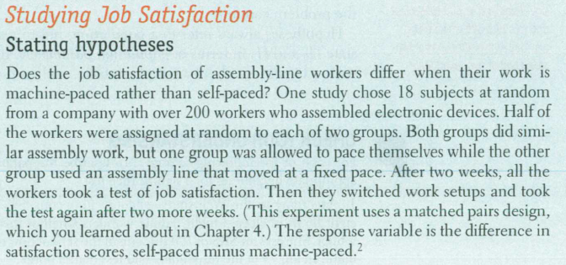
Example

Slide 6
Example

Slide 7
Example

Slide 8
A Trial as a Hypothesis Test
Think about the logic of jury trials:
To prove someone is guilty, we start by assuming they are innocent.
We retain that hypothesis until the facts make it unlikely beyond a reasonable doubt.
Then, and only then, we reject the hypothesis of innocence and declare the person guilty.

Slide 9
A Trial as a Hypothesis Test
The same logic used in jury trials is used in statistical tests of hypotheses:
We begin by assuming that a hypothesis is true.
Next we consider whether the data are consistent with the hypothesis.
If they are, all we can do is retain the hypothesis we started with. If they are not, then like a jury, we ask whether they are unlikely beyond a reasonable doubt.

Slide 10
P-Values
The statistical twist is that we can quantify our level of doubt.
We can use the model proposed by our hypothesis to calculate the probability that the event we’ve witnessed could happen.
That’s just the probability we’re looking for—it quantifies exactly how surprised we are to see our results.
This probability is called a P-value.

Slide 11
P-Values
When the data are consistent with the model from the null hypothesis, the P-value is high and we are unable to reject the null hypothesis.
In that case, we have to “retain” the null hypothesis we started with.
We can’t claim to have proved it; instead we “fail to reject the null hypothesis” when the data are consistent with the null hypothesis model and in line with what we would expect from natural sampling variability.
If the P-value is low enough, we’ll “reject the null hypothesis,” since what we observed would be very unlikely were the null model true.

Slide 12
P-Values

Slide 13
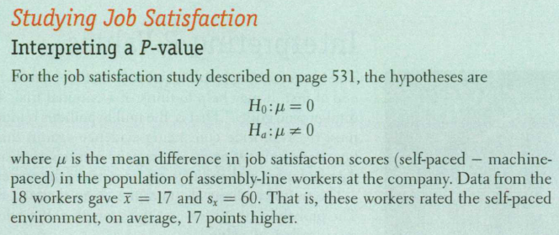
Example

Slide 14
Example

Slide 15
Example

Slide 16
Example

Slide 17
What to Do with an “Innocent” Defendant
If the evidence is not strong enough to reject the presumption of innocent, the jury returns with a verdict of “not guilty.”
The jury does not say that the defendant is innocent.
All it says is that there is not enough evidence to convict, to reject innocence.
The defendant may, in fact, be innocent, but the jury has no way to be sure.

Slide 18
What to Do with an “Innocent” Defendant
Said statistically, we will fail to reject the null hypothesis.
We never declare the null hypothesis to be true, because we simply do not know whether it’s true or not.
Sometimes in this case we say that the null hypothesis has been retained.

Slide 19
What to Do with an “Innocent” Defendant
In a trial, the burden of proof is on the prosecution.
In a hypothesis test, the burden of proof is on the unusual claim.
The null hypothesis is the ordinary state of affairs, so it’s the alternative to the null hypothesis that we consider unusual (and for which we must marshal evidence).

Slide 20
The Reasoning of Hypothesis Testing
There are four basic parts to a hypothesis test:
Hypotheses
Model
Mechanics
Conclusion
Let’s look at these parts in detail…

Slide 21
The Reasoning of Hypothesis Testing
Hypotheses
The null hypothesis: To perform a hypothesis test, we must first translate our question of interest into a statement about model parameters.
In general, we have
H₀: parameter = hypothesized value.
The alternative hypothesis: The alternative hypothesis, H_{A}, contains the values of the parameter we consider plausible when we reject the null.

Slide 22
The Reasoning of Hypothesis Testing
Model
To plan a statistical hypothesis test, specify the model you will use to test the null hypothesis and the parameter of interest.
All models require assumptions, so state the assumptions and check any corresponding conditions.
Your model step should end with a statement such
Because the conditions are satisfied, I can model the sampling distribution of the proportion with a Normal model.
Watch out, though. It might be the case that your model step ends with “Because the conditions are not satisfied, I can’t proceed with the test.” If that’s the case, stop and reconsider.

Slide 23
The Reasoning of Hypothesis Testing
Model
Each test we discuss in the book has a name that you should include in your report.
The test about proportions is called a one-proportion z-test.

Slide 24
One-Proportion z-Test
The conditions for the one-proportion z-test are the same as for the one proportion z-interval. We test the hypothesis H₀: p = p₀
using the statistic
where
When the conditions are met and the null hypothesis is true, this statistic follows the standard Normal model, so we can use that model to obtain a P-value.

Slide 25
The Reasoning of Hypothesis Testing
Mechanics
Under “mechanics” we place the actual calculation of our test statistic from the data.
Different tests will have different formulas and different test statistics.
Usually, the mechanics are handled by a statistics program or calculator, but it’s good to know the formulas.

Slide 26
The Reasoning of Hypothesis Testing
Mechanics
The ultimate goal of the calculation is to obtain a P-value.
The P-value is the probability that the observed statistic value (or an even more extreme value) could occur if the null model were correct.
If the P-value is small enough, we’ll reject the null hypothesis.
Note: The P-value is a conditional probability—it’s the probability that the observed results could have happened if the null hypothesis is true.

Slide 27
The Reasoning of Hypothesis Testing
Conclusion
The conclusion in a hypothesis test is always a statement about the null hypothesis.
The conclusion must state either that we reject or that we fail to reject the null hypothesis.
And, as always, the conclusion should be stated in context.

Slide 28
The Reasoning of Hypothesis Testing
Conclusion
Your conclusion about the null hypothesis should never be the end of a testing procedure.
Often there are actions to take or policies to change.

Slide 29
Two-Sided vs One-Sided

Slide 30
Alternative Alternatives
There are three possible alternative hypotheses:
H_{A}: parameter < hypothesized value
H_{A}: parameter ≠ hypothesized value
H_{A}: parameter > hypothesized value

Slide 31
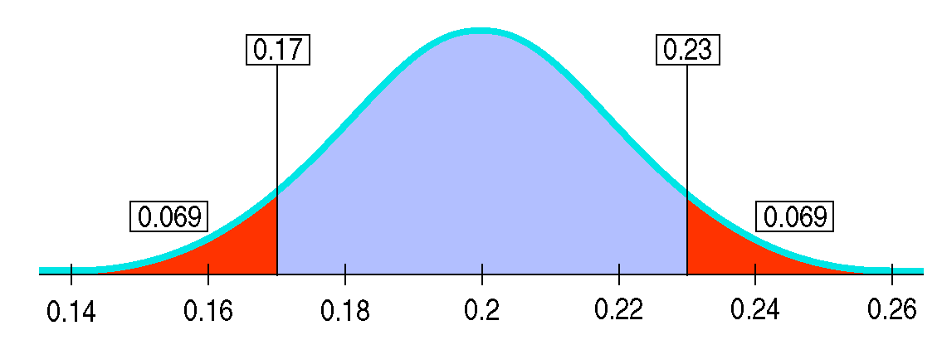
Alternative Alternatives
H_{A}: parameter ≠ value is known as a two-sided alternative because we are equally interested in deviations on either side of the null hypothesis value.
For two-sided alternatives, the P-value is the probability of deviating in either direction from the null hypothesis value.

Slide 32
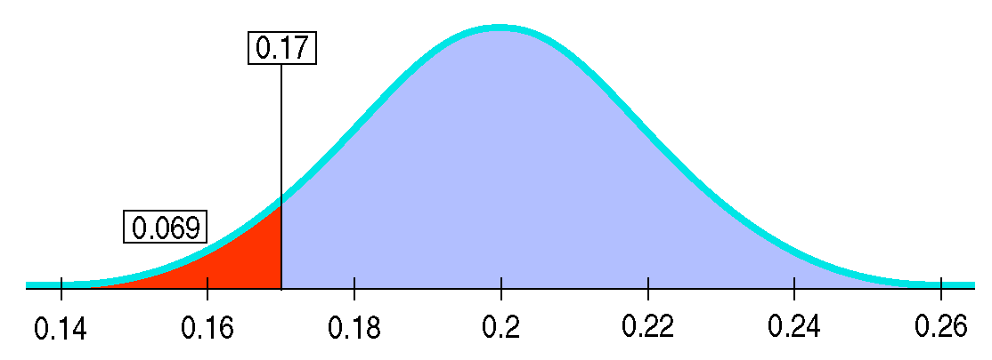
Alternative Alternatives
The other two alternative hypotheses are called one-sided alternatives.
A one-sided alternative focuses on deviations from the null hypothesis value in only one direction.
Thus, the P-value for one-sided alternatives is the probability of deviating only in the direction of the alternative away from the null hypothesis value.

Slide 33
P-Values and Decisions: What to Tell About a Hypothesis Test
How small should the P-value be in order for you to reject the null hypothesis?
It turns out that our decision criterion is context-dependent.
When we’re screening for a disease and want to be sure we treat all those who are sick, we may be willing to reject the null hypothesis of no disease with a fairly large P-value (0.10).
A longstanding hypothesis, believed by many to be true, needs stronger evidence (and a correspondingly small P-value) to reject it.
Another factor in choosing a P-value is the importance of the issue being tested.

Slide 34
P-Values and Decisions
Your conclusion about any null hypothesis should be accompanied by the P-value of the test.
If possible, it should also include a confidence interval for the parameter of interest.
Don’t just declare the null hypothesis rejected or not rejected.
Report the P-value to show the strength of the evidence against the hypothesis.
This will let each reader decide whether or not to reject the null hypothesis.

Slide 35
Example
A 1996 report from the U.S. Consumer Product Safety Commission claimed that at least 90% of all American homes have at least one smoke detector. A city’s fire department has been running a public safety campaign about smoke detectors consisting of posters, billboards, and ads on radio and TV and in the newspaper. The city wonders if this concerted effort has raised the local level above the 90% national rate. Building inspectors visit 400 randomly selected homes and find that 376 have smoke detectors. Is this strong evidence that the local rate is higher than the national rate?

Slide 36
Example
A 1996 report from the U.S. Consumer Product Safety Commission claimed that at least 90% of all American homes have at least one smoke detector. A city’s fire department has been running a public safety campaign about smoke detectors consisting of posters, billboards, and ads on radio and TV and in the newspaper. The city wonders if this concerted effort has raised the local level above the 90% national rate. Building inspectors visit 400 randomly selected homes and find that 376 have smoke detectors. Is this strong evidence that the local rate is higher than the national rate?

Slide 37
Example
A 1996 report from the U.S. Consumer Product Safety Commission claimed that at least 90% of all American homes have at least one smoke detector. A city’s fire department has been running a public safety campaign about smoke detectors consisting of posters, billboards, and ads on radio and TV and in the newspaper. The city wonders if this concerted effort has raised the local level above the 90% national rate. Building inspectors visit 400 randomly selected homes and find that 376 have smoke detectors. Is this strong evidence that the local rate is higher than the national rate?

Slide 38
Example
A 1996 report from the U.S. Consumer Product Safety Commission claimed that at least 90% of all American homes have at least one smoke detector. A city’s fire department has been running a public safety campaign about smoke detectors consisting of posters, billboards, and ads on radio and TV and in the newspaper. The city wonders if this concerted effort has raised the local level above the 90% national rate. Building inspectors visit 400 randomly selected homes and find that 376 have smoke detectors. Is this strong evidence that the local rate is higher than the national rate?

Slide 39
Example
A 1996 report from the U.S. Consumer Product Safety Commission claimed that at least 90% of all American homes have at least one smoke detector. A city’s fire department has been running a public safety campaign about smoke detectors consisting of posters, billboards, and ads on radio and TV and in the newspaper. The city wonders if this concerted effort has raised the local level above the 90% national rate. Building inspectors visit 400 randomly selected homes and find that 376 have smoke detectors. Is this strong evidence that the local rate is higher than the national rate?

Slide 40
What Can Go Wrong?
Hypothesis tests are so widely used—and so widely misused—that the issues involved are addressed in their own chapter (Chapter 21).
There are a few issues that we can talk about already, though:

Slide 41
What Can Go Wrong?
Don’t base your null hypothesis on what you see in the data.
Think about the situation you are investigating and develop your null hypothesis appropriately.
Don’t base your alternative hypothesis on the data, either.
Again, you need to Think about the situation.

Slide 42
What Can Go Wrong?
Don’t make your null hypothesis what you want to show to be true.
You can reject the null hypothesis, but you can never “accept” or “prove” the null.
Don’t forget to check the conditions.
We need randomization, independence, and a sample that is large enough to justify the use of the Normal model.

Slide 43
What Can Go Wrong?
Don’t accept the null hypothesis.
If you fail to reject the null hypothesis, don’t think a bigger sample would be more likely to lead to rejection.
Each sample is different, and a larger sample won’t necessarily duplicate your current observations.

Slide 44
What have we learned?
We can use what we see in a random sample to test a particular hypothesis about the world.
Hypothesis testing complements our use of confidence intervals.
Testing a hypothesis involves proposing a model, and seeing whether the data we observe are consistent with that model or so unusual that we must reject it.
We do this by finding a P-value—the probability that data like ours could have occurred if the model is correct.

Slide 45
What have we learned?
We’ve learned:
Start with a null hypothesis.
Alternative hypothesis can be one- or two-sided.
Check assumptions and conditions.
Data are out of line with H₀, small P-value, reject the null hypothesis.
Data are consistent with H₀, large P-value, don’t reject the null hypothesis.
State the conclusion in the context of the original question.

Slide 46
What have we learned?
We know that confidence intervals and hypothesis tests go hand in hand in helping us think about models.
A hypothesis test makes a yes/no decision about the plausibility of a parameter value.
A confidence interval shows us the range of plausible values for the parameter.

Slide 47
Homework
Pgs 469 - 472
1, 3, 5, 6, 10, 12, 21, 24, 25, 29, 32

