Slide 1
Statistics 10
Re-Expressing Data
Get it Straight

Slide 2
Straight to the Point
We cannot use a linear model unless the relationship between the two variables is linear. Often re-expression can save the day, straightening bent relationships so that we can fit and use a simple linear model.
Two simple ways to re-express data are with logarithms and reciprocals.
Re-expressions can be seen in everyday life—everybody does it.

Slide 3
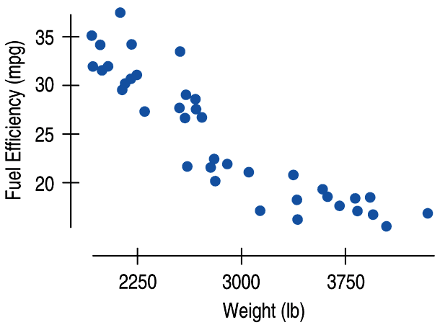
Straight to the Point
The relationship between fuel efficiency (in miles per gallon) and weight (in pounds) for late model cars looks fairly linear at first:

Slide 4
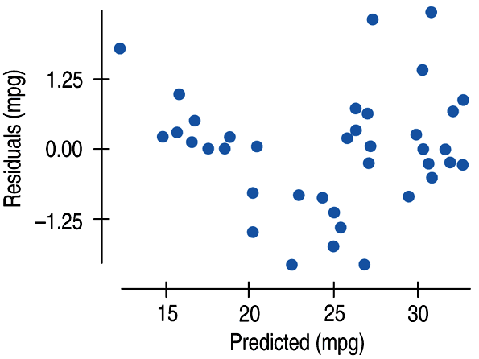
Straight to the Point
A look at the residuals plot shows a problem:

Slide 5
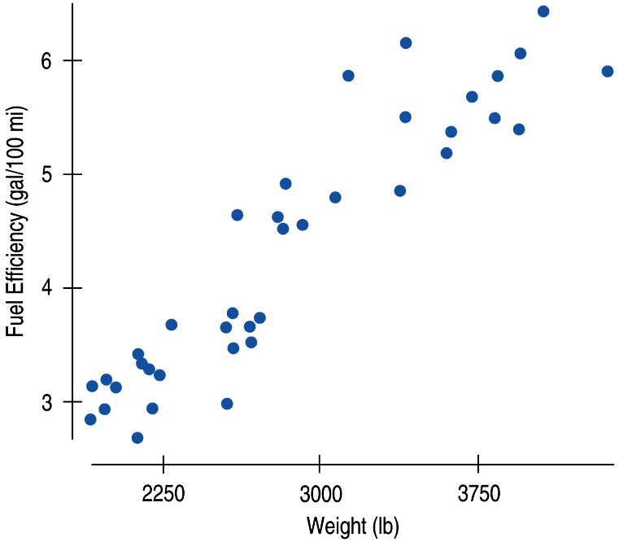
Straight to the Point
We can re-express fuel efficiency as gallons per hundred miles (a reciprocal) and eliminate the bend in the original scatterplot:

Slide 6
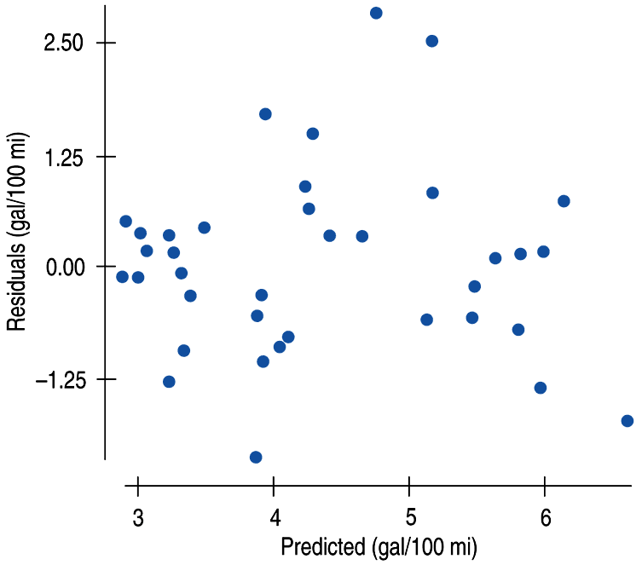
Straight to the Point
A look at the residuals plot for the new model seems more reasonable:

Slide 7
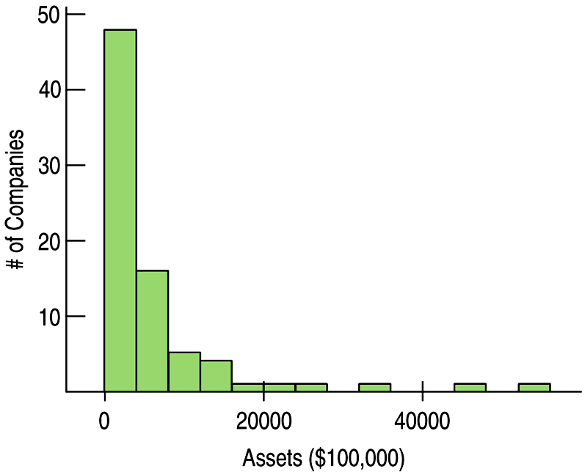
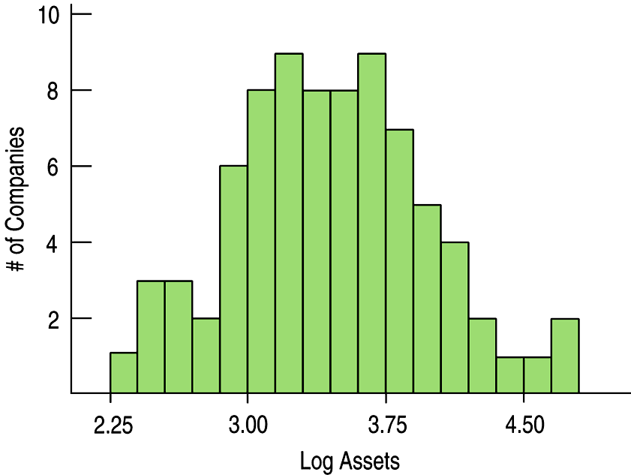
Goals of Re-expression
Goal 1: Make the distribution of a variable (as seen in its histogram, for example) more symmetric.

Slide 8
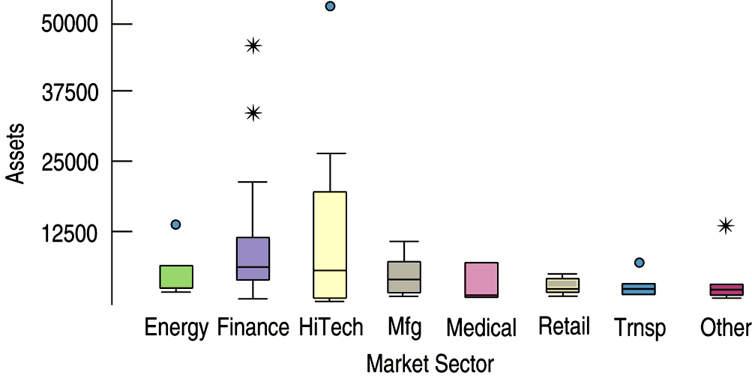
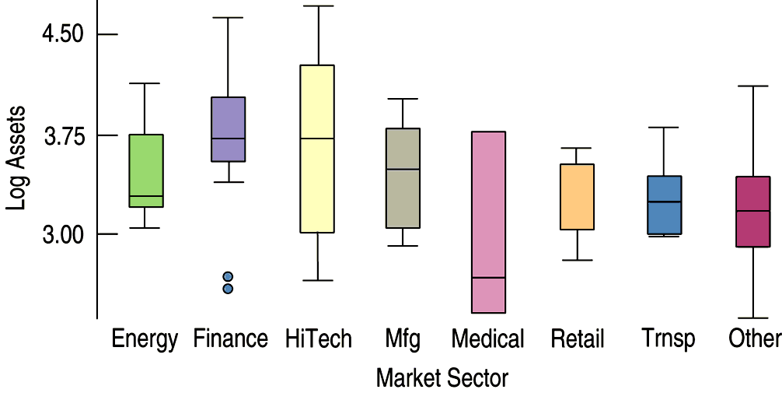
Goals of Re-expression
Goal 2: Make the spread of several groups (as seen in side-by-side boxplots) more alike, even if their centers differ.

Slide 9
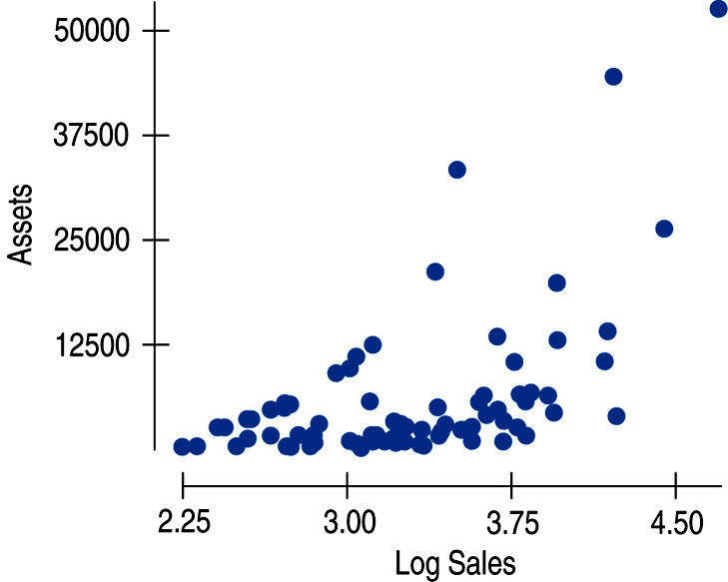
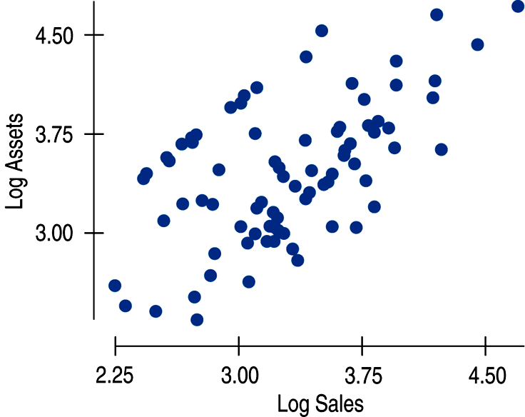
Goals of Re-expression
Goal 3: Make the form of a scatterplot more nearly linear.

Slide 10
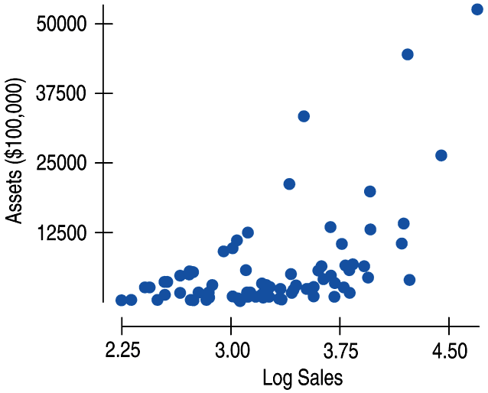
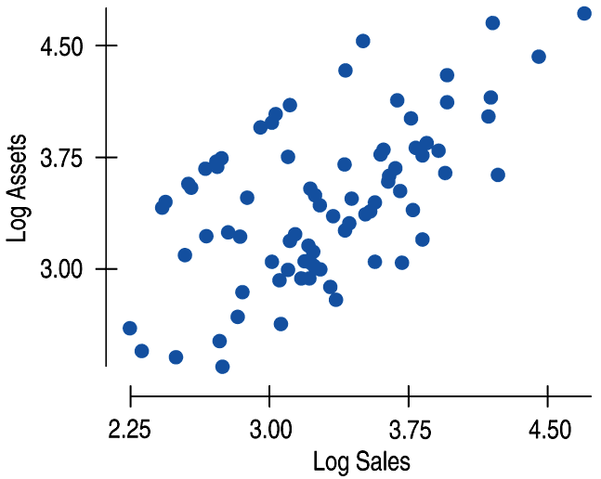
Goals of Re-expression
Goal 4: Make the scatter in a scatterplot spread out evenly rather than thickening at one end.
This can be seen in the two scatterplots we just saw with Goal 3:

Slide 11
The Ladder of Powers
There is a family of simple re-expressions that move data toward our goals in a consistent way. This collection of re-expressions is called the Ladder of Powers.
The Ladder of Powers orders the effects that the re-expressions have on data.

Slide 12
The Ladder of Powers
Power
Name
Comment
2
Square of data values
Try with unimodal distributions that are skewed to the left.
1
Raw data
Data with positive and negative values and no bounds are less likely to benefit from re-expression.
½
Square root of data values
Counts often benefit from a square root re-expression.
“0”
We’ll use logarithms here
Measurements that cannot be negative often benefit from a log re-expression.
–1/2
Reciprocal square root
An uncommon re-expression, but sometimes useful.
–1
The reciprocal of the data
Ratios of two quantities (e.g., mph) often benefit from a reciprocal.

Slide 13
Plan B: Attack of the Logarithms
When none of the data values is zero or negative, logarithms can be a helpful ally in the search for a useful model.
Try taking the logs of both the x- and y-variable.
Then re-express the data using some combination of x or log(x) vs. y or log(y).

Slide 14
Plan B: Attack of the Logarithms

Slide 15
Multiple Benefits
We often choose a re-expression for one reason and then discover that it has helped other aspects of an analysis.
For example, a re-expression that makes a histogram more symmetric might also straighten a scatterplot or stabilize variance.

Slide 16
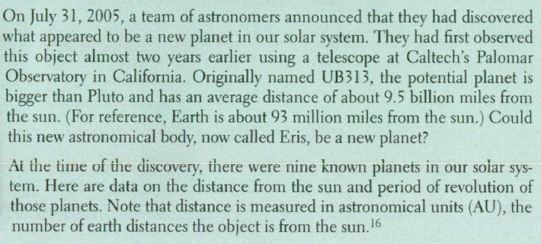
Calculator
Transforming data on a calculator

Slide 17
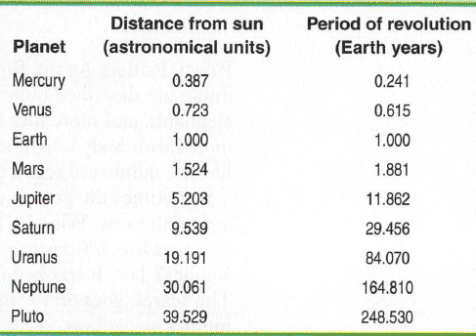
Calculator
Transforming data on a calculator
Enter this data in your calculator

Slide 18
Calculator
Transforming data on a calculator

Slide 19
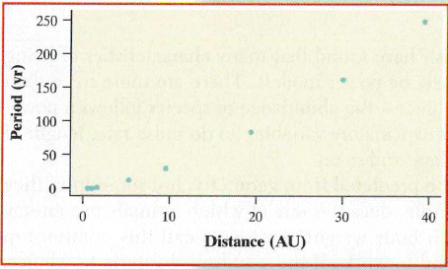
Calculator
Transforming data on a calculator

Slide 20
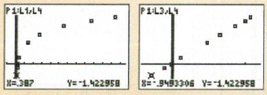
Calculator
Transforming data on a calculator

Slide 21
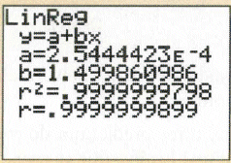
Calculator
Transforming data on a calculator

Slide 22
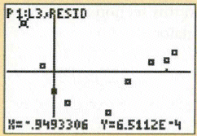
Calculator
Transforming data on a calculator

Slide 23
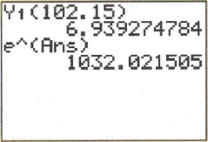
Calculator
Transforming data on a calculator

Slide 24
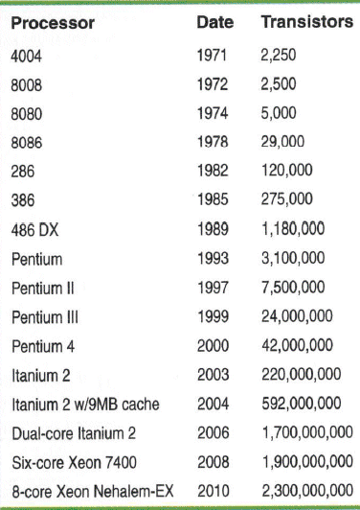
Example
Moore’s Law

Slide 25
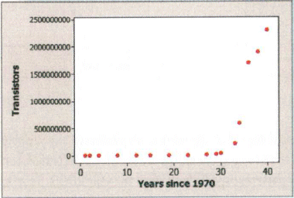
Example
Moore’s Law
Try to straighten this data, and find an appropriate model

Slide 26
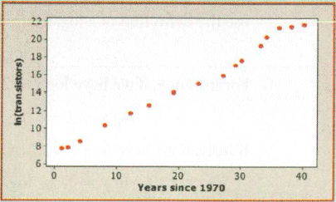
Example
Moore’s Law

Slide 27
Example
Moore’s Law
What is the model?

Slide 28
Example
Moore’s Law
Use the model to predict the number of transistors in the year 2020

Slide 29
Example
Moore’s Law

Slide 30
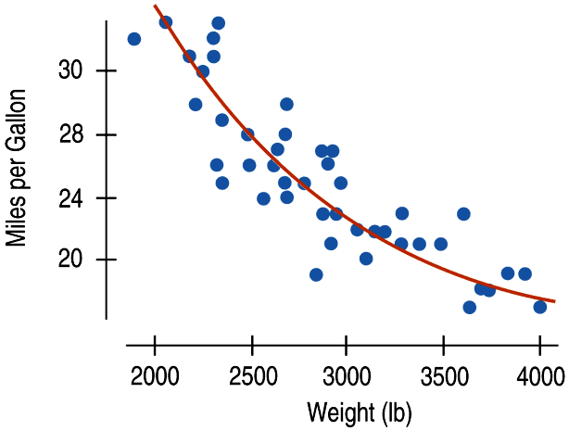
Why Not Just Use a Curve?
If there’s a curve in the scatterplot, why not just fit a curve to the data?

Slide 31
Why Not Just Use a Curve?
The mathematics and calculations for “curves of best fit” are considerably more difficult than “lines of best fit.”
Besides, straight lines are easy to understand.
We know how to think about the slope and the y-intercept.

Slide 32
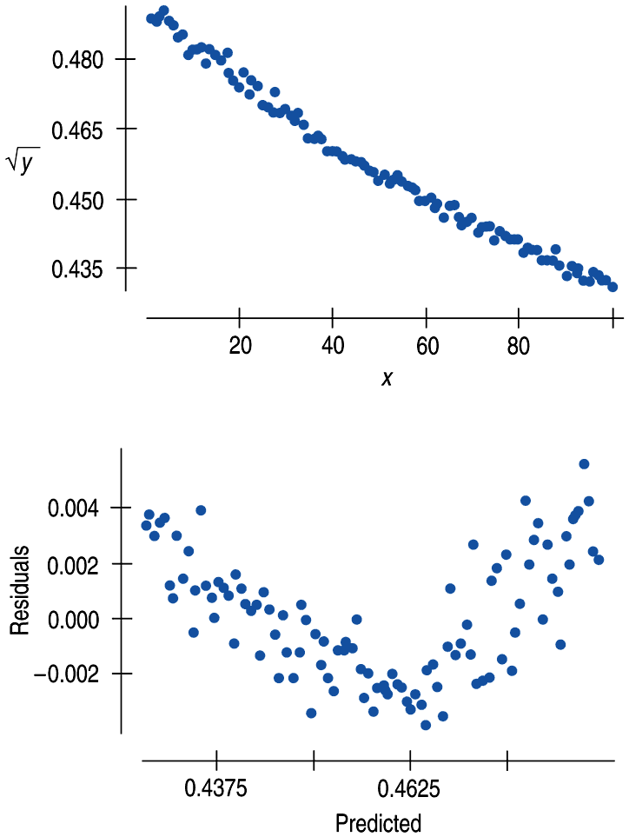
What Can Go Wrong?
Don’t expect your model to be perfect.
Don’t stray too far from the ladder.
Don’t choose a model based on R² alone:

Slide 33
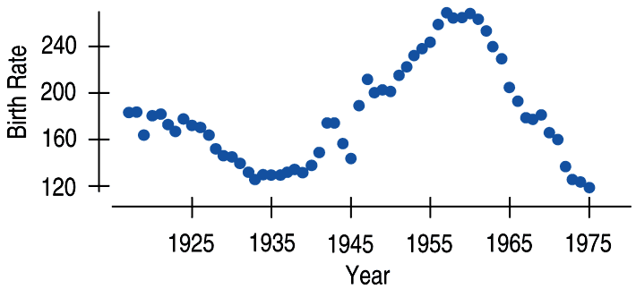
What Can Go Wrong?
Beware of multiple modes.
Re-expression cannot pull separate modes together.
Watch out for scatterplots that turn around.
Re-expression can straighten many bent relationships, but not those that go up then down, or down then up.

Slide 34
What Can Go Wrong?
Watch out for negative data values.
It’s impossible to re-express negative values by any power that is not a whole number on the Ladder of Powers or to re-express values that are zero for negative powers.
Watch for data far from 1.
Data values that are all very far from 1 may not be much affected by re-expression unless the range is very large. If all the data values are large (e.g., years), consider subtracting a constant to bring them back near 1.

Slide 35
What have we learned?
When the conditions for regression are not met, a simple re-expression of the data may help.
A re-expression may make the:
Distribution of a variable more symmetric.
Spread across different groups more similar.
Form of a scatterplot straighter.
Scatter around the line in a scatterplot more consistent.

Slide 36
What have we learned?
Taking logs is often a good, simple starting point.
To search further, the Ladder of Powers or the log-log approach can help us find a good re-expression.
Our models won’t be perfect, but re-expression can lead us to a useful model.

Slide 37
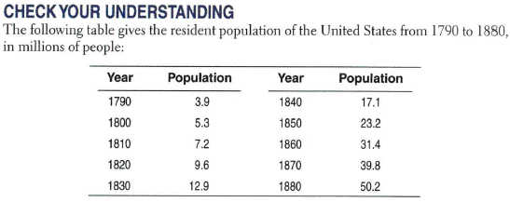
Practice

Slide 38
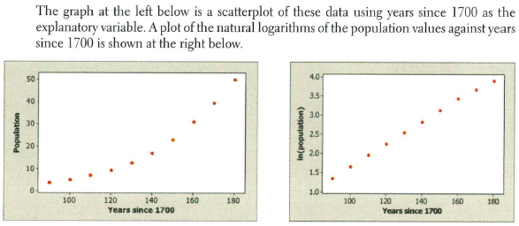
Practice

Slide 39
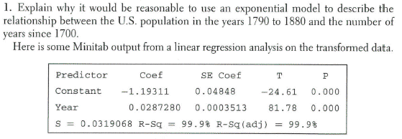
Practice

Slide 40
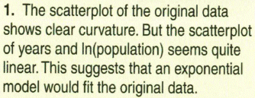
Practice

Slide 41
Practice

Slide 42
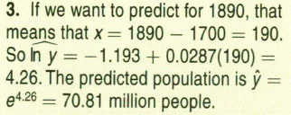
Practice

Slide 43
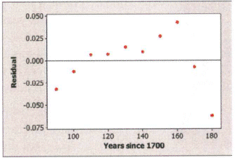
Practice

Slide 44
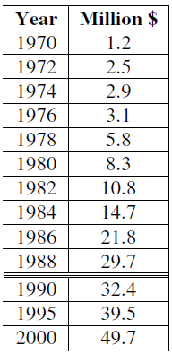
Practice
Mortgages (Republic National Bank, founded 1970)
1970 – 1988 Model (Scale the years somehow…)

Slide 45
Practice
Mortgages (Republic National Bank, founded 1970)
1970 – 1988 Model (Scale the years somehow…)

Slide 46
Practice
Mortgages (Republic National Bank, founded 1970)
Compare post-1990 mortgages to the previous trend

Slide 47
Practice
Mortgages (Republic National Bank, founded 1970)
Compare post-1990 mortgages to the previous trend

Slide 48
Homework
Pages 238 – 243
1, 2, 4, 6, 10, 24, 26, 28, 32

