Slide 1
Statistics 19
Confidence Intervals for Proportions

Slide 2
Standard Error
Both of the sampling distributions we’ve looked at are Normal.
For proportions
For means

Slide 3
Standard Error
When we don’t know p or σ, we’re stuck, right?
Nope. We will use sample statistics to estimate these population parameters.
Whenever we estimate the standard deviation of a sampling distribution, we call it a standard error.

Slide 4
Standard Error
For a sample proportion, the standard error is
For the sample mean, the standard error is

Slide 5
A Confidence Interval
Recall that the sampling distribution model of is centered at p, with standard deviation
Since we don’t know p, we can’t find the true standard deviation of the sampling distribution model, so we need to find the standard error:

Slide 6
A Confidence Interval
By the 68-95-99.7% Rule, we know
about 68% of all samples will have ’s within 1 SE of p
about 95% of all samples will have ’s within 2 SEs of p
about 99.7% of all samples will have ’s within 3 SEs of p
We can look at this from ’s point of view…

Slide 7
A Confidence Interval
Consider the 95% level:
There’s a 95% chance that p is no more than 2 SEs away from .
So, if we reach out 2 SEs, we are 95% sure that p will be in that interval. In other words, if we reach out 2 SEs in either direction of , we can be 95% confident that this interval contains the true proportion.
This is called a 95% confidence interval.

Slide 8
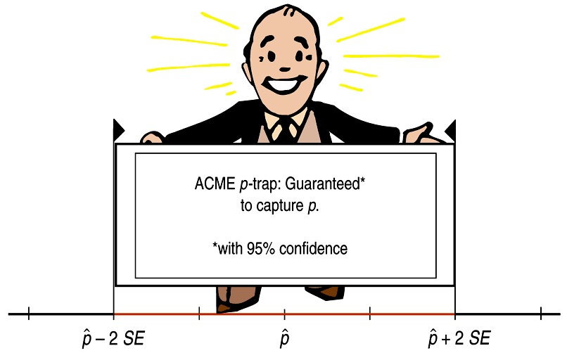
A Confidence Interval

Slide 9
What Does “95% Confidence” Really Mean?
Each confidence interval uses a sample statistic to estimate a population parameter.
But, since samples vary, the statistics we use, and thus the confidence intervals we construct, vary as well.

Slide 10
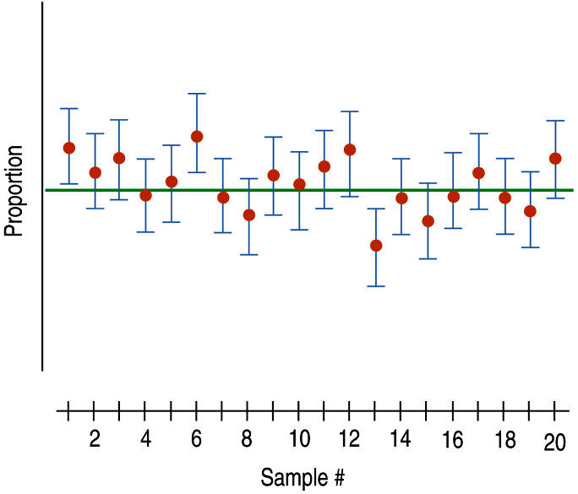
What Does “95% Confidence” Really Mean?
The figure to the right shows that some of our confidence intervals (from 20 random samples) capture the true proportion (the green horizontal line), while others do not:

Slide 11
What Does “95% Confidence” Really Mean?
Our confidence is in the process of constructing the interval, not in any one interval itself.
Thus, we expect 95% of all 95% confidence intervals to contain the true parameter that they are estimating.

Slide 12
Margin of Error: Certainty vs. Precision
We can claim, with 95% confidence, that the interval contains the true population proportion.
The extent of the interval on either side of is called the margin of error (ME).
In general, confidence intervals have the form estimate ± ME.
The more confident we want to be, the larger our ME needs to be, making the interval wider.

Slide 13
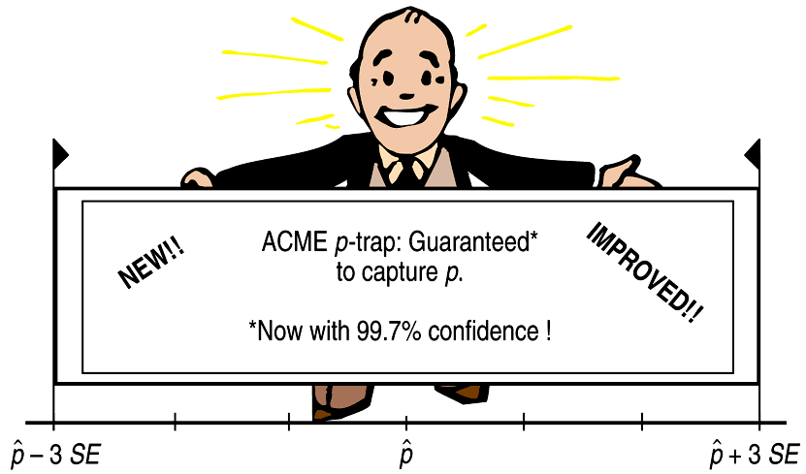
Margin of Error: Certainty vs. Precision

Slide 14
Margin of Error: Certainty vs. Precision
To be more confident, we wind up being less precise.
We need more values in our confidence interval to be more certain.
Because of this, every confidence interval is a balance between certainty and precision.
The tension between certainty and precision is always there.
Fortunately, in most cases we can be both sufficiently certain and sufficiently precise to make useful statements.

Slide 15
Margin of Error: Certainty vs. Precision
The choice of confidence level is somewhat arbitrary, but keep in mind this tension between certainty and precision when selecting your confidence level.
The most commonly chosen confidence levels are 90%, 95%, and 99% (but any percentage can be used).

Slide 16
Critical Values
The ‘2’ in (our 95% confidence interval) came from the 68-95-99.7% Rule.
Using a table or technology, we find that a more exact value for our 95% confidence interval is 1.96 instead of 2.
We call 1.96 the critical value and denote it z*.
For any confidence level, we can find the corresponding critical value (the number of SEs that corresponds to our confidence interval level).

Slide 17
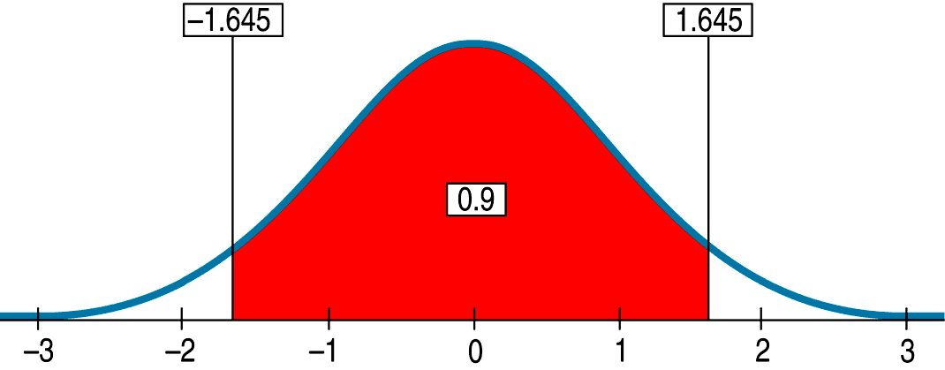
Critical Values
Example: For a 90% confidence interval, the critical value is 1.645:

Slide 18
Example
Your local newspaper polls a random sample of 330 voters, finding 144 who say they will vote “yes” on the upcoming school budget. Create a confidence interval for actual sentiment of all voters. Just use 2 SDs and concentrate on the conditions and the interpretation.

Slide 19
Example
Your local newspaper polls a random sample of 330 voters, finding 144 who say they will vote “yes” on the upcoming school budget. Create a confidence interval for actual sentiment of all voters. Just use 2 SDs and concentrate on the conditions and the interpretation.

Slide 20
Example
Your local newspaper polls a random sample of 330 voters, finding 144 who say they will vote “yes” on the upcoming school budget. Create a confidence interval for actual sentiment of all voters. Just use 2 SDs and concentrate on the conditions and the interpretation.

Slide 21
Example
Your local newspaper polls a random sample of 330 voters, finding 144 who say they will vote “yes” on the upcoming school budget. Create a confidence interval for actual sentiment of all voters. Just use 2 SDs and concentrate on the conditions and the interpretation.

Slide 22
Example
An experiment finds that 27% of 53 subjects report improvement after using a new medicine. Create a 95% confidence interval for the actual cure rate. Use z = 1.96. Why is this interval so wide? Make it narrower – 90% confidence. What are the advantages and disadvantages? What sample size would we need in a follow-up study if we want a margin of error of 5% with 98% confidence?

Slide 23
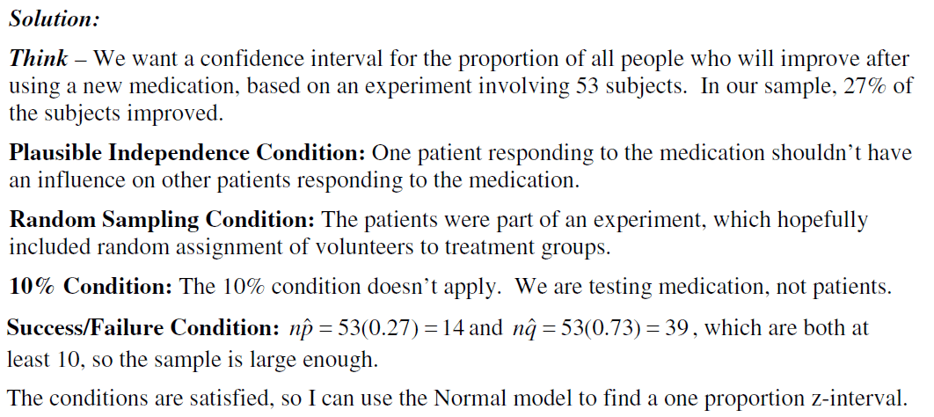
Example
An experiment finds that 27% of 53 subjects report improvement after using a new medicine. Create a 95% confidence interval for the actual cure rate. Use z = 1.96. Why is this interval so wide? Make it narrower – 90% confidence. What are the advantages and disadvantages? What sample size would we need in a follow-up study if we want a margin of error of 5% with 98% confidence?

Slide 24
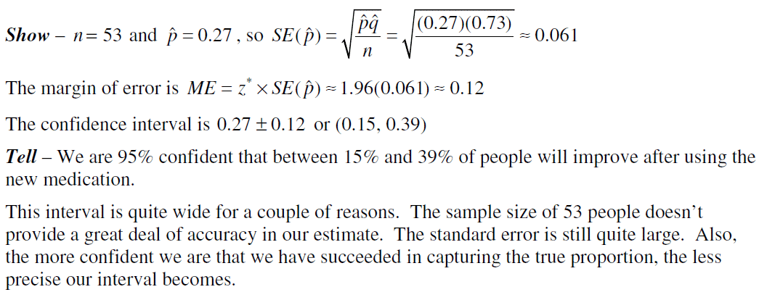
Example
An experiment finds that 27% of 53 subjects report improvement after using a new medicine. Create a 95% confidence interval for the actual cure rate. Use z = 1.96. Why is this interval so wide? Make it narrower – 90% confidence. What are the advantages and disadvantages? What sample size would we need in a follow-up study if we want a margin of error of 5% with 98% confidence?

Slide 25
Example
An experiment finds that 27% of 53 subjects report improvement after using a new medicine. Create a 95% confidence interval for the actual cure rate. Use z = 1.96. Why is this interval so wide? Make it narrower – 90% confidence. What are the advantages and disadvantages? What sample size would we need in a follow-up study if we want a margin of error of 5% with 98% confidence?

Slide 26
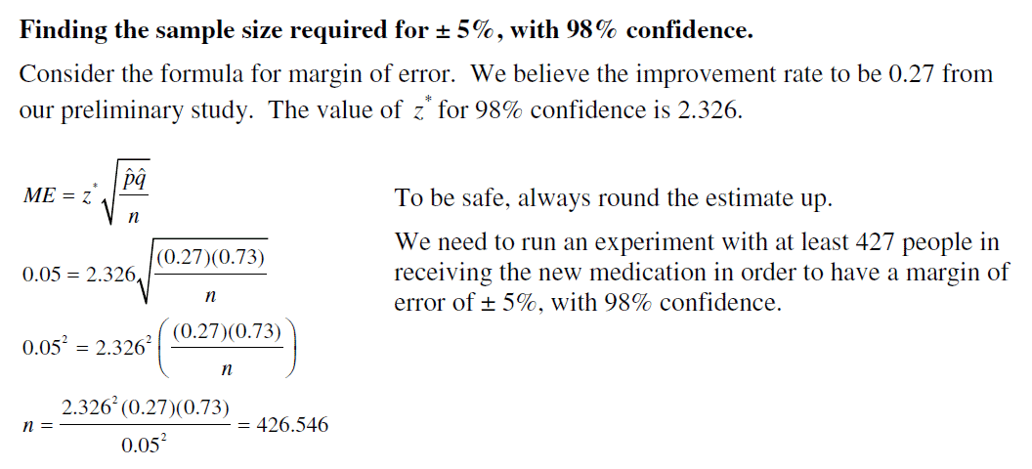
Example
An experiment finds that 27% of 53 subjects report improvement after using a new medicine. Create a 95% confidence interval for the actual cure rate. Use z = 1.96. Why is this interval so wide? Make it narrower – 90% confidence. What are the advantages and disadvantages? What sample size would we need in a follow-up study if we want a margin of error of 5% with 98% confidence?

Slide 27
Assumptions and Conditions
All statistical models make upon assumptions.
Different models make different assumptions.
If those assumptions are not true, the model might be inappropriate and our conclusions based on it may be wrong.
You can never be sure that an assumption is true, but you can often decide whether an assumption is plausible by checking a related condition.

Slide 28
Assumptions and Conditions
Here are the assumptions and the corresponding conditions you must check before creating a confidence interval for a proportion:
Independence Assumption: We first need to Think about whether the Independence Assumption is plausible. It’s not one you can check by looking at the data. Instead, we check two conditions to decide whether independence is reasonable.

Slide 29
Assumptions and Conditions
Randomization Condition: Were the data sampled at random or generated from a properly randomized experiment? Proper randomization can help ensure independence.
10% Condition: Is the sample size no more than 10% of the population?
Sample Size Assumption: The sample needs to be large enough for us to be able to use the CLT.
Success/Failure Condition: We must expect at least 10 “successes” and at least 10 “failures.”

Slide 30
One-Proportion z-Interval
When the conditions are met, we are ready to find the confidence interval for the population proportion, p.
The confidence interval is
where
The critical value, z*, depends on the particular confidence level, C, that you specify.

Slide 31
Choosing Your Sample Size
The question of how large a sample to take is an important step in planning any study.
Choose a Margin or Error (ME) and a Confidence Interval Level.
The formula requires which we don’t have yet because we have not taken the sample. A good estimate for , which will yield the largest value for (and therefore for n) is 0.50.
Solve the formula for n.

Slide 32
Example
What sample size does it take to estimate the outcome of an election with a margin of error of 3%?

Slide 33
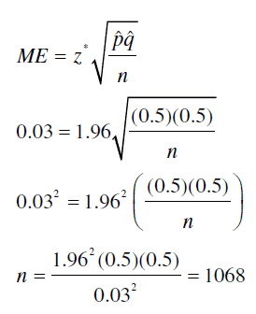
Example
What sample size does it take to estimate the outcome of an election with a margin of error of 3%?

Slide 34
What Can Go Wrong?
Don’t Misstate What the Interval Means:
Don’t suggest that the parameter varies.
Don’t claim that other samples will agree with yours.
Don’t be certain about the parameter.
Don’t forget: It’s about the parameter (not the statistic).
Don’t claim to know too much.
Do take responsibility (for the uncertainty).
Do treat the whole interval equally.

Slide 35
What Can Go Wrong?
Margin of Error Too Large to Be Useful:
We can’t be exact, but how precise do we need to be?
One way to make the margin of error smaller is to reduce your level of confidence. (That may not be a useful solution.)
You need to think about your margin of error when you design your study.
To get a narrower interval without giving up confidence, you need to have less variability.
You can do this with a larger sample…

Slide 36
What Can Go Wrong?
Choosing Your Sample Size:
In general, the sample size needed to produce a confidence interval with a given margin of error at a given confidence level is:
where z* is the critical value for your confidence level.
To be safe, round up the sample size you obtain.

Slide 37
What Can Go Wrong?
Violations of Assumptions:
Watch out for biased samples—keep in mind what you learned in Chapter 12.
Think about independence.

Slide 38
What have we learned?
Finally we have learned to use a sample to say something about the world at large.
This process (statistical inference) is based on our understanding of sampling models, and will be our focus for the rest of the book.
In this chapter we learned how to construct a confidence interval for a population proportion.
Best estimate of the true population proportion is the one we observed in the sample.

Slide 39
What have we learned?
Best estimate of the true population proportion is the one we observed in the sample.
Create our interval with a margin of error.
Provides us with a level of confidence.
Higher level of confidence, wider our interval.
Larger sample size, narrower our interval.
Calculate sample size for desired degree of precision and level of confidence.
Check assumptions and condition.

Slide 40
What have we learned?
We’ve learned to interpret a confidence interval by Telling what we believe is true in the entire population from which we took our random sample. Of course, we can’t be certain, but we can be confident.

Slide 41
Homework
Pages 446 – 449
1, 3, 5, 7, 9, 13, 16, 20, 22, 29, 31, 33, 38

