Slide 1
Statistics 14
From Randomness to Probability

Slide 2
Probability
This unit will define the phrase “statistically significant
This chapter will lay the ground work through probability

Slide 3
Politics
The menu at the Coffee Garden at 900 East and 900 South in Salt Lake City has included a scrumptious selection of quiche for about 10 years. The recipe calls for four fresh eggs for each quiche. A Salt Lake County Health Department inspector paid a visit recently and pointed out that research by the Food and Drug Administration indicates that one in four eggs carries Salmonella bacterium, so restaurants should never use more than three eggs when preparing quiche. The manager on duty wondered if simply throwing out three eggs from each dozen and using the remaining nine in four-egg-quiches would serve the same purpose.

Slide 4
Dealing with Random Phenomena
A random phenomenon is a situation in which we know what outcomes could happen, but we don’t know which particular outcome did or will happen.
In general, each occasion upon which we observe a random phenomenon is called a trial.
At each trial, we note the value of the random phenomenon, and call it an outcome.
When we combine outcomes, the resulting combination is an event.
The collection of all possible outcomes is called the sample space.

Slide 5
The Law of Large Numbers
First a definition . . .
When thinking about what happens with combinations of outcomes, things are simplified if the individual trials are independent.
Roughly speaking, this means that the outcome of one trial doesn’t influence or change the outcome of another.
For example, coin flips are independent.

Slide 6
The Law of Large Numbers
The Law of Large Numbers (LLN) says that the long-run relative frequency of repeated independent events gets closer and closer to a single value.
We call the single value the probability of the event.
Because this definition is based on repeatedly observing the event’s outcome, this definition of probability is often called empirical probability.

Slide 7
The Nonexistent Law of Averages
The LLN says nothing about short-run behavior.
Relative frequencies even out only in the long run, and this long run is really long (infinitely long, in fact).
The so called Law of Averages (that an outcome of a random event that hasn’t occurred in many trials is “due” to occur) doesn’t exist at all.

Slide 8
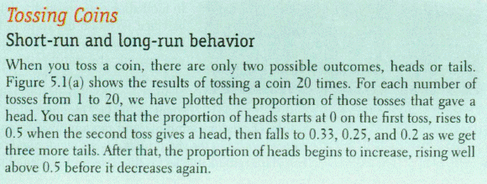
Example

Slide 9
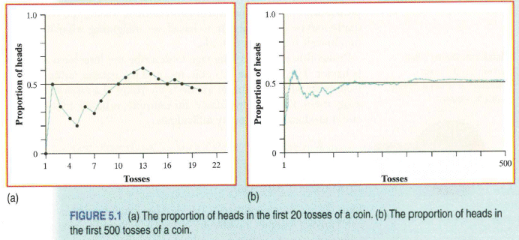
Example

Slide 10
Modeling Probability
When probability was first studied, a group of French mathematicians looked at games of chance in which all the possible outcomes were equally likely. They developed mathematical models of theoretical probability.
It’s equally likely to get any one of six outcomes from the roll of a fair die.
It’s equally likely to get heads or tails from the toss of a fair coin.
However, keep in mind that events are not always equally likely.
A skilled basketball player has a better than 50-50 chance of making a free throw.

Slide 11
Modeling Probability
The probability of an event is the number of outcomes in the event divided by the total number of possible outcomes.
P(A) =
# of outcomes in A
# of possible outcomes

Slide 12
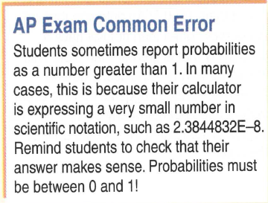
Advice

Slide 13
Personal Probability
In everyday speech, when we express a degree of uncertainty without basing it on long-run relative frequencies or mathematical models, we are stating subjective or personal probabilities.
Personal probabilities don’t display the kind of consistency that we will need probabilities to have, so we’ll stick with formally defined probabilities.

Slide 14
The First Three Rules of Working with Probability
We are dealing with probabilities now, not data, but the three rules don’t change.
Make a picture.
Make a picture.
Make a picture.

Slide 15
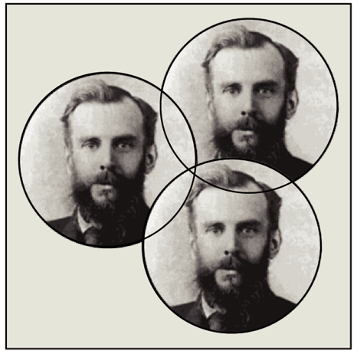
The First Three Rules of Working with Probability
The most common kind of picture to make is called a Venn diagram.
We will see Venn diagrams in practice shortly…

Slide 16
Formal Probability
Two requirements for a probability:
A probability is a number between 0 and 1.
For any event A, 0 ≤ P(A) ≤ 1.

Slide 17
Formal Probability
Probability Assignment Rule:
The probability of the set of all possible outcomes of a trial must be 1.
P(S) = 1 (S represents the set of all possible outcomes.)

Slide 18
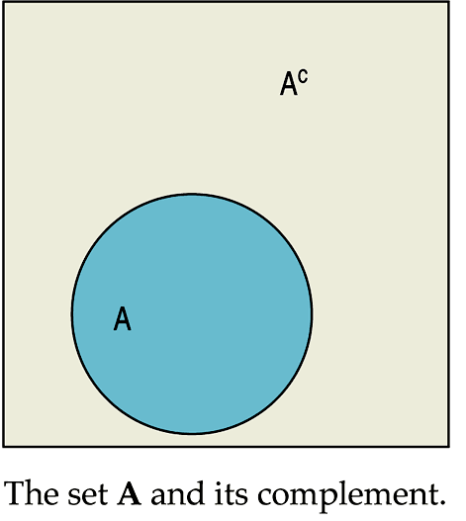
Formal Probability
Complement Rule:
The set of outcomes that are not in the event A is called the complement of A, denoted A^{C}.
The probability of an event occurring is 1 minus the probability that it doesn’t occur: P(A) = 1 – P(A^{C})

Slide 19
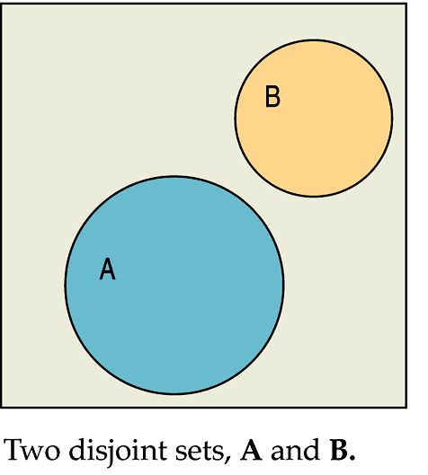
Formal Probability
Addition Rule:
Events that have no outcomes in common (and, thus, cannot occur together) are called disjoint (or mutually exclusive).

Slide 20
Formal Probability
Addition Rule (cont.):
For two disjoint events A and B, the probability that one or the other occurs is the sum of the probabilities of the two events.
P(A ∪ B) = P(A) + P(B), provided that A and B are disjoint.

Slide 21
Formal Probability
Multiplication Rule:
For two independent events A and B, the probability that both A and B occur is the product of the probabilities of the two events.
P(A ∩ B) = P(A) × P(B), provided that A and B are independent.

Slide 22
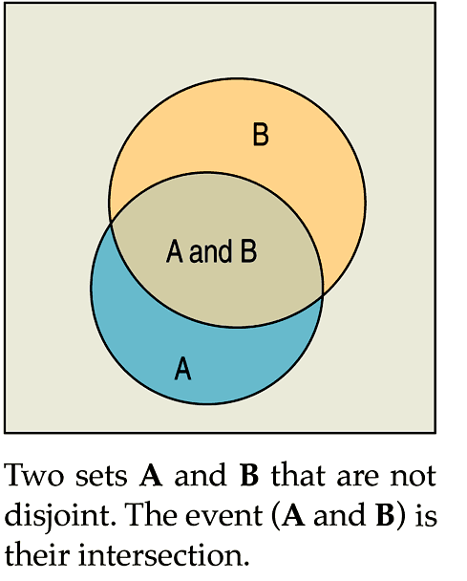
Formal Probability
Multiplication Rule (cont.):
Two independent events A and B are not disjoint, provided the two events have probabilities greater than zero:

Slide 23
Formal Probability
Multiplication Rule:
Many Statistics methods require an Independence Assumption, but assuming independence doesn’t make it true.
Always Think about whether that assumption is reasonable before using the Multiplication Rule.

Slide 24
Formal Probability - Notation
Notation alert:
In this text we use the notation P(A ∪ B) and P(A ∩ B).
In other situations, you might see the following:
P(A or B) instead of P(A ∪ B)
P(A and B) instead of P(A ∩ B)

Slide 25
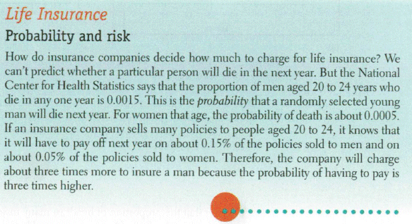
In Practice

Slide 26
Putting the Rules to Work
In most situations where we want to find a probability, we’ll use the rules in combination.
A good thing to remember is that it can be easier to work with the complement of the event we’re really interested in.

Slide 27
Vocabulary Example

Slide 28
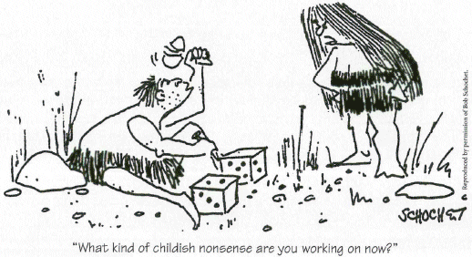

Slide 29
Activity

Slide 30
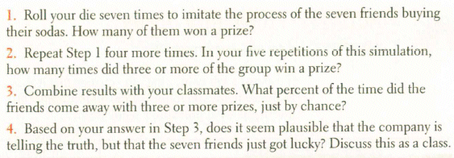
Activity

Slide 31
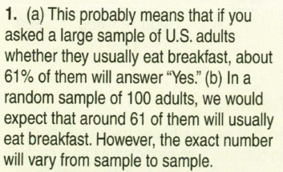
Practice

Slide 32
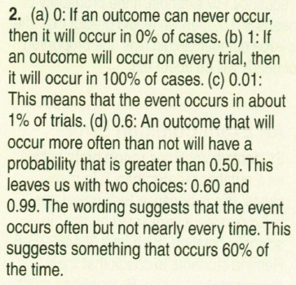
Practice

Slide 33
What Can Go Wrong?
Beware of probabilities that don’t add up to 1.
To be a legitimate probability distribution, the sum of the probabilities for all possible outcomes must total 1.
Don’t add probabilities of events if they’re not disjoint.
Events must be disjoint to use the Addition Rule.

Slide 34
What Can Go Wrong?
Don’t multiply probabilities of events if they’re not independent.
The multiplication of probabilities of events that are not independent is one of the most common errors people make in dealing with probabilities.
Don’t confuse disjoint and independent—disjoint events can’t be independent.

Slide 35
What have we learned?
Probability is based on long-run relative frequencies.
The Law of Large Numbers speaks only of long-run behavior.
Watch out for misinterpreting the LLN.

Slide 36
What have we learned?
There are some basic rules for combining probabilities of outcomes to find probabilities of more complex events. We have the:
Probability Assignment Rule
Complement Rule
Addition Rule for disjoint events
Multiplication Rule for independent events

Slide 37
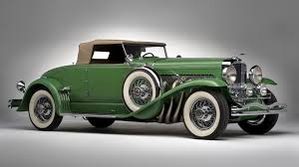
Example
Suppose that 40% of cars in your area are manufactured in the United States, 30% in Japan, 10% in Germany, and 20% in other countries. If cars are selected at random, find the probability that:
A car is not U.S.-made.
Think – The events U.S.-made and not U.S.-made are complementary events. The Complement Rule can be used.
Show – P(not U.S.-made) =1 − P(U.S.-made) = 1− 0.40 = 0.60
Tell – The probability that a randomly selected car is not made in the U.S. is 60%.

Slide 38
Example
Suppose that 40% of cars in your area are manufactured in the United States, 30% in Japan, 10% in Germany, and 20% in other countries. If cars are selected at random, find the probability that:
It is made in Japan or Germany.
Think – A car cannot be Japanese and German, so the events are disjoint. The Addition Rule can be used.
Show – P(Japanese or German) = P(Japanese) + P(German) = 0.30 + 0.10 = 0.40
Tell – The probability that a randomly selected car was made in Japan or Germany is 40%.

Slide 39
Example
Suppose that 40% of cars in your area are manufactured in the United States, 30% in Japan, 10% in Germany, and 20% in other countries. If cars are selected at random, find the probability that:
You see two in a row from Japan.
Think – Since the cars are selected at random, the events are independent. The Multiplication Rule can be used.
Show – P(two Japanese in a row) = P(Japanese)P(Japanese) = (0.30)(0.30) = 0.09
Tell – The probability that two randomly selected cars were both made in Japan is 9%.

Slide 40
Example
Suppose that 40% of cars in your area are manufactured in the United States, 30% in Japan, 10% in Germany, and 20% in other countries. If cars are selected at random, find the probability that:
None of three cars came from Germany.
Think – Since the cars are selected at random, the events are independent. The Multiplication Rule can be used. Also, German and not German are complementary events, so the Complement Rule can be used.
Show – P(No German cars in three cars) =
(Not German) (Not German) (Not German)
=(0.90)(0.90)(0.90) = 0.729
Tell – The probability that none of the three randomly selected cars are made in Germany is 72.9%

Slide 41
Example
Suppose that 40% of cars in your area are manufactured in the United States, 30% in Japan, 10% in Germany, and 20% in other countries. If cars are selected at random, find the probability that:
At least one of three cars is U.S.-made.
Think – Since the cars are selected at random, the events are independent. The Multiplication Rule can be used. Also, “at least one” and “none” are complementary events, so the Complement Rule can be used.
Show – P(at least one U.S. in three) = 1 – (No U.S. in three)
= 1 –(0.60)(0.60)(0.60) = 0.784
Tell – The probability that at least one of the three randomly selected cars is made in the U.S. is 78.4%

Slide 42
Example
Suppose that 40% of cars in your area are manufactured in the United States, 30% in Japan, 10% in Germany, and 20% in other countries. If cars are selected at random, find the probability that:
The first Japanese car is the fourth one you choose.
Think – Since the cars are selected at random, the events are independent. The multiplication rule can be used. Also, “Japanese” and “Not Japanese” are complementary events, so the Complement Rule can be used.
Show – P(First J is the fourth car)
= P(not J ∩ not J ∩ not J ∩ not J)
= [P(Not J)]⁴ P(J)
= (0.70) (0.30) 0.1029
Tell – The probability that the first Japanese car is the fourth car chosen is 10.29%

Slide 43
Homework
Pages 339 - 343
2, 3, 7, 8, 12, 14, 16, 23, 32, 34, 35

