Slide 1
Statistics 1
Introduction

Slide 2
Introduction
AP Test – May 11, 2014 – Afternoon, sorry Gabe
Reading list – Yes for the whole year!

Slide 3
Activity
Supplies
1 Deck of cards each

Slide 4
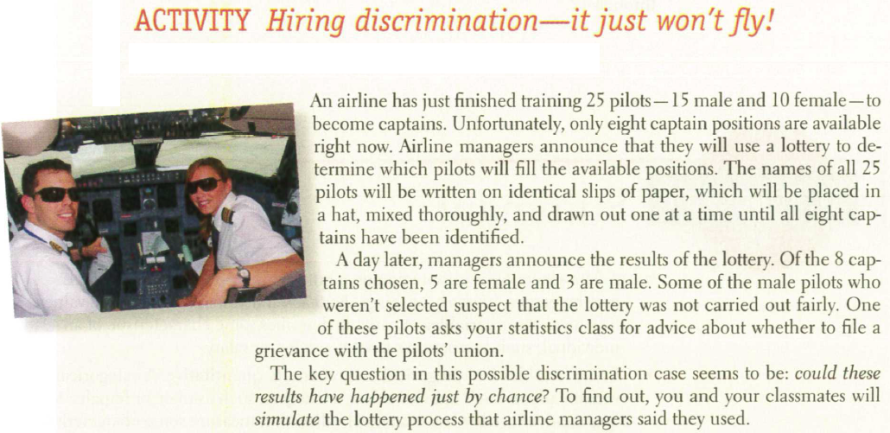
Activity

Slide 5
Activity

Slide 6
Activity
4. Discuss the results with your classmates. Does it seem believable that airline managers carried out a fair lottery? What advice would you give the male pilot who contacted you?
5. Would your advice change if the lottery had chosen 6 female (and 2 male) pilots? Explain .

Slide 7
Homework
Read section 1.
Get a jump on section 2, due Monday
When reading – Outline. Always practice the TI tips
Fill out survey form for self, and five fellow students, no overlap

