Slide 1
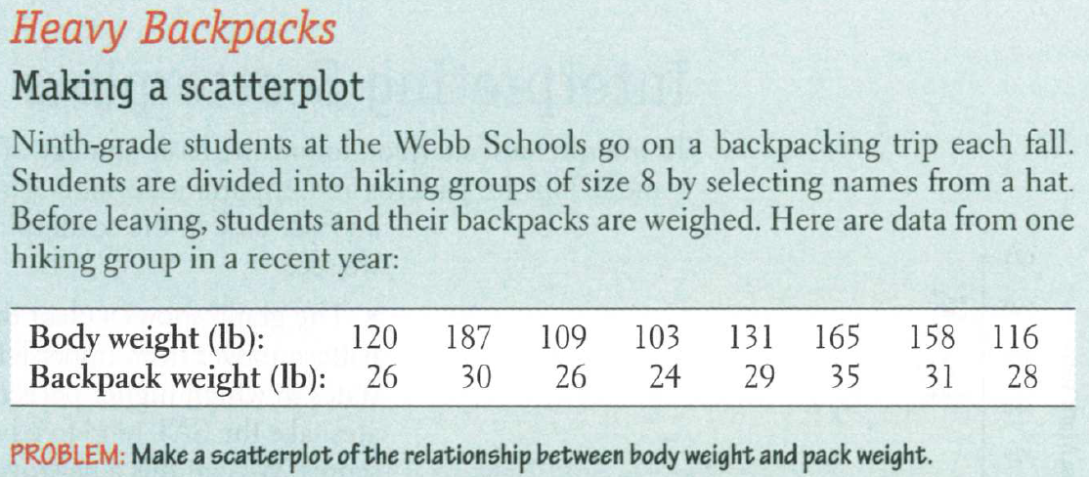
Practice

Slide 2
Practice

Slide 3
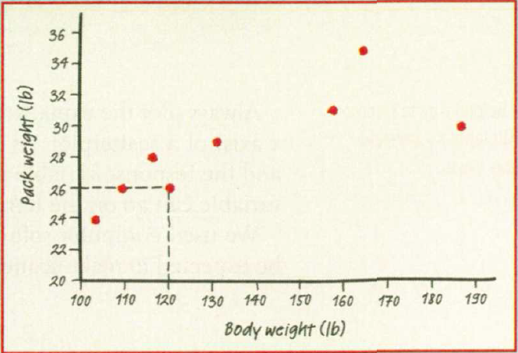
Practice

Slide 5
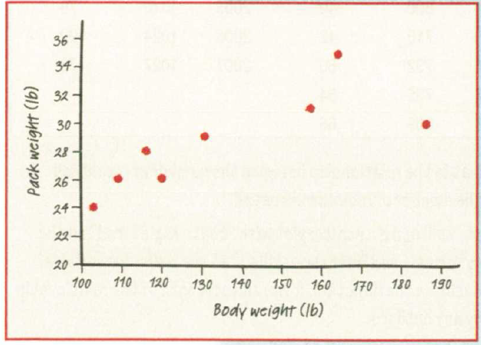
Practice

Slide 6
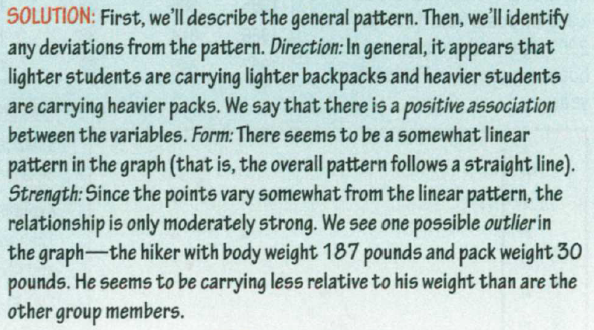
Practice

Slide 7
Example
Describe how the scatterplot might look
Drug dosage and degree of pain relief
The association is likely to be strong, positive and curved. Assuming, of course, that the drug is an effective pain reliever, as the dosage increases, the degree of pain relief will increase. Eventually, the association is likely to level off, until no further pain relief is possible, since the pain will be gone.

Slide 8
Practice
Describe how the scatterplot might look
Calories consumed and weight loss
The association is likely to be moderate, negative and linear. As fewer calories are consumed, more weight is likely to be lost. The association will not be strong, since some people lose weight easier than others, and there are other variables involved like overall health, exercise and beginning weight.

Slide 9
Practice
Describe how the scatterplot might look
Hours of sleep and score on a test
The association is likely weak, positive and possibly linear. Generally, a wellrested person is expected to score higher on a test. The relationship is weak, since there are other variables involved. Maybe a person got less sleep because they were up studying.

Slide 10
Practice
Describe how the scatterplot might look
Shoe size and grade point average
There is no association between shoe size and GPA. The scatterplot is likely to be randomly scattered.

Slide 11
Practice
Describe how the scatterplot might look
Time for a mile run and age
The association between time for a mile run and age is likely to be moderate and curved, with no dominant direction. The very young will likely have high run times. Run times are likely to be the lowest for people in their late teens or early twenties. Older people are likely to have high run times.

Slide 12
Practice
Describe how the scatterplot might look
Age of car and cost of repairs
The association between age of car and cost of repairs is positive, moderate, and linear. As cars get older, they usually require more repairs.

Slide 13
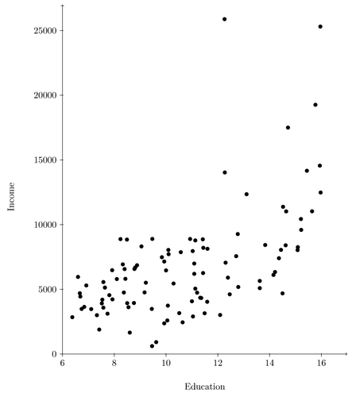
Practice
Describe the data

Slide 14
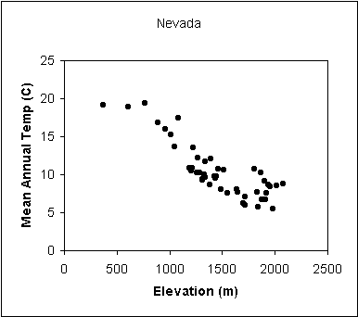
Practice
Describe the data

Slide 15
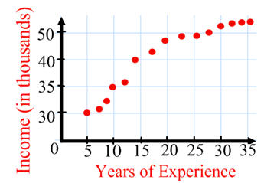
Practice
Describe the data

Slide 16
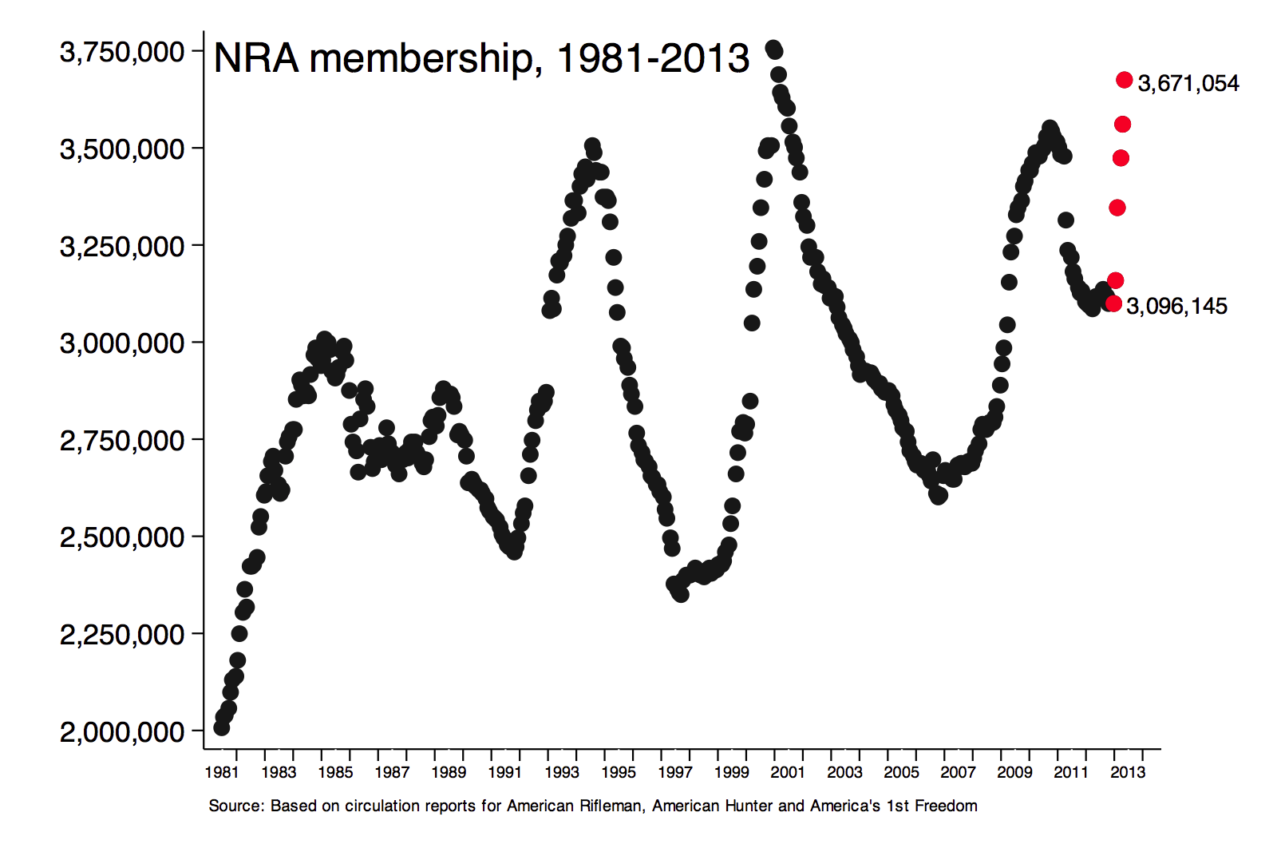
Practice
Describe the data

Slide 17
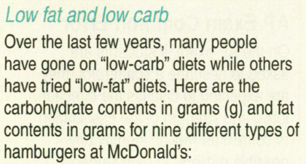
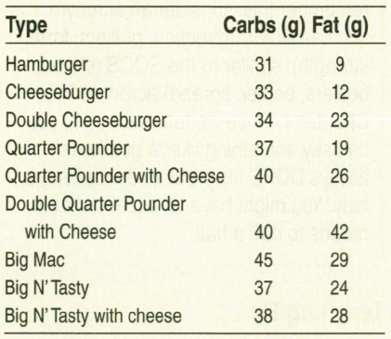
Practice

Slide 18
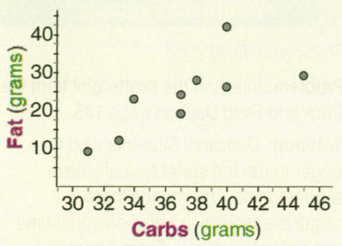
Practice

Slide 19
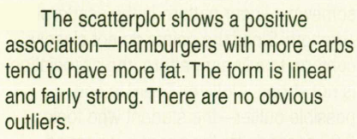
Practice

