Slide 1
Statistics 3
Displaying and Describing Categorical Data

Slide 2
The Three Rules of Data Analysis
The three rules of data analysis won’t be difficult to remember:
Make a picture—things may be revealed that are not obvious in the raw data. These will be things to think about.
Make a picture—important features of and patterns in the data will show up. You may also see things that you did not expect.
Make a picture—the best way to tell others about your data is with a well-chosen picture.

Slide 3
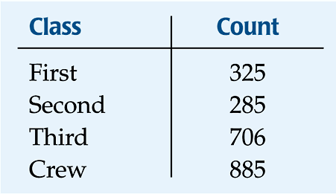
Frequency Tables: Making Piles
We can “pile” the data by counting the number of data values in each category of interest.
We can organize these counts into a frequency table, which records the totals and the category names.

Slide 4
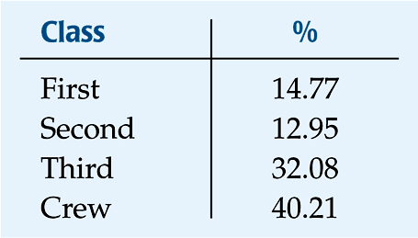
Frequency Tables: Making Piles
A relative frequency table is similar, but gives the percentages (instead of counts) for each category.

Slide 5
Frequency Tables: Making Piles
Both types of tables show how cases are distributed across the categories.
They describe the distribution of a categorical variable because they name the possible categories and tell how frequently each occurs.

Slide 6
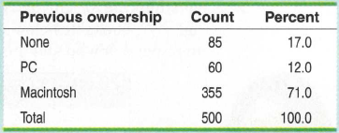
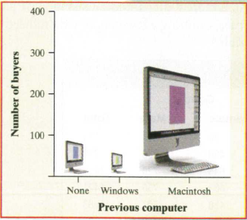
What’s Wrong With This Picture?

Slide 7
The Area Principle
The Monitor display violates the area principle:
The area occupied by a part of the graph should correspond to the magnitude of the value it represents.

Slide 8
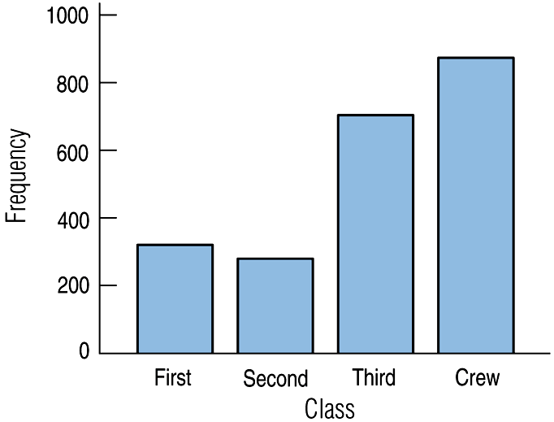
Bar Charts
A bar chart displays the distribution of a categorical variable, showing the counts for each category next to each other for easy comparison.
A bar chart stays true to the area principle.
Thus, a better display for the ship data is:

Slide 9
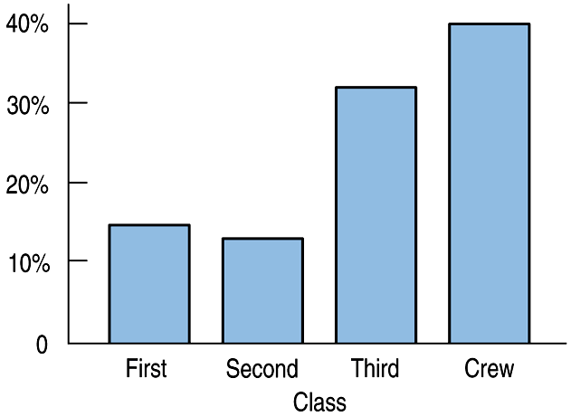
Bar Charts
A relative frequency bar chart displays the relative proportion of counts for each category.
A relative frequency bar chart also stays true to the area principle.
Replacing counts with percentages in the ship data:

Slide 10
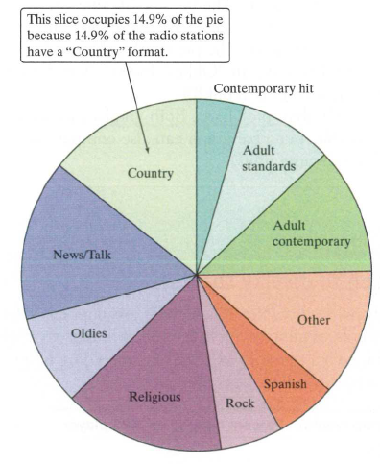
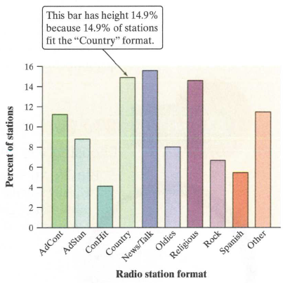
Bar Charts and Pie Charts
US Radio Stations by format

Slide 11
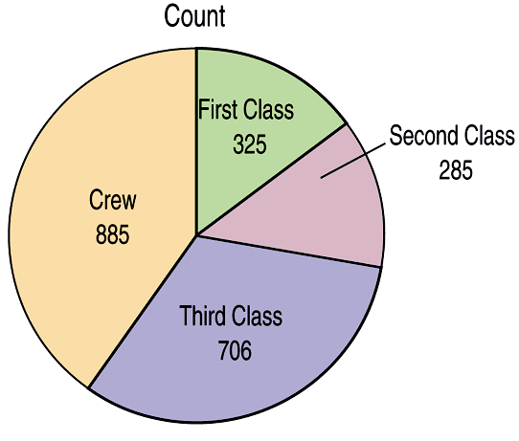
Pie Charts
When you are interested in parts of the whole, a pie chart might be your display of choice.
Pie charts show the whole group of cases as a circle.
They slice the circle into pieces whose size is proportional to the fraction of the whole in each category.

Slide 12
Pie Charts

Slide 13
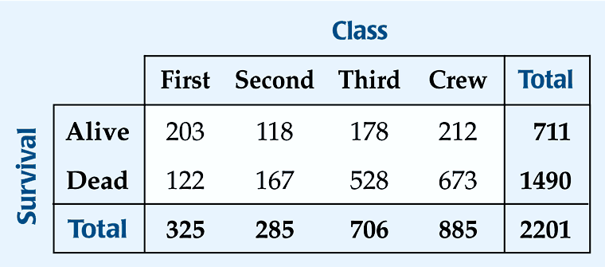
Contingency Tables
A contingency table allows us to look at two categorical variables together.
It shows how individuals are distributed along each variable, contingent on the value of the other variable.
Example: we can examine the class of ticket and whether a person survived the Titanic:

Slide 14
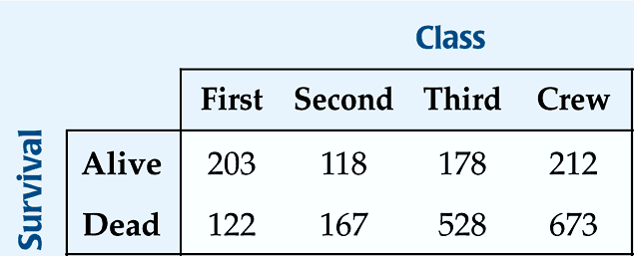
Contingency Tables
The margins of the table, both on the right and on the bottom, give totals and the frequency distributions for each of the variables.
Each frequency distribution is called a marginal distribution of its respective variable.
The marginal distribution of Survival is:

Slide 15
Contingency Tables
Each cell of the table gives the count for a combination of values of the two values.
For example, the second cell in the crew column tells us that 673 crew members died when the Titanic sunk.

Slide 16
Conditional Distributions
A conditional distribution shows the distribution of one variable for just the individuals who satisfy some condition on another variable.
The following is the conditional distribution of ticket Class, conditional on having survived:

Slide 17
Conditional Distributions
The following is the conditional distribution of ticket Class, conditional on having perished:

Slide 18
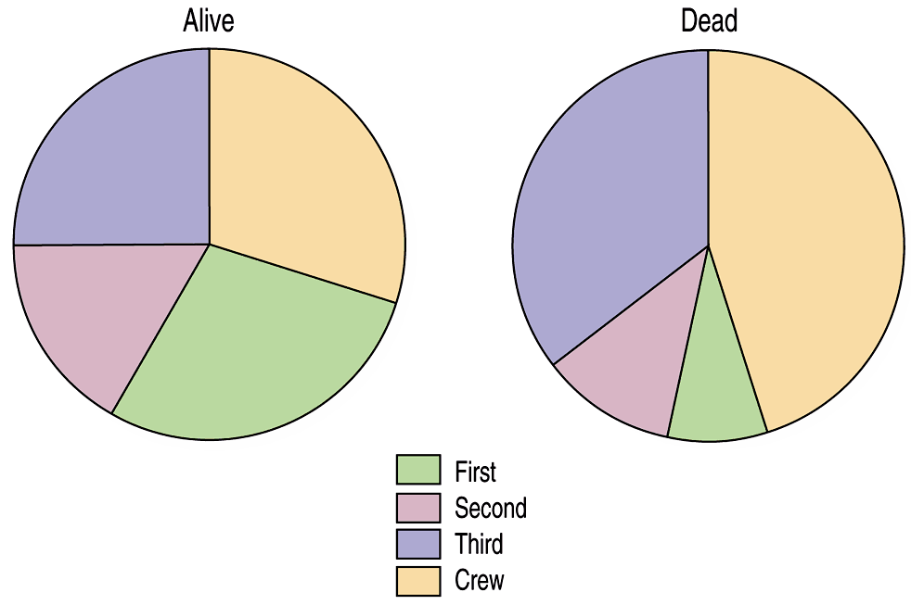
Conditional Distributions
The conditional distributions tell us that there is a difference in class for those who survived and those who perished.
This is better shown with pie charts of the two distributions:

Slide 19
Conditional Distributions
We see that the distribution of Class for the survivors is different from that of the nonsurvivors.
This leads us to believe that Class and Survival are associated, that they are not independent.
The variables would be considered independent when the distribution of one variable in a contingency table is the same for all categories of the other variable.

Slide 20
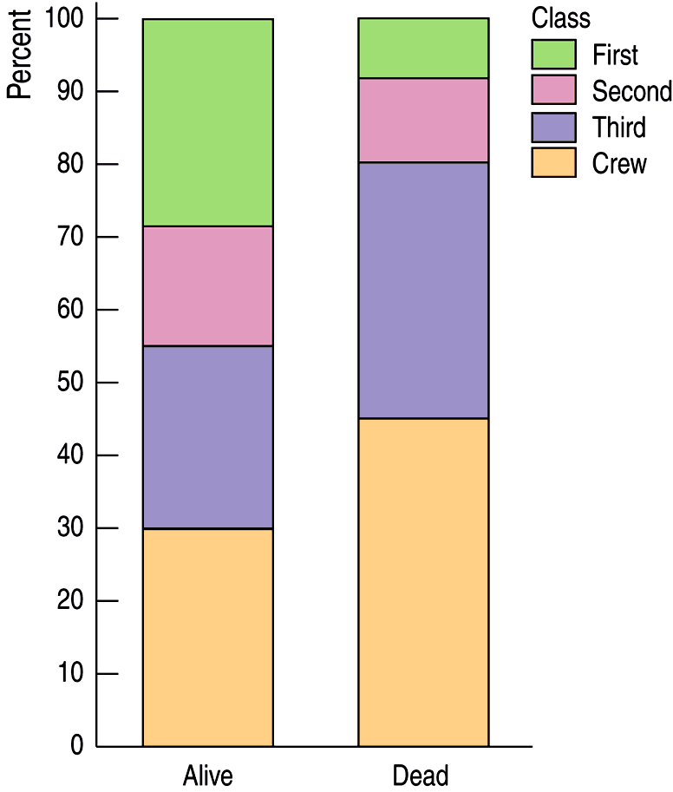
Segmented Bar Charts
A segmented bar chart displays the same information as a pie chart, but in the form of bars instead of circles.
Each bar is treated as the “whole” and is divided proportionally into segments corresponding o the percentage in each group.
Here is the segmented bar chart for ticket Class by Survival status:

Slide 21
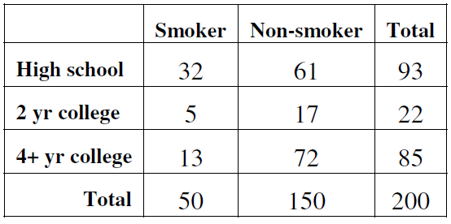
Example

Slide 22
Example

Slide 23
Example

Slide 24
Example

Slide 25
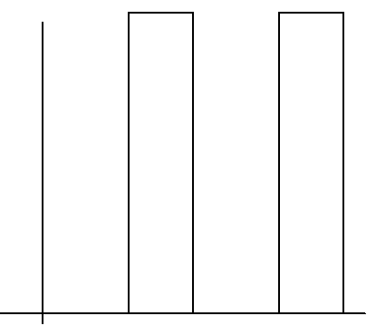
Example

Slide 26
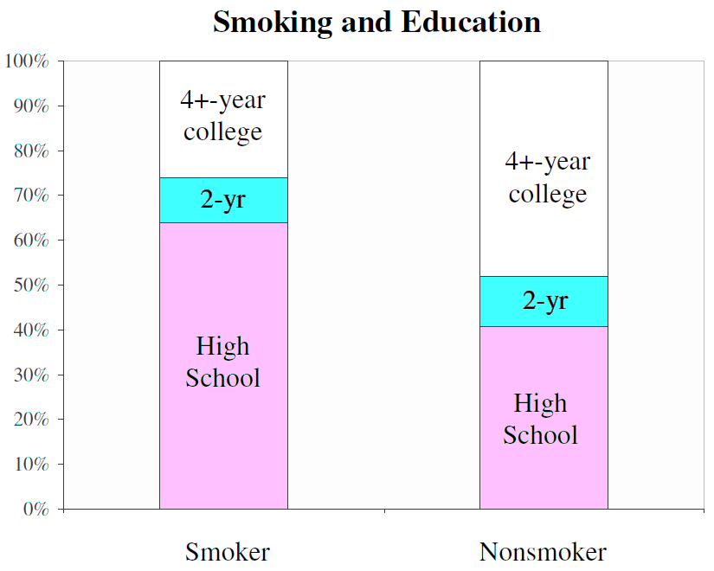

Slide 27
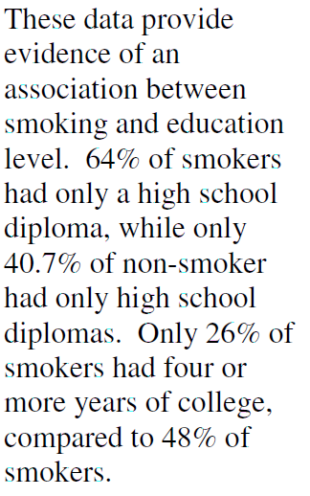
Example

Slide 28
Example

Slide 29
Example

Slide 30
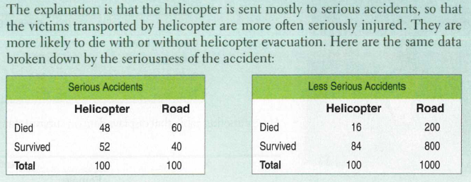
Example

Slide 31
Example

Slide 32
Example
Simpson’s Paradox
An association between two variables that holds for each individual value of a third variable can be changed or even reversed when the data for all values of the third variable are combined.

Slide 33
Example
Two companies have labor and management classifications of employees. Company A’s laborers have a higher average salary than company B’s, as do Company A’s managers. But overall company B pays a higher average salary. How can that be? And which is the better way to compare earning potential at the two companies?
The paradox can be explained when you realize that Company A must employ a greater percentage of laborers than Company B. Also, Company A must employ a smaller percentage of managers than Company B. If laborers earn salaries that are considerably lower than managers, the salaries of Company A’s laborers will pull the company average down, and the salaries of Company B’s managers will pull the company average up. The proper way to compare the companies is to use the salaries that are broken down by job type. Using the overall average salary leads to a misleading conclusion

Slide 34
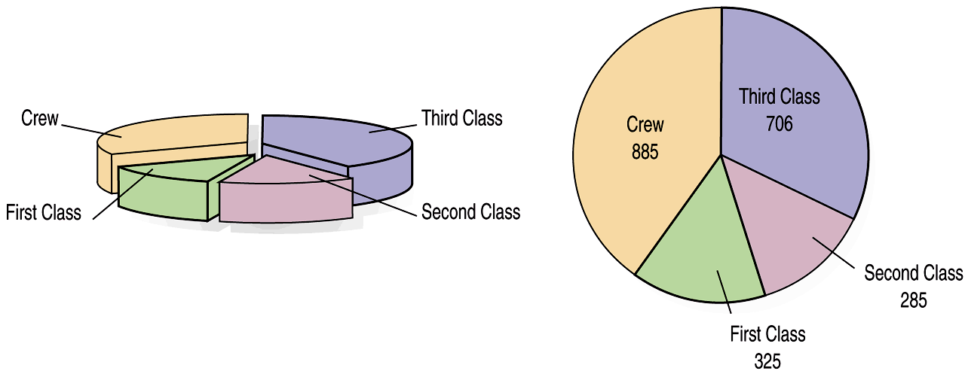
What Can Go Wrong?
Don’t violate the area principle.
While some people might like the pie chart on the left better, it is harder to compare fractions of the whole, which a well-done pie chart does.

Slide 35
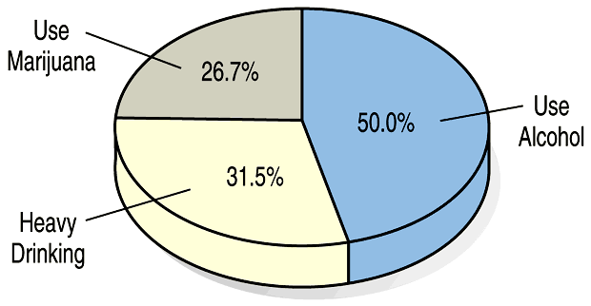
What Can Go Wrong?
Keep it honest—make sure your display shows what it says it shows.
This plot of the percentage of high-school students who engage in specified dangerous behaviors has a problem. Can you see it?

Slide 36
What Can Go Wrong?
Don’t confuse similar-sounding percentages—pay particular attention to the wording of the context.
Don’t forget to look at the variables separately too—examine the marginal distributions, since it is important to know how many cases are in each category.

Slide 37
What Can Go Wrong?
Be sure to use enough individuals!
Do not make a report like “We found that 66.67% of the rats improved their performance with training. The other rat died.”

Slide 38
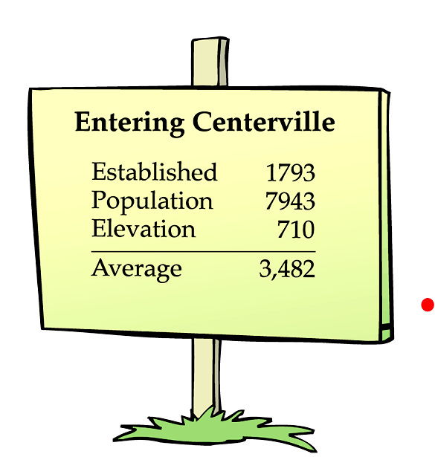
What Can Go Wrong?
Don’t overstate your case—don’t claim something you can’t.
Don’t use unfair or silly averages—this could lead to Simpson’s Paradox, so be careful when you average one variable across different levels of a second variable.

Slide 39
What have we learned?
We can summarize categorical data by counting the number of cases in each category (expressing these as counts or percents).
We can display the distribution in a bar chart or pie chart.
And, we can examine two-way tables called contingency tables, examining marginal and/or conditional distributions of the variables.

Slide 40
Homework
Pages 37 – 43
5, 6, 19, 22, 26, 39

