Slide 1
Geometry 3-1
Properties of Parallel Lines

Slide 2
Definition
Transversal – A line that crosses two other lines
Note: the two other lines may be parallel, but do not need to be parallel

Slide 3
Definition
Corresponding Angles – Angles that appear in the same relative position
X
X

Slide 4
Definition
Alternate Interior Angles – Angles between the pair of lines and on opposite sides of the transversal
X
X

Slide 5
Definition
Alternate Exterior Angles – Angles outside the pair of lines and on opposite sides of the transversal
X
X

Slide 6
Definition
Same Side Interior Angles – Angles inside the pair of lines and on the same side of the transversal
X
X

Slide 7
Transversal
 | Same side of Transversal | Opposite sides of Transversal
Between the Parallel Lines | Same Side Interior | Alternate Interior
Outside the Parallel Lines |  | Alternate Exterior
Same position compared to parallel lines | Corresponding

Slide 8
X
X
Corresponding Angles

Slide 9
Consecutive Interior
Angles
X
X

Slide 10
X
X
Alternate Interior Angles

Slide 11
X
X
Corresponding Angles

Slide 12
Alternate Exterior
Angles
X
X

Slide 13
X
X
Consecutive Interior Angles

Slide 14
X
X
Consecutive Interior Angles

Slide 15
X
X
Alternate Interior Angles

Slide 16
Corresponding Angles
X
X

Slide 17
X
X
Alternate Interior Angles

Slide 18
X
X
Alternate Exterior Angles

Slide 19
X
X
Alternate Exterior Angles

Slide 20
Corresponding Angles
X
X

Slide 21
X
X
Alternate Exterior Angles

Slide 22
Corresponding Angles
X
X

Slide 23
X
X
Corresponding Angles

Slide 24
Alternate Interior
Angles
X
X

Slide 25
X
X
Corresponding Angles

Slide 26
Consecutive Interior
Angles
X
X

Slide 27
X
X
Corresponding Angles

Slide 28
Alternate Interior
Angles
X
X

Slide 29
X
X
Consecutive Interior Angles

Slide 30
Alternate Exterior
Angles
X
X

Slide 31
X
X
Corresponding Angles

Slide 32
Corresponding Angles
X
X

Slide 33
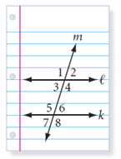
Investigation

Slide 34
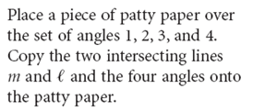
Investigation

Slide 35
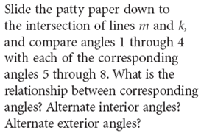
Investigation

Slide 36
Conjecture / Postulate
If two parallel lines are cut by a transversal, then the corresponding angles are congruent
X
X

Slide 37
Conjecture / Theorem
If two parallel lines are cut by a transversal, then the alternate interior angles are congruent
X
X

Slide 38
Conjecture / Theorem
If two parallel lines are cut by a transversal, then the alternate exterior angles are congruent
X
X

Slide 39
Conjecture / Theorem
If two parallel lines are cut by a transversal, then the same side interior angles are supplementary
X
X

Slide 40
Investigation
Will these conjectures hold if the lines are not parallel?
Try it
No

Slide 41
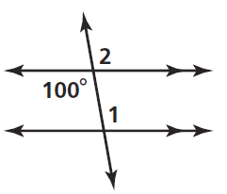
Practice

Slide 42
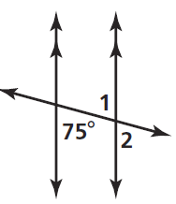
Practice

Slide 43
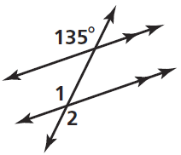
Practice

Slide 44
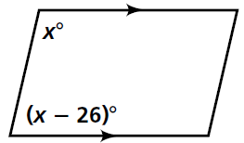
Practice

Slide 45
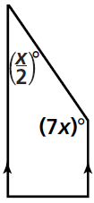
Practice

Slide 46
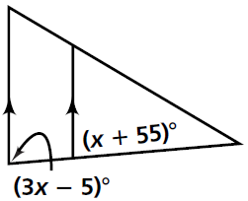
Practice

Slide 47
Homework
Pages 119 – 121
10-18, 24, 29

Slide 48
Honors Homework
Pages 119 – 121
10 - 24, 29

