Slide 1
Geometry 7-R
Unit 7 Area
Review Problems

Slide 2
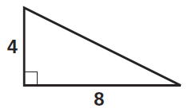
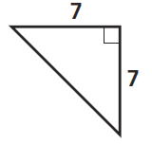
Review Problems
1

Slide 3
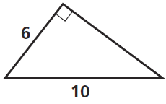
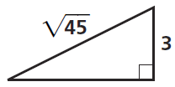
Review Problems
2

Slide 4
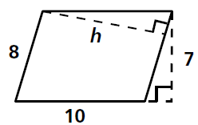
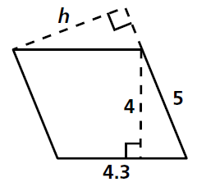
Review Problems
3

Slide 5
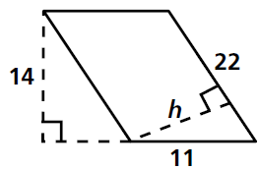
Review Problems
4

Slide 6
Review Problems
5

Slide 7
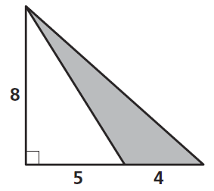
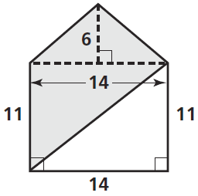
Review Problems
6

Slide 8
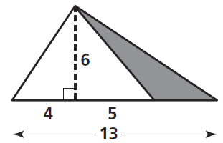
Review Problems
7

Slide 9
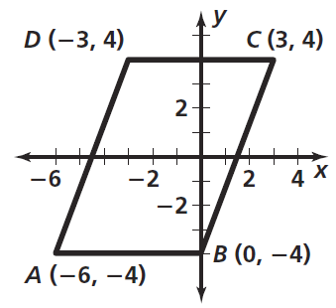
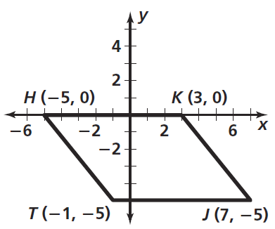
Review Problems
8

Slide 10
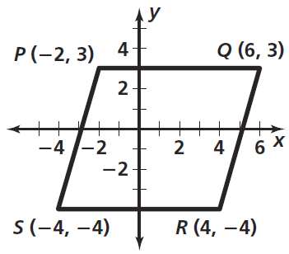
Review Problems
9

Slide 11
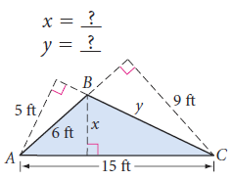
Review Problems
10

Slide 12
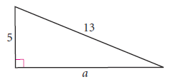
Review Problems
11

Slide 13
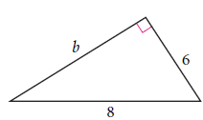
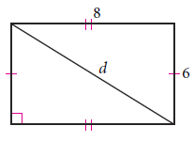
Review Problems
12

Slide 14
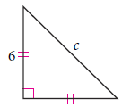
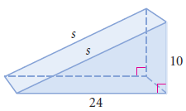
Review Problems
13

Slide 15
Review Problems
14

Slide 16
Review Problems
15

Slide 17
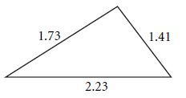
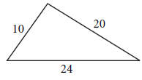
Review Problems
No
No
16

Slide 18
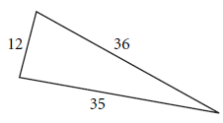
Review Problems
No
No
17

Slide 19
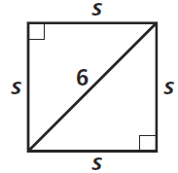
Review Problems
18

Slide 20
Review Problems
19

Slide 21
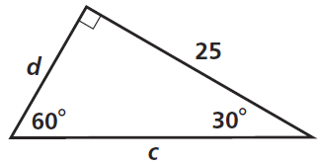
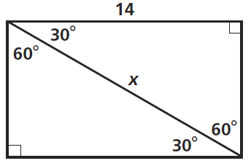
Review Problems
20

Slide 22
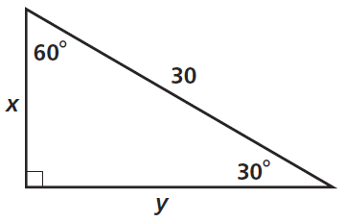
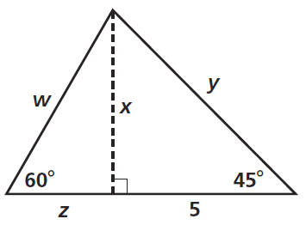
Review Problems
21

Slide 23
Review Problems
22

Slide 24
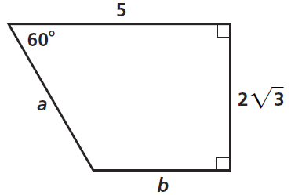
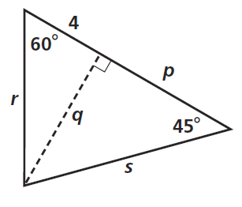
Review Problems
23

Slide 25
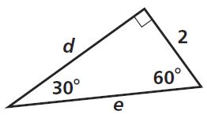
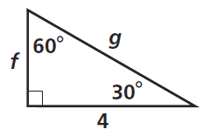
Review Problems
24

Slide 26
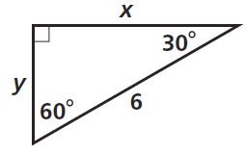
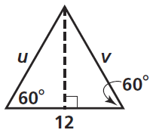
Review Problems
25

Slide 27
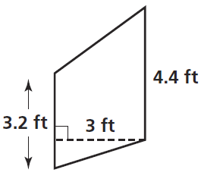
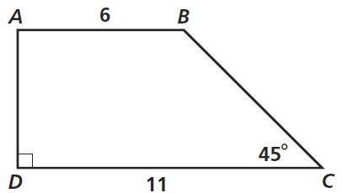
Review Problems
26

Slide 28
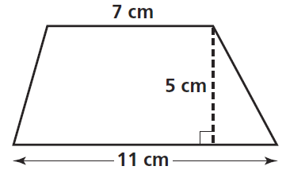
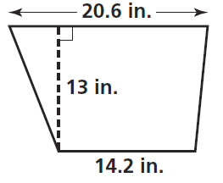
Review Problems
27

Slide 29
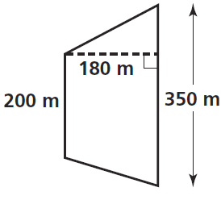
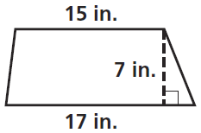
Review Problems
28

Slide 30
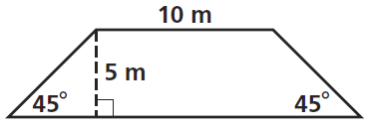
Review Problems
29

Slide 31
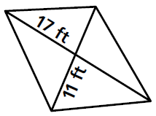
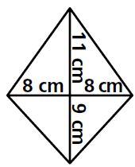
Review Problems
30

Slide 32
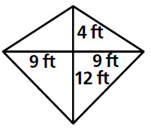
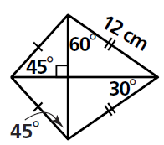
Review Problems
31

Slide 33
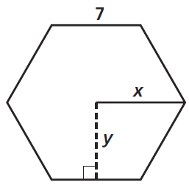
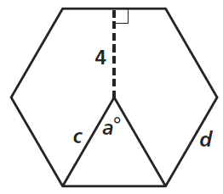
Review Problems
32

Slide 34
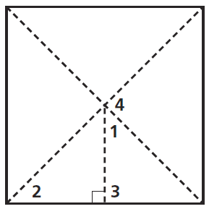
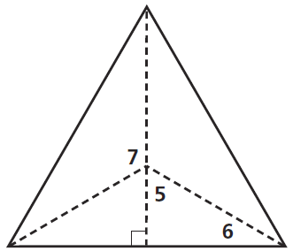
Review Problems
33

Slide 35
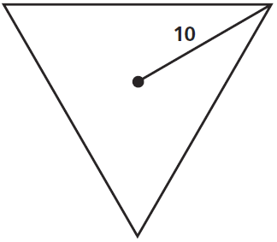
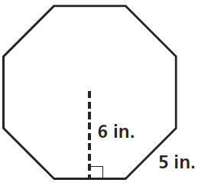
Review Problems
34

Slide 36
Review Problems
35

Slide 37
Review Problems
36

Slide 38
Review Problems
37

Slide 39
Review Problems
38

Slide 40
Review Problems
39

Slide 41
Review Problems
40

Slide 42
Review Problems
165°
60°
130°
41

Slide 43
Review Problems
42

Slide 44
Review Problems
43

Slide 45
Review Problems
44

Slide 46
Review Problems
45

Slide 47
Review Problems
46

Slide 48
Review Problems
47

Slide 49
Review Problems
48

Slide 50
Review Problems
49

Slide 51
Review Problems
50

Slide 52
Review Problems
51

Slide 53
Review Problems
52

Slide 54
Review Problems
53

Slide 55
Review Problems
54

Slide 56
Review Problems
55

Slide 57
Review Problems
56

Slide 58
Review Problems
57

Slide 59
Review Problems
58

Slide 60
Review Problems
59

Slide 61
Review Problems
60

Slide 62
Review Problems
61

Slide 63
Review Problems
62

Slide 64
Answers
No
No
No
No

Slide 65
Answers

Slide 66
Answers
130°
165°
60°

Slide 67
Answers

