Slide 1
Geometry 5-2
Bisectors in Triangles

Slide 2
Class Needs
Straight Edge
Patty Paper

Slide 3
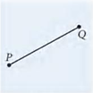
Investigation
Finding a right bisector the easy way

Slide 4
Investigation
Fold your patty paper so that endpoint P and Q land exactly on top of each other, that is , the coincide. Crease your paper along the fold

Slide 5
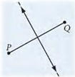
Investigation
Unfold your paper. Draw a line in the crease. What is the relationship of this line to PQ? Use your ruler and protractor to verify your observations.

Slide 6
Perpendicular Bisector Theorem
If a point is on the perpendicular bisector of a segment, then it is equidistant from the endpoints of the segment

Slide 7
Converse - Perpendicular Bisector Theorem
If a point is equidistant from the endpoints of a segment, then it is on the perpendicular bisector of the segment

Slide 8
Investigation
On patty paper, draw a large-scale angle. Label it PQR

Slide 9
Investigation

Slide 10
Investigation

Slide 11
Investigation
Place a point on your angle bisector. Label it A. Compare the distances from A to each of the two sides. Remember that “distance” means the shortest distance. Try it with other points on the angle bisector.

Slide 12
Angle Bisector Theorem
If a point is on the bisector of an angle, then it is equidistant from the sides of the angle

Slide 13
Converse - Angle Bisector Theorem
If a point is the interior of an angle is equidistant from the sides of the angle, then the point is on the angle bisector.

Slide 14
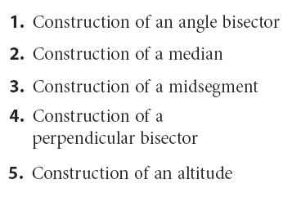
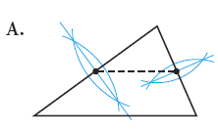
Practice
Construction of a midsegment

Slide 15
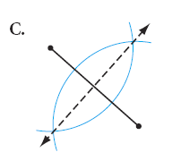
Practice
Construction of a Perpendicular Bisector

Slide 16
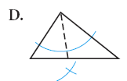
Practice
Construction of an Angle Bisector

Slide 17
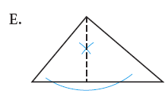
Practice
Construction of an altitude

Slide 18
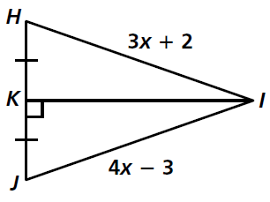
Practice

Slide 19
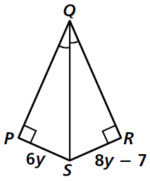
Practice

Slide 20
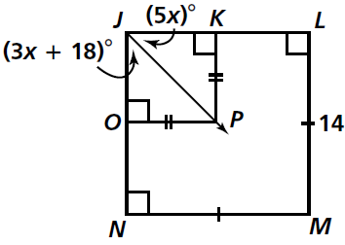
Practice

Slide 21
Practice

Slide 23
Homework
Pages 251 – 254
9, 12 – 16, 18, 19, 56, 57

Slide 24
Honors Homework
Pages 251 – 254
9, 12 – 16, 18, 19, 41, 56, 57

