Slide 1
Geometry 8-6
Perimeters and Areas of Similar Figures

Slide 2
Exploration
Get your supplies
Graph Paper

Slide 3
Exploration
Draw a Rectangle on your graph paper
Calculate its area (in graph units)

Slide 4
Exploration
Multiply each dimension of the rectangle by a scale factor and draw the new larger (smaller) rectangle
Calculate its area

Slide 5
Exploration
What is the ratio of the side lengths?
What is the ratio of the areas?
How many smaller rectangles would it take to fill the larger rectangle?

Slide 6
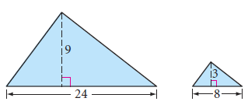
Exploration
Calculate the area of these two similar triangles
108
12
What is the ratio of the side lengths?
What is the ratio of the areas?

Slide 7
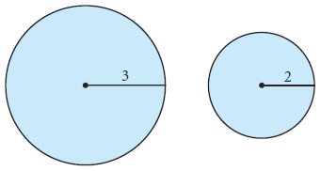
Exploration
Calculate the area of these two circles is terms of pi
9π
4π
What is the ratio of the radii?
What is the ratio of the areas?

Slide 8
Proportional Area
If corresponding side lengths of two similar polygons or the radii of two circles compare in the ratio a/b, then the areas compare in the ratio a²/b².

Slide 9
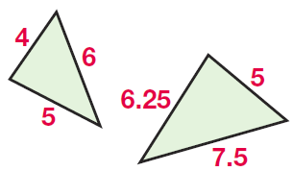
Example

Slide 10
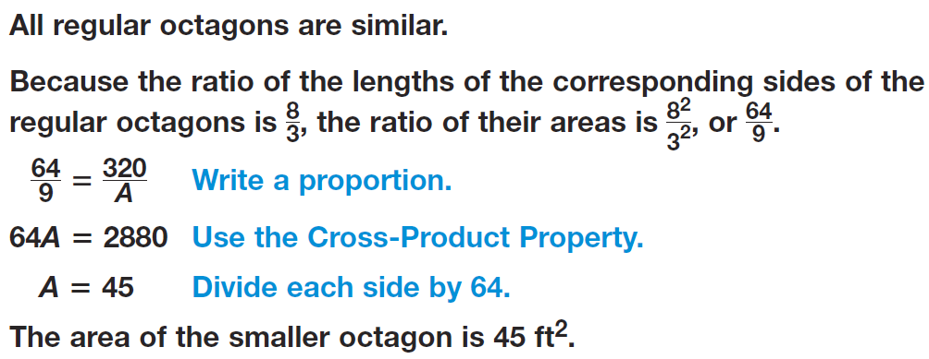
Example

Slide 11
Example

Slide 12
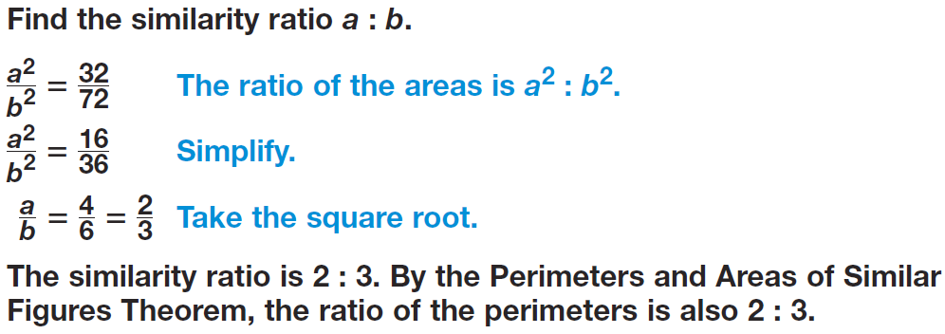
Example

Slide 13
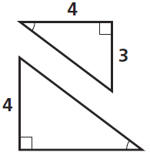
Practice

Slide 14
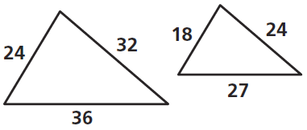
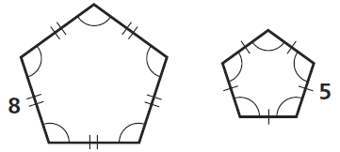
Practice

Slide 15
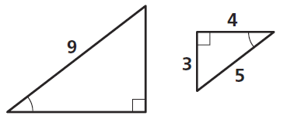
Practice

Slide 16
Practice

Slide 17
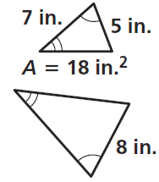
Practice

Slide 18
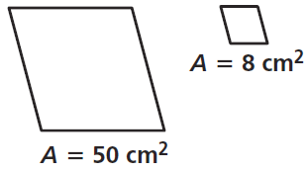
Practice

Slide 19
Practice

Slide 20
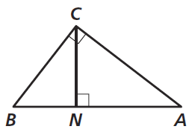
Practice

Slide 21
Practice

Slide 22
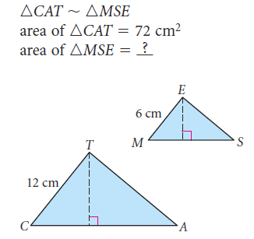
Sample Problems

Slide 23
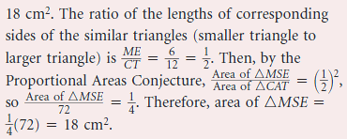
Sample Problems

Slide 24
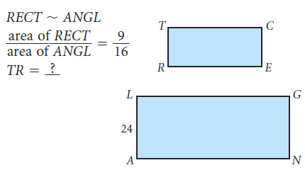
Sample Problems

Slide 25
Sample Problems

Slide 26
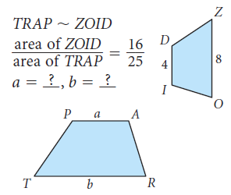
Sample Problems

Slide 27
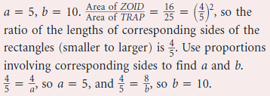
Sample Problems

Slide 28
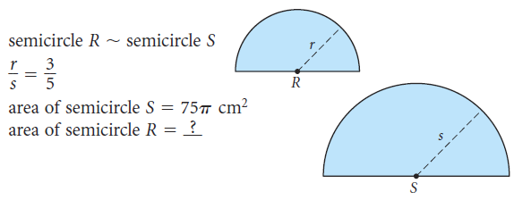
Sample Problems

Slide 29
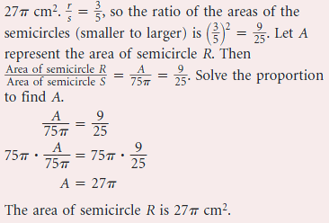
Sample Problems

Slide 30
Homework
Pages 456 – 459
2-18 even, 26, 36, 39, 50, 51

