Slide 1
Geometry 4-2
Triangle Congruence by SSS and SAS

Slide 2
Investigation
Break one piece of spaghetti into three similar length sizes.
Arrange the pieces into a triangle
How many different triangles can you make?
Trace each that is different and compare.

Slide 3
SSS

Slide 4
Congruence

Slide 5
Investigation
Draw a triangle with the following
One 40º angle
The leg left of the angle is 4 inches long
The leg right of the angle is 3 inches long

Slide 6
Investigation
How many different ways can the triangle be constructed?
Compare with classmates nearby

Slide 7
Congruence

Slide 8
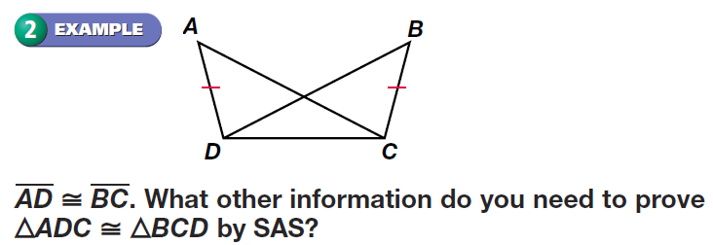
Congruence

Slide 9
Congruence

Slide 10
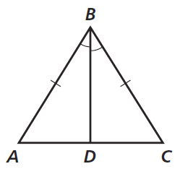
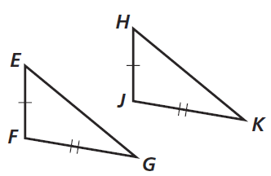
Congruence

Slide 11
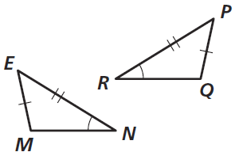
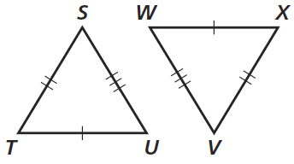
Congruence

Slide 12
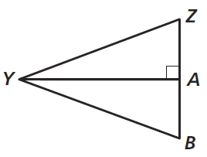
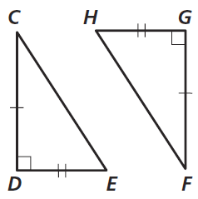
Congruence

Slide 13
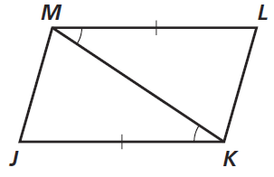
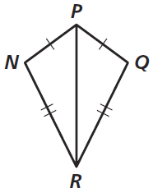
Congruence

Slide 14
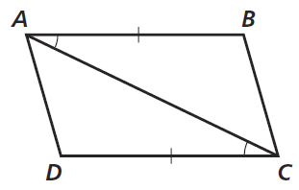
Congruence

Slide 15
Homework
Pages 189 – 192
1 – 4 , 14 – 21, 33, 53

Slide 16
Honors Homework
Pages 189 – 192
1 – 4 , 14 – 21, 33, 42, 53

