Slide 1
Geometry 10-4
Surface Areas of Pyramids and Cones

Slide 2
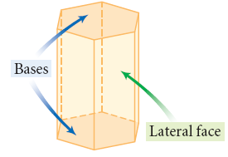
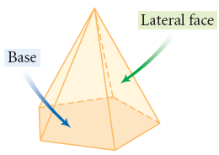
Surface Area
Lateral Faces and Bases in Prisms and Pyramids

Slide 3
Vocabulary
Pyramid – A polyhedron with a base, and the remaining faces are triangles meeting at one point
Vertex of a Pyramid – The point where triangles meet
Altitude – The height of a pyramid
Slant Height – The height of a lateral face triangle in a pyramid

Slide 4
Surface Area

Slide 5
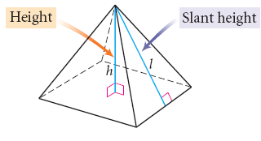
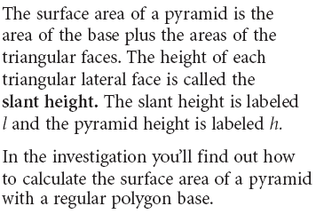
Surface Area

Slide 6
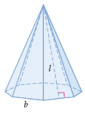
Surface Area

Slide 7
Surface Area
½ bl

Slide 8
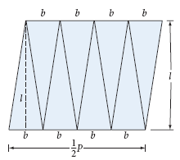
Surface Area
½ nbl or ½ pl

Slide 9
Surface Area
½ anb or ½ ap

Slide 10
Surface Area
½ anb + ½ nbl = ½ nb ( a + l )

Slide 11
Surface Area
½ ap + ½ pl = ½ p ( a + l )

Slide 12
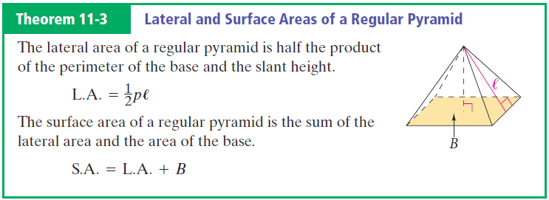
Surface Area of a Pyramid

Slide 13
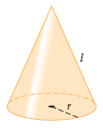
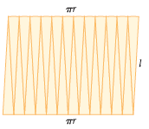
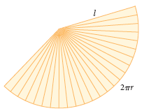
Surface Area

Slide 14
Surface Area
πr²

Slide 15
Surface Area
2πr / 2πl = r/l

Slide 16
Surface Area
πl² r / l = l π r

Slide 17
Surface Area
πr ( r + l )

Slide 18
Surface Area

Slide 19
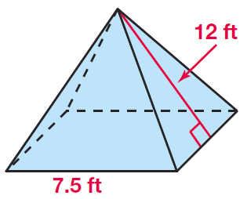
Example

Slide 20
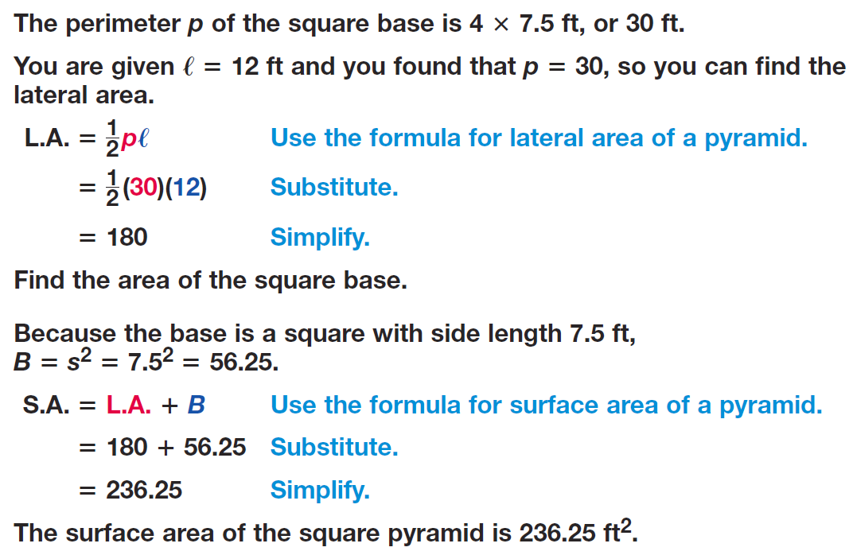
Example

Slide 21
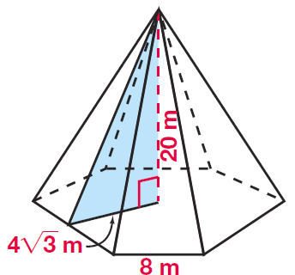
Example

Slide 22
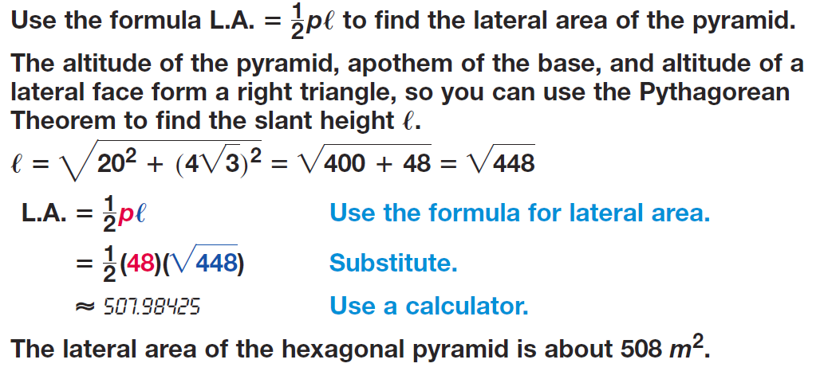
Example

Slide 23
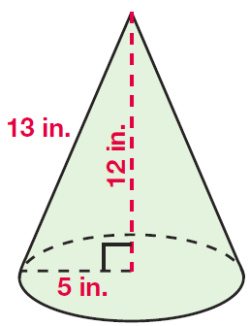
Example

Slide 24
Example

Slide 25
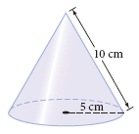
Surface Area - Example

Slide 26
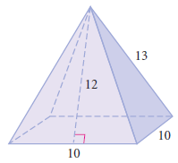
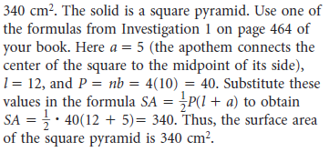
Practice Problems

Slide 27
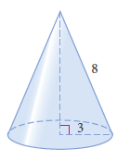
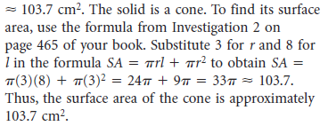
Practice Problems

Slide 28
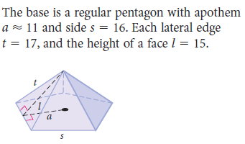
Practice Problems

Slide 29
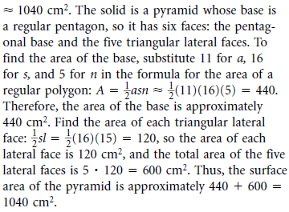
Practice Problems

Slide 30
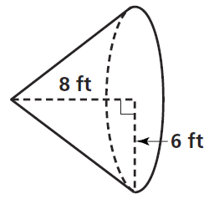
Practice Problems

Slide 31
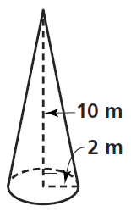
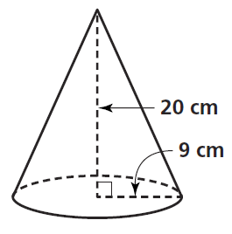
Practice Problems

Slide 32
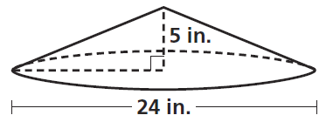
Practice Problems

Slide 33
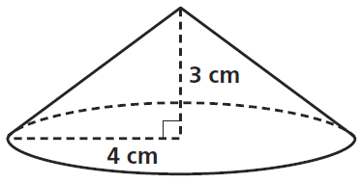
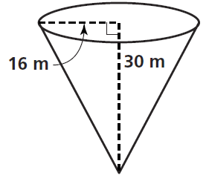
Practice Problems

Slide 34
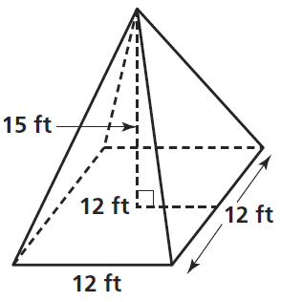
Practice Problems

Slide 35
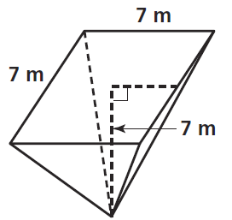
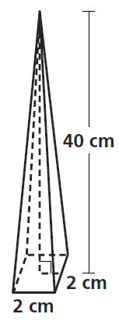
Practice Problems

Slide 36
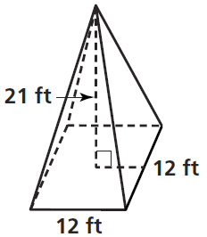
Practice Problems

Slide 37
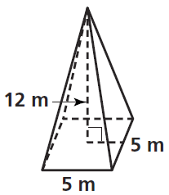
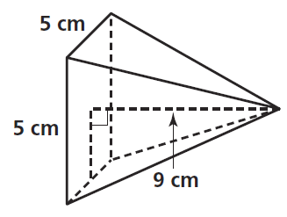
Practice Problems

Slide 38
Homework
Pages 540 – 543
2 – 20 even, 26, 32, 62

Slide 39
Honors Homework
Pages 540 – 543
2 – 20 even, 26, 31 - 33, 46, 48, 62

