Slide 1
Geometry 4-R
Unit 4 Congruent Triangles
Review Problems

Slide 2
True
False
True
Review Problems
1

Slide 3
False
False
True
Review Problems
2

Slide 4
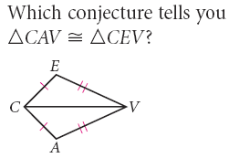
Review Problems
3

Slide 5
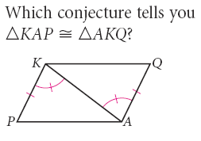
Review Problems
4

Slide 6
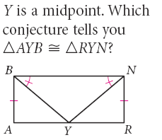
Review Problems
5

Slide 7
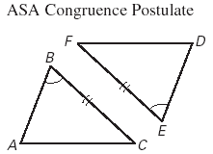
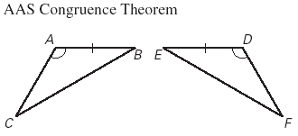
Review Problems
6

Slide 8
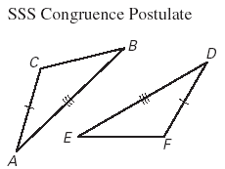
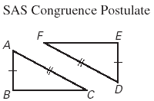
Review Problems
7

Slide 9
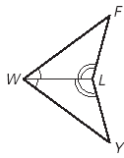
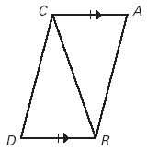
Yes, SAS
Yes, ASA
Review Problems
8

Slide 10
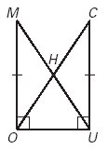
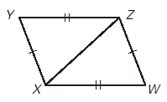
Yes, SAS
Yes, SSS
Review Problems
9

Slide 11
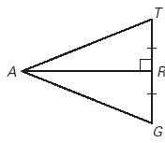
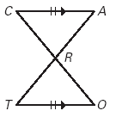
Yes, SAS
Yes, SAS
Review Problems
10

Slide 12
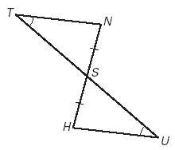
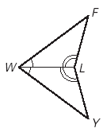
Yes, AAS
Yes, ASA
Review Problems
11

Slide 13
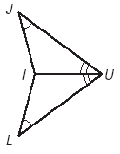
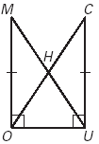
Yes, AAS
Yes, SAS
Review Problems
12

Slide 14
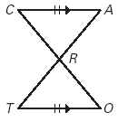
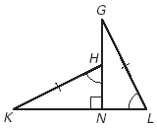
Yes, ASA
Yes, AAS
Review Problems
13

Slide 15
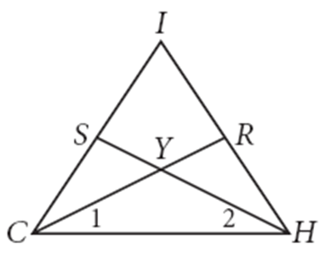
Review Problems
14

Slide 16
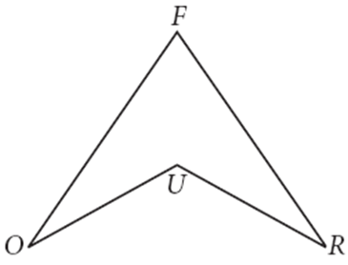
Review Problems
15

Slide 17
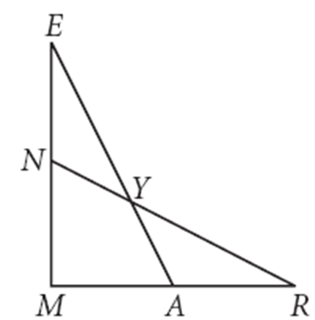
Review Problems
Review Problems
16

Slide 18
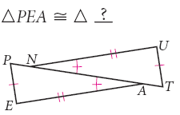
Review Problems
17

Slide 19
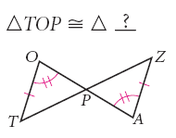
Review Problems
18

Slide 20
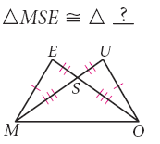
Review Problems
19

Slide 21
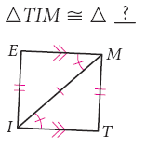
Review Problems
20

Slide 22
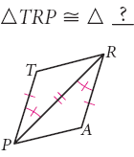
Review Problems
21

Slide 23
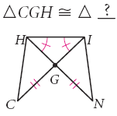
Review Problems
22

Slide 24
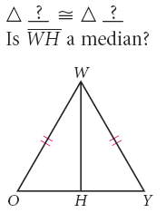
Review Problems
23

Slide 25
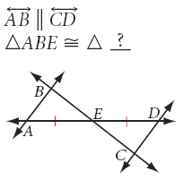
Review Problems
24

Slide 26
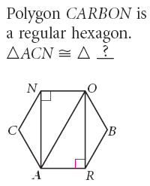
Review Problems
25

Slide 27
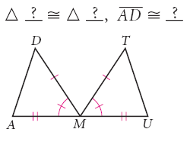
Review Problems
26

Slide 28
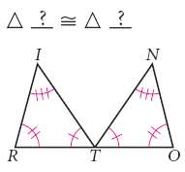
Review Problems
27

Slide 29
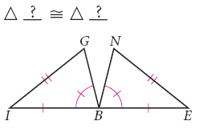
Review Problems
28

Slide 30
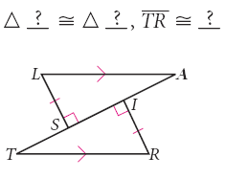
Review Problems
29

Slide 31
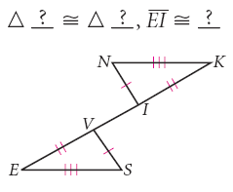
Review Problems
30

Slide 32
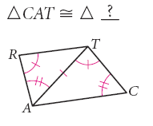
Review Problems
31

Slide 33
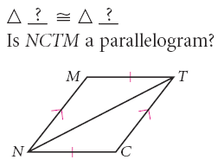
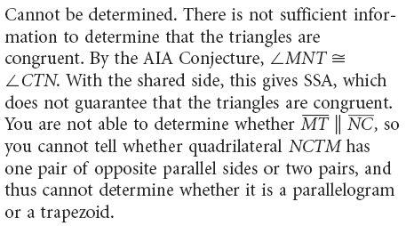
Review Problems
32

Slide 34
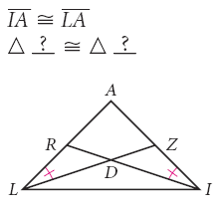
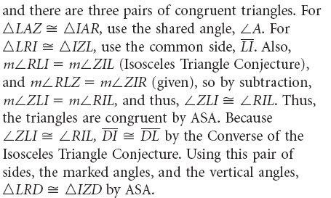
Review Problems
33

Slide 35
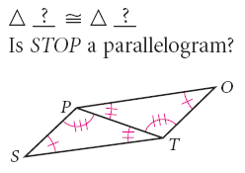
Review Problems
34

Slide 36
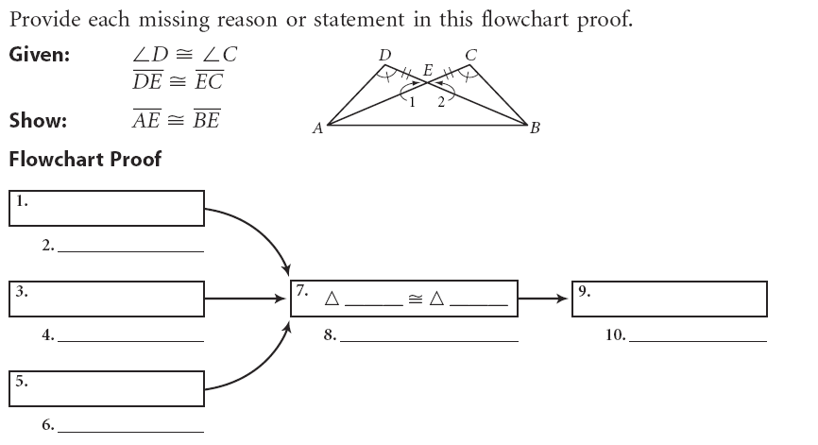
Review Problems
35

Slide 37
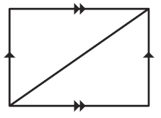
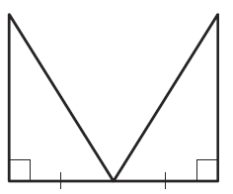
Review Problems
36

Slide 38
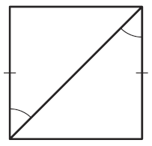
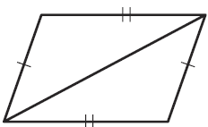
Review Problems
37

Slide 39
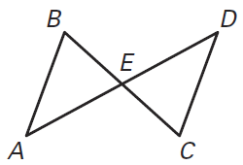
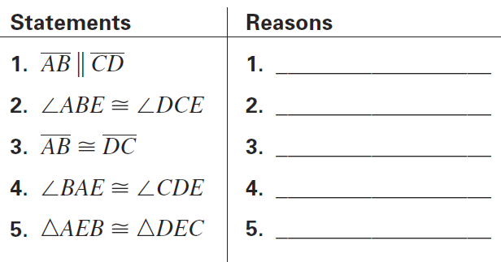
Review Problems
38

Slide 40
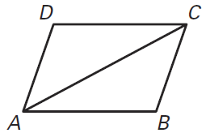
Review Problems
39

Slide 41
Review Problems
40

Slide 42
Review Problems
41

Slide 43
Review Problems
42

Slide 44
Review Problems
43

Slide 45
Review Problems
44

Slide 46
Review Problems
45

Slide 47
Review Problems
46

Slide 48
Review Problems
47

Slide 49
Review Problems
48

Slide 50
Review Problems
49

Slide 51
Review Problems
50

Slide 52
Review Problems
51

Slide 53
Review Problems
52

Slide 54
Review Problems
53

Slide 55
Review Problems
54

Slide 56
Review Problems
55

Slide 57
Review Problems
56

Slide 58
Review Problems
57

Slide 59
Review Problems
58

Slide 60
Review Problems
59

Slide 61
Review Problems
60

Slide 62
Answers
SSS
SAS
SSS
Cannot determine
Yes
Yes
Yes, SAS
Yes, SSS
True
False
True
False
False
True
Yes, SAS
Yes, SAS
Yes, AAS
Yes, ASA
Yes, AAS
Yes, SAS
Yes, ASA
Yes, AAS
Yes, SAS
Yes, ASA

Slide 63
Answers
Cannot Determine
Cannot Determine
Cannot Determine
Cannot Determine
Cannot Determine
Cannot Determine
Cannot Determine

Slide 64
Answers
C

Slide 65
Answers

