Slide 1
Geometry 5-4a
Inverses and Contrapositives

Slide 2
Review
Conditional Statements
Hypothesis - Conclusion

Slide 3
Review

Slide 4
Definitions
Negation – A statement with the opposite meaning of original statement
Inverse – A conditional statement where both the hypothesis and the conclusion are negations
Contrapositive – A conditional statement where both the hypothesis and the conclusion are negated

Slide 5
Summary

Slide 6
Inverses and Contrapositives

Slide 7
Inverses and Contrapositives

Slide 8
Inverses and Contrapositives

Slide 9
Inverses and Contrapositives

Slide 10
Inverses and Contrapositives

Slide 11
Inverses and Contrapositives

Slide 12
Inverses and Contrapositives

Slide 13
Inverses and Contrapositives

Slide 14
Inverses and Contrapositives

Slide 15
Inverses and Contrapositives

Slide 16
Inverses and Contrapositives

Slide 17
Geometry 5-4b
Indirect Reasoning

Slide 18
Definitions
Indirect Reasoning – a type of reasoning in which all possibilities are considered and then the unwanted ones are proved false. The remaining possibilities must be true.

Slide 19
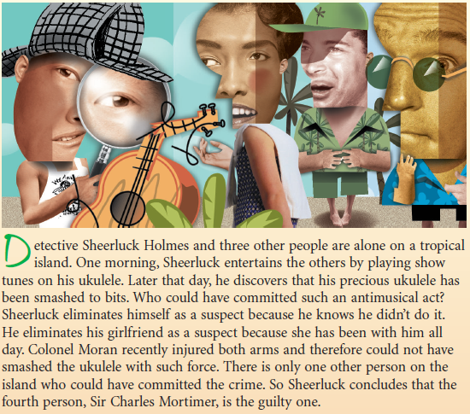

Slide 20
Indirect Reasoning

Slide 21
Indirect Reasoning

Slide 22
Indirect Reasoning
Indirect proofs require the identification of contradictions.
When given three statements, consider each of the three combinations of the statements to identify any and all contradictions

Slide 23
Indirect Reasoning

Slide 24
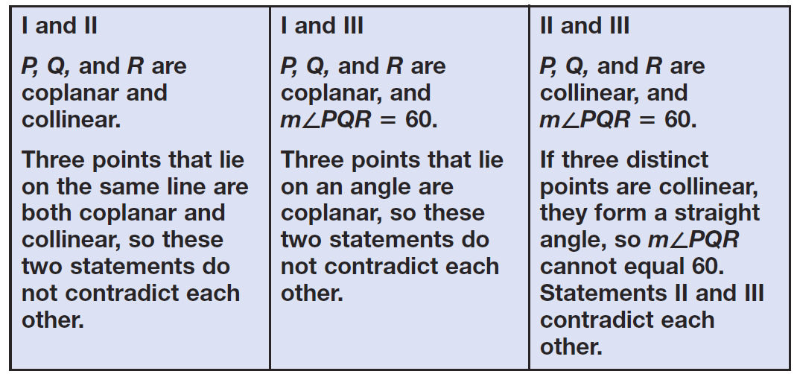
Indirect Reasoning

Slide 25
Indirect Reasoning

Slide 26
Indirect Reasoning

Slide 27
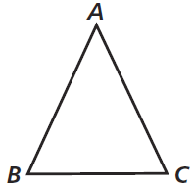
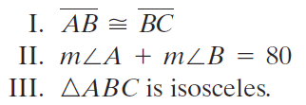
Indirect Reasoning

Slide 28
Indirect Reasoning

Slide 29
Indirect Reasoning

Slide 30
Indirect Reasoning

Slide 31
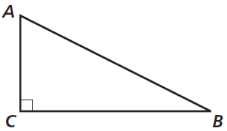
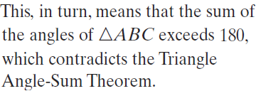
Indirect Reasoning

Slide 32
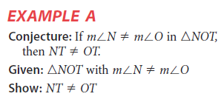
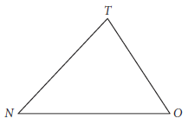
Indirect Reasoning

Slide 33
Indirect Reasoning

Slide 34
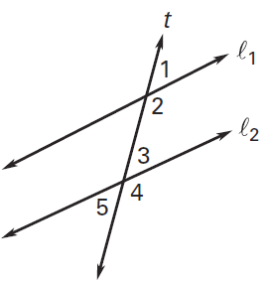
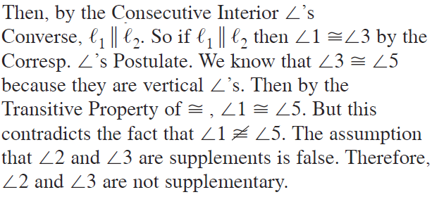
Indirect Reasoning

Slide 35
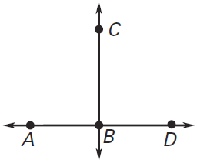
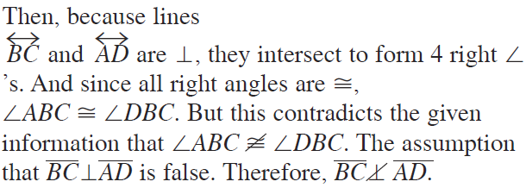
Indirect Reasoning

Slide 36
Homework
Pages 267 – 270
2 – 14 even, 17, 18, 21, 22, 28, 31, 34, 35, 38, 47 - 55

