Slide 1
Geometry 5-3a
Concurrent Lines

Slide 2
Volunteer
Draw three lines, in three different colors on the whiteboard
Where do the lines cross?

Slide 3
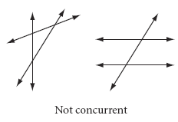
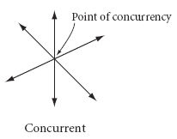
Definition
Concurrent – Lines or segments that have three or more points in common

Slide 4
Investigation
Supplies
Patty Paper - 2
Straight Edge
Compass
Printer paper

Slide 5
Investigation
Draw a large triangle on your patty paper
Some students draw obtuse, some right, some acute

Slide 6
Investigation
Fold Angle Bisectors into each angle of the triangle
Highlight the lines

Slide 7
Investigation
Are the angle bisectors concurrent?
Label and Save this piece of patty Paper

Slide 8
Angle Bisector
The three angle bisectors of a triangle are concurrent
Incenter

Slide 9
Investigation
Draw a large triangle on your patty paper
Some students draw obtuse, some right, some acute

Slide 10
Investigation
Fold perpendicular bisectors into each side of your triangles
Highlight the altitudes

Slide 11
Investigation
Are the perpendicular bisectors concurrent?
Label and Save this piece of patty Paper

Slide 12
Perpendicular Bisector
The three perpendicular bisectors of a triangle are concurrent
Circumcenter

Slide 13
Investigation
Use the Circumcenter patty paper
Measure the distance from the Circumcenter to each of the vertices

Slide 14
Investigation
Tape or glue the patty paper to another piece of paper

Slide 15
Investigation
Use the Circumcenter as the center of a circle, and a vertex as the radius, and construct a circle around your triangle.

Slide 16
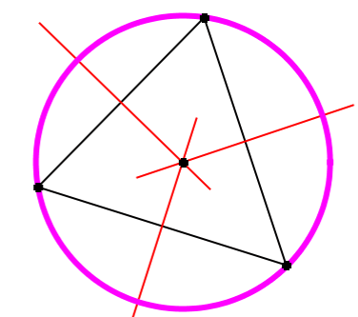
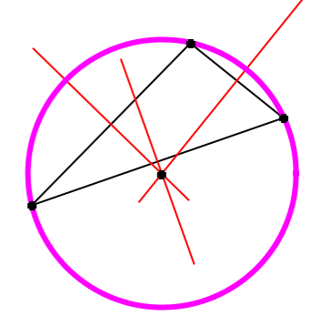
Circumcenter Theorem
The perpendicular bisectors of the sides of a triangle are concurrent at a point equidistant from the vertices

Slide 17
Investigation
Use the Incenter patty paper
Measure the distance from the Incenter to each of the three sides (perpendicular distances)

Slide 18
Investigation
Tape or glue the patty paper down, and construct a circle, with the incenter as the center and the distance to the sides as the radius

Slide 19
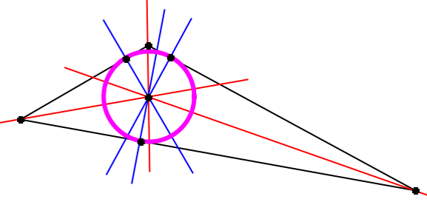
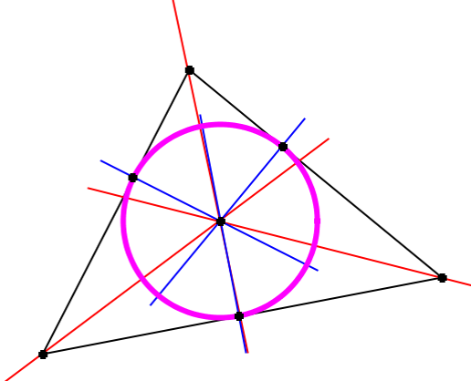
Incenter Theorem
The bisectors of the angles of a triangle are concurrent at a point equidistant from the sides

Slide 20
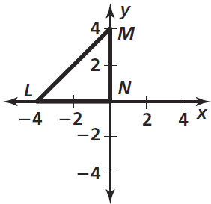
Practice Problems

Slide 21
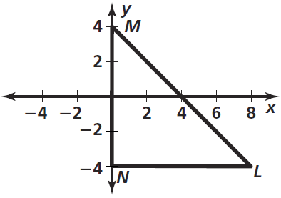
Practice Problems

Slide 22
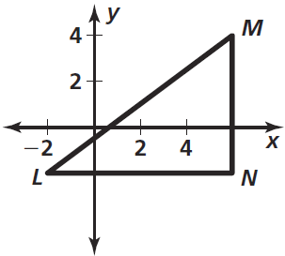
Practice Problems

Slide 23
Homework
Pages 259 – 263
2, 3, 6, 8, 9, 19, 21, 45

Slide 24
Honors Homework
Pages 259 – 263
2, 3, 6, 8, 9, 19, 21, 31, 45

