Slide 1
Geometry 7-8
Geometric Probability

Slide 2
Review

Slide 3
Areas

Slide 4
Area
Area of a Triangle

Slide 5
Theorem
The Pythagorean theorem
In a right triangle, the sum of the squares of the legs of the triangle equals the square of the hypotenuse of the triangle
B
c
a
C
A
b

Slide 6
Theorem
Converse of the Pythagorean theorem
If the square of the length of the longest side of a triangle is equal to the sum of the squares of the lengths of the other two sides, then the triangle is a right triangle.
B
c
a
C
A
b

Slide 7
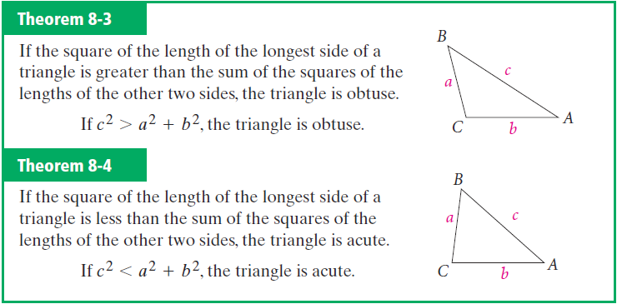
Converse of Pythagorean

Slide 8
Theorem
45° – 45° – 90° Triangle
In a 45° – 45° – 90° triangle the hypotenuse is the square root of two times as long as each leg

Slide 9
Theorem
30° – 60° – 90° Triangle
In a 30° – 60° – 90° triangle, the hypotenuse is twice as long as the shorter leg, and the longer leg is the square root of three times as long as the shorter leg

Slide 10
Area

Slide 11
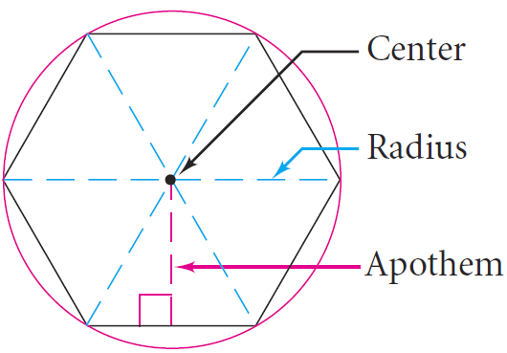
Vocabulary

Slide 12
Area

Slide 13
Circle Vocabulary (review)
Circle – The set of all points in a plane that are equidistant from a given point
Center – Equidistant point of a circle
Radius – Distance from the center of a circle to a point on the circle
Diameter – Distance from a point on the circle to another point on the circle through the center of the circle
Congruent Circles – Circles with congruent radii
Central Angle – Angle with vertex at the center of the circle

Slide 14
Arc Vocabulary
Central Angle
An angle whose vertex is the center of a circle
Major Arc
Part of the circle that measures between 180° and 360°
Part of the circle that measures between 0° and 180°
Minor Arc
Semicircle
An arc whose endpoints are the endpoints of a diameter of a circle
Measure of a Minor Arc
The measure of the arcs central angle
Measure of a Major Arc
The difference between 360° and the measure of its associated minor arc

Slide 15
New Theorem

Slide 16
Example

Slide 17
Circle Area Conjecture
The area of a circle is given by the formula A = πr² where A is the Area of the circle and r is the radius of the circle

Slide 18
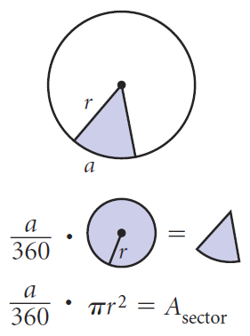
Sector of a Circle

Slide 19
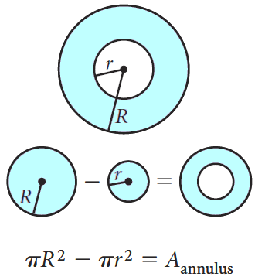
Annulus of a Circle

Slide 20
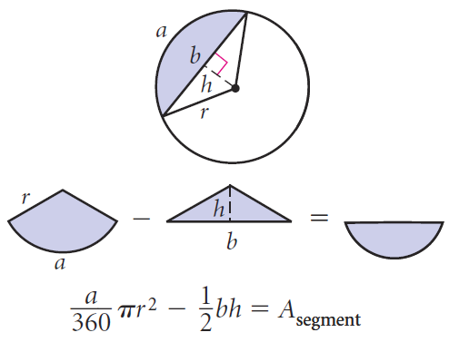
Segment of a Circle*

Slide 21
Geometric Probability
New Material

Slide 22
Probability
Probability
Number from zero to one that represents a chance that an event will occur
0 = Event cannot occur
1 = Event certain to occur

Slide 23
Probability
Geometric Probability
Related process in which the division involves geometric measures such as length or area
Probability and Length
Probability and Area

Slide 24
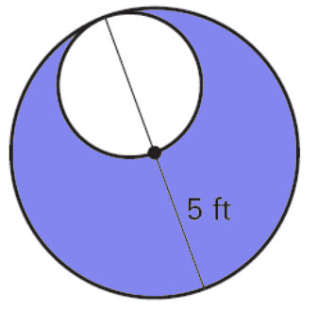
Examples
Find the probability that a randomly point in the figure lies in the shaded region.

Slide 25
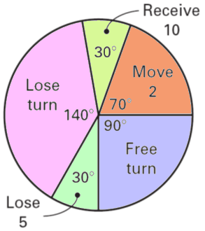
Examples
Find the probability for each outcome on the game spinner shown
a. Receive a free turn
b. Lose a turn
c. Receive ten bonus points
d. Move forward two spaces
e. Lose five points

Slide 26
Example

Slide 27
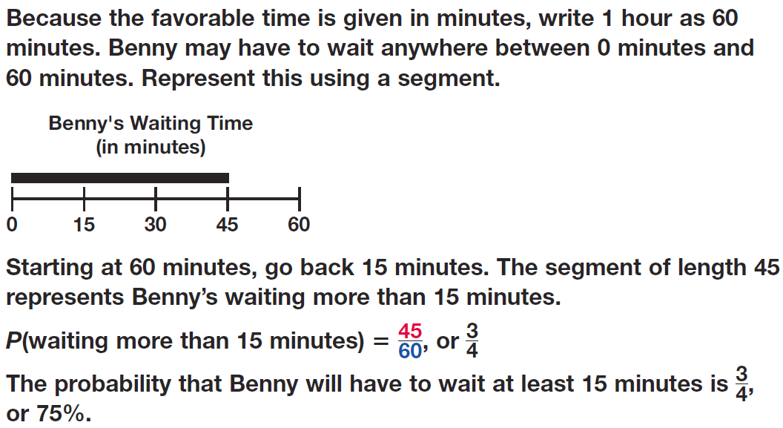
Example

Slide 28
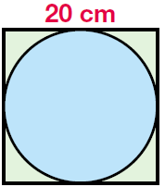
Example

Slide 29
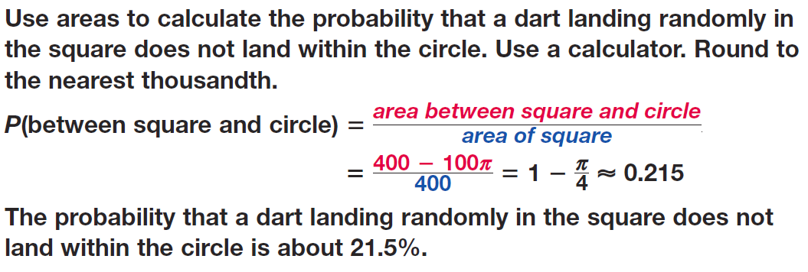
Example

Slide 30
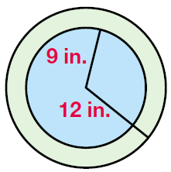
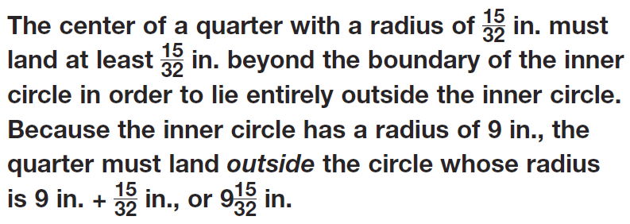
Example

Slide 31
Example

Slide 32
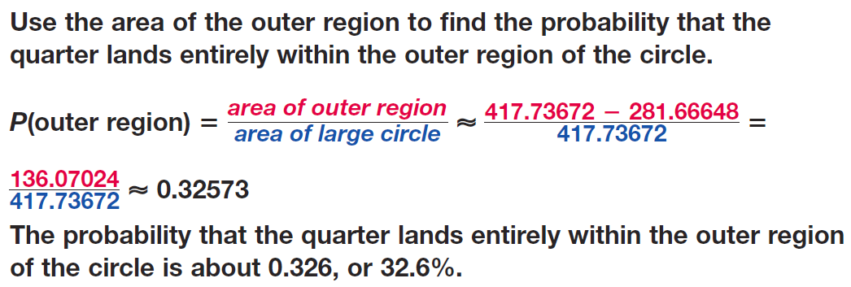
Example

Slide 33
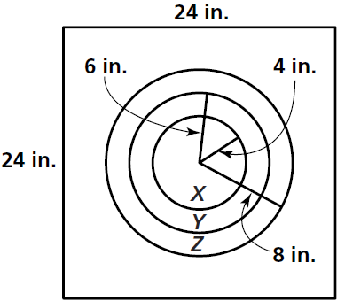
Practice

Slide 34
Practice

Slide 35
Practice

Slide 36
Practice

Slide 37
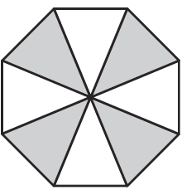
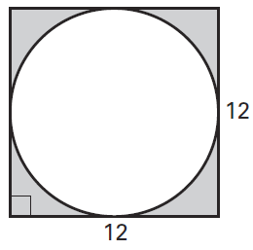
Practice

Slide 38
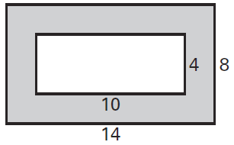
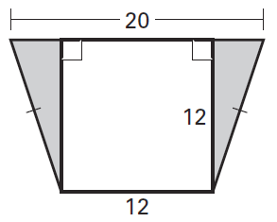
Practice

Slide 39
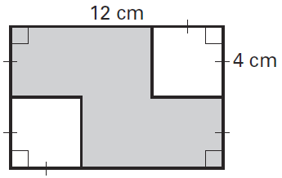
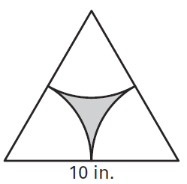
Practice

Slide 40
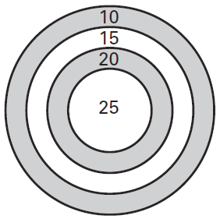
Practice

Slide 41
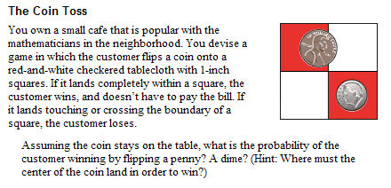

Slide 42
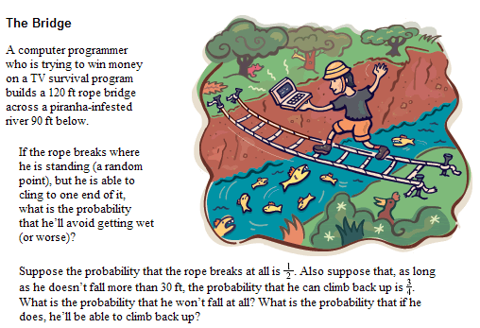

Slide 43
Activity
Create the following target with a single sheet of computer paper
3 in.

Slide 44
Activity
Drop a penny from at least 2 feet to land on the paper. Do not count it if it misses the paper entirely. Count how many land entirely inside the circle.
3 in.

Slide 45
Activity
The diameter of a penny is 0.75 inches.
Calculate the theoretical probability
3 in.

Slide 46
Homework
Pages 404 – 407
1 – 3, 7, 15 – 20, 32, 34, 44, 52 - 54

