Slide 1
Geometry 11-4a
Angle Measures

Slide 2
Supplies
Protractor
Ruler
Compass

Slide 3
Tangent Angle Exploration
Draw a circle ¼ the size of the paper, in the middle of the page. Mark the center U
Construct a vertical tangent through tangent point F.
Add another point N anywhere on the circle.
Construct chord FN
Add radii UF and UN
Measure the central angles and the tangent angles
N
F
U

Slide 4
Tangent Angle Exploration
Extend the chord NU into a secant that intersects the tangent line
Label this intersection point L.
Label the intersection with the circle T.
Measure arc TF and angle ULF
Subtract arc TF from arc FN
N
F
U
T
L

Slide 5
Tangent Angle Exploration
Draw a tangent line through point N until it intersects the other tangent line
Label this intersection point W.
Measure angle W
Subtract the minor arc from the major arc
Compare this to angle W
W
N
F
U

Slide 6
Two Secants - Theorem
If two secants intersect in the exterior of a circle, then the measure of the angle formed is one half the difference of the measures of the intercepted arcs
X
W
V
Z
mŸWVZ = ½ Arcs (XY - WZ)
Y

Slide 7
Tangent Secant - Theorem
If a tangent and a secant intersect in the exterior of a circle, then the measure of the angle formed is one half the difference of the measures of the intercepted arcs
B
A
mŸADC = ½ Arcs (BC - AC)
D
C

Slide 8
Two Tangent - Theorem
If two tangents intersect in the exterior of a circle, then the measure of the angle formed is one half the difference of the measures of the intercepted arcs
P
mŸPSR = ½ Arcs (PQR - PR)
Q
S
R

Slide 9
Chord Chord- Theorem
If two chords intersect, then the measure of each angle is one half the sum of the measures of the arcs intercepted by the angle and it vertical angle
D
mŸDEC = ½ Arcs (CD + AB)
mŸBEC = ½ Arcs (BC + AD)
E
A
C
B

Slide 10
Theorems

Slide 11
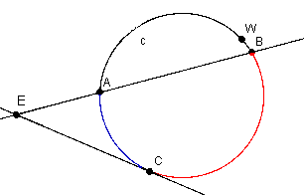
What is the equation?
mŸAEC = ½ Arcs (BC - AC)

Slide 12
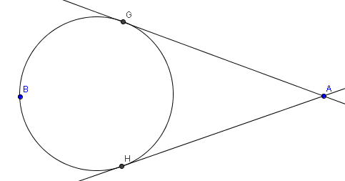
What is the equation?
mŸGAH = ½ Arcs (GBH - GH)

Slide 13
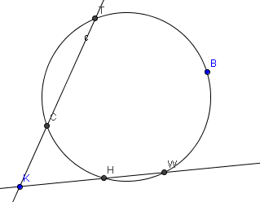
What is the equation?
mŸCKH = ½ Arcs (TBW - CH)

Slide 14
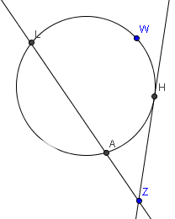
What is the equation?
mŸAZH = ½ Arcs (LWH - AH)

Slide 15
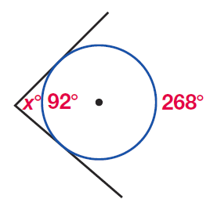
Example

Slide 16
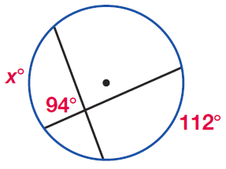
Example

Slide 17
Example

Slide 18
Example

Slide 19
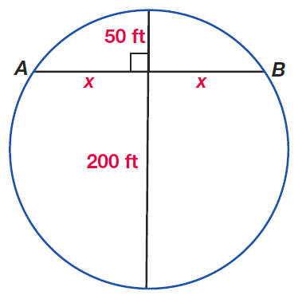
Example

Slide 20
Sample Problems

Slide 21
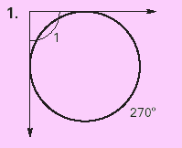
90°

Slide 22
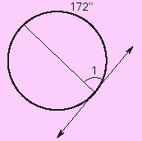
86°

Slide 23
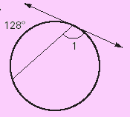
116°

Slide 24
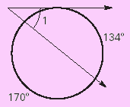
39°

Slide 25
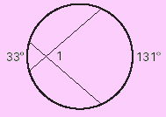
82°

Slide 26
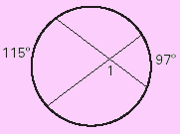
74°

Slide 27
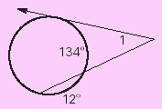
40°

Slide 28
24.5°

Slide 29
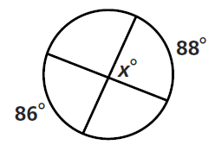
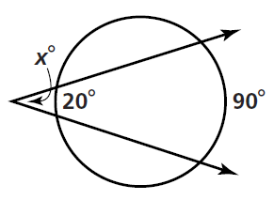
Practice Problems

Slide 30
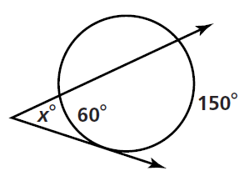
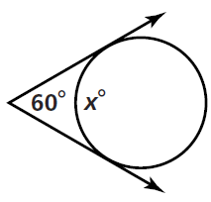
Practice Problems

Slide 31
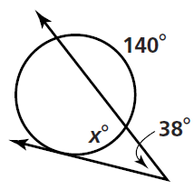
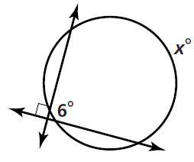
Practice Problems

Slide 32
Homework
Pages 611 – 613
1 – 6, 43, 44

