Slide 1
Algebra 2 8-6
Radical Expressions and Rational Exponents

Slide 2
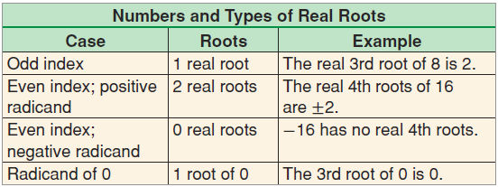
Property

Slide 3
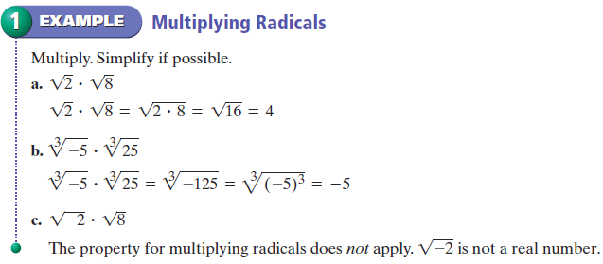
Multiply Radicals - Example

Slide 4
Multiply Radicals - Practice

Slide 5
Simplified Radical Expressions
Radical expressions are considered “simplified” when all possible integers have been brought outside the radical sign.

Slide 6
Simplify Radicals - Example

Slide 7
Simplify Radicals - Practice

Slide 8
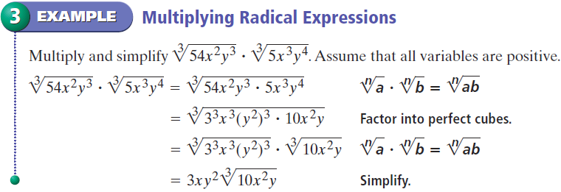
Simplify Radicals - Example

Slide 9
Simplify Radicals - Practice

Slide 10
Property

Slide 11
Simplify Radicals - Example

Slide 12
Simplify Radicals - Practice

Slide 13
Definition
Rationalize the Denominator – Rewriting a fraction so there are no radicals in the denominator. Multiplying the denominator by any radicals removes the radical.

Slide 14
Rationalizing - Example

Slide 15
Rationalizing - Example

Slide 16
Rationalizing - Practice

Slide 17
Summary

Slide 18
Big Idea - Summary
Multiplication and division inside radicals can be combined
Simplified without radical in denominator
Simplified when no integers can be removed

Slide 19
Summary

Slide 20
Example

Slide 21
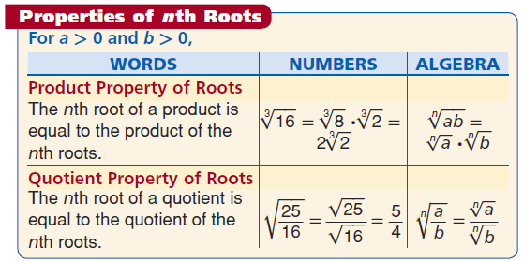
Radical Expressions

Slide 22
Vocabulary
Rational Exponents – Another way to write radical expressions

Slide 23
Rational Exponents

Slide 24
Conjugates - Example

Slide 25
Rational Exponents - Practice

Slide 26
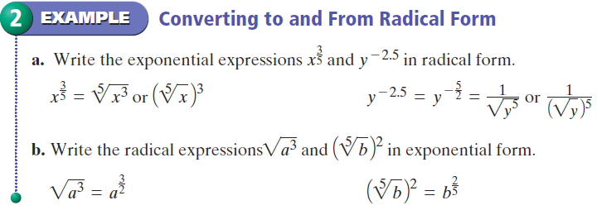
Rational Exponents - Example

Slide 27
Rational Exponents - Practice

Slide 28
Rational Exponents - Practice

Slide 29
Exponents - Summary

Slide 30
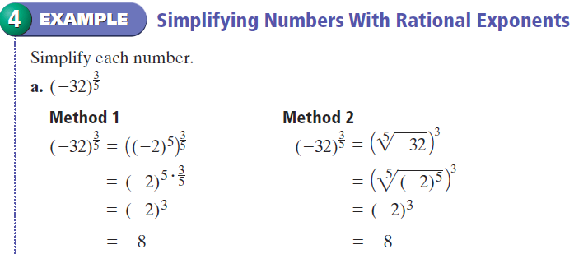
Rational Exponents - Example

Slide 31
Rational Exponents - Example

Slide 32
Rational Exponents - Practice

Slide 33
Rational Exponents
Simplified exponents are always positive numbers

Slide 34
Rational Exponents - Example

Slide 35
Rational Exponents - Practice

Slide 36
Big Idea - Summary
Radical index is denominator of fractional exponent
Multiply terms with common base – Add exponents
Divide terms with common base – Subtract the denominator
Negative exponents – Make positive and switch to other side of fraction
Exponent to an exponent – Multiply exponents

Slide 37
Practice

Slide 38
Practice

Slide 39
Practice

Slide 40
Practice

Slide 41
Practice

Slide 42
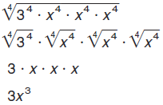
Example

Slide 43
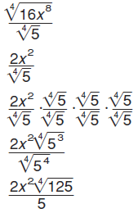
Example

Slide 44
Homework
Pages 615 – 616
30 – 56 even, 62-76 even,

