Slide 1
Algebra 2 6-3
Dividing Polynomials Review

Slide 2
Synthetic Division

Slide 3
Synthetic Division - Practice

Slide 4
Synthetic Division - Practice

Slide 5
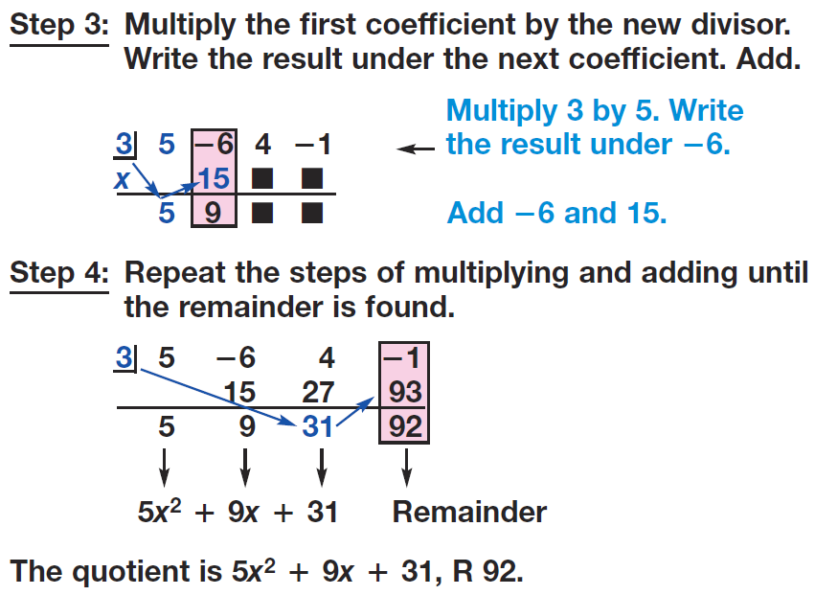
Synthetic Division - Practice

Slide 6
Example

Slide 7
Practice

Slide 8
Practice

Slide 9
Example

Slide 10
Practice

Slide 11
Synthetic Division - Practice

Slide 12
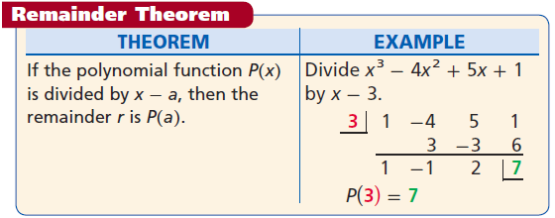
Remainder Theorem

Slide 13
Polynomial Division

Slide 14
Polynomial Division

Slide 15
Polynomial Division

Slide 16
Polynomial Division – Practice

Slide 17
Homework
Pages 426 - 428
5, 6, 31, 45, 49, 53, 71

