Slide 1
Algebra 2 4-1b
Operations with Matrices

Slide 2
Adding Matrices

Slide 3
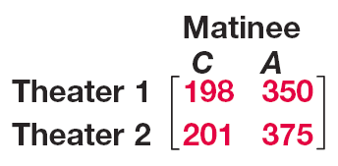
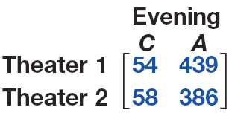
Adding Matrices

Slide 4
Adding Matrices

Slide 5
Adding Matrices

Slide 6
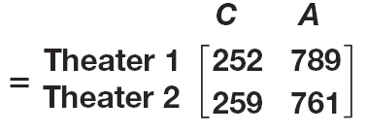
Adding Matrices

Slide 7
Matrix Addition Summary

Slide 8
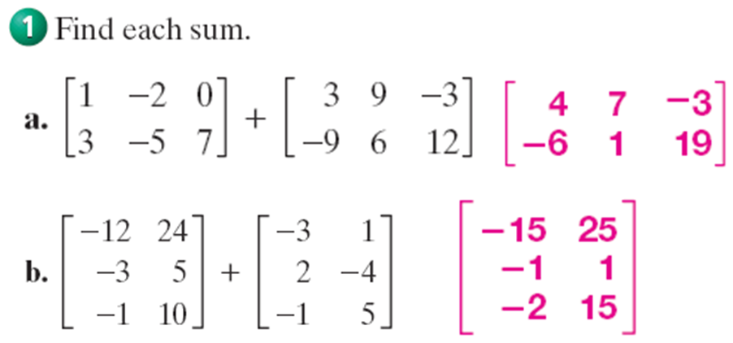
Addition Practice

Slide 9
Vocabulary
Zero Matrix – A matrix whose all elements are zero. The additive identity matrix.
Inverse Matrix – A matrix whose all elements are additive inverses of the original matrix.

Slide 10
Zero, Inverse - Examples

Slide 11
Zero, Inverse - Examples

Slide 12
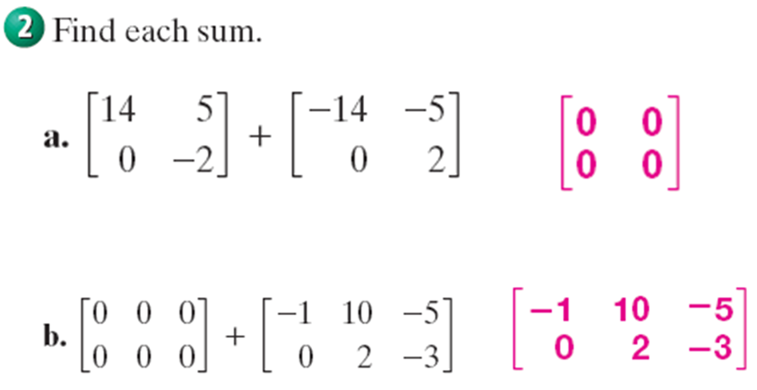
Zero, Inverse - Practice

Slide 13
Summary

Slide 14
Subtraction
Subtraction is addition with the additive inverse
Subtraction may be accomplished by either subtracting, or using the additive inverse

Slide 15
Subtraction - Example

Slide 16
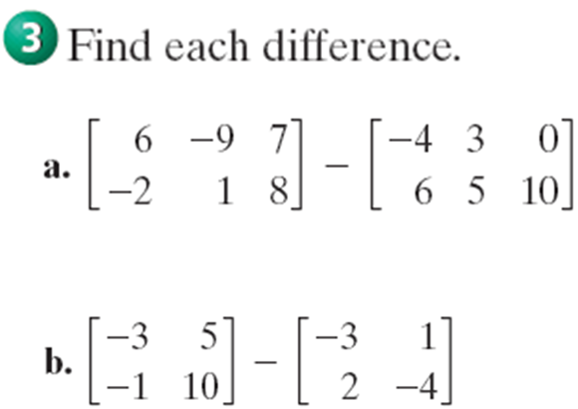
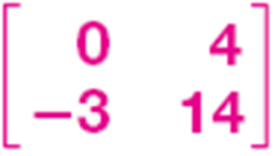
Subtraction - Practice

Slide 17
Solving - Example

Slide 18
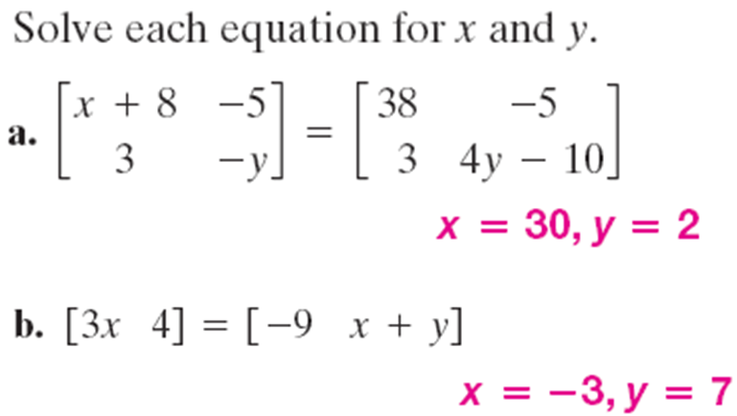
Solving - Practice

Slide 19
Vocabulary
Scalar – A real number factor. Matrices can be multiplied by scalars

Slide 20
Scalar Summary

Slide 21
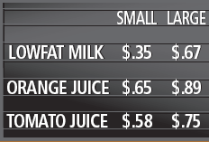
Example

Slide 22
Practice

Slide 23
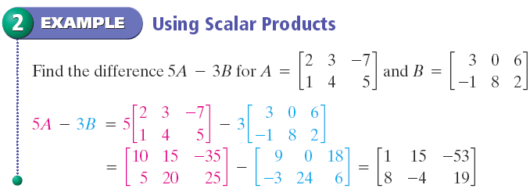
Scalar Products - Example

Slide 24
Practice

Slide 25
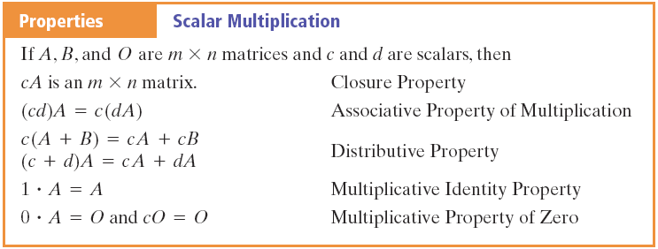
Summary

Slide 26
Solving Matrices with Scalar - Example

Slide 27
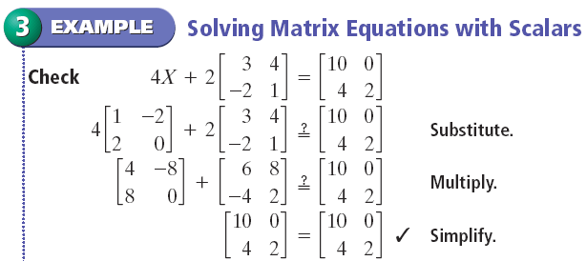
Solving Matrices with Scalar - Example

Slide 28
Solving Matrices with Scalar - Practice

Slide 29
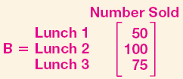
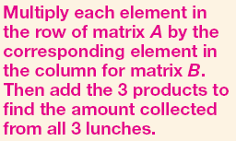
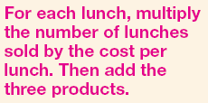

Slide 30
Homework
Pg 250 - 252
13 – 16, 18 – 21, 29, 38

