Slide 1
Algebra 2 2-5
Two Variable Inequalities

Slide 3
2 Variable Investigation
Label the first graph for the following

Slide 4
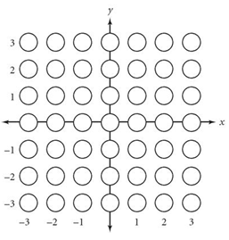
2 Variable Investigation
>
Finish the chart for this equation
>
>
>
<
<
<

Slide 5
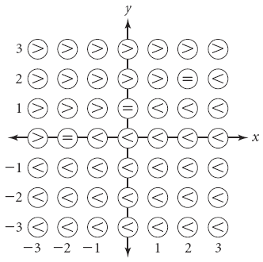

Slide 6
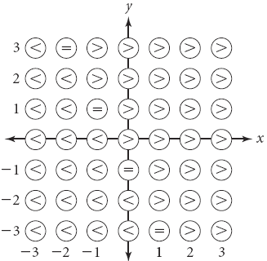

Slide 7
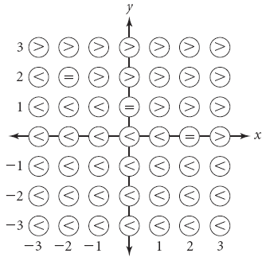

Slide 8
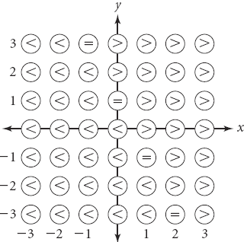

Slide 9
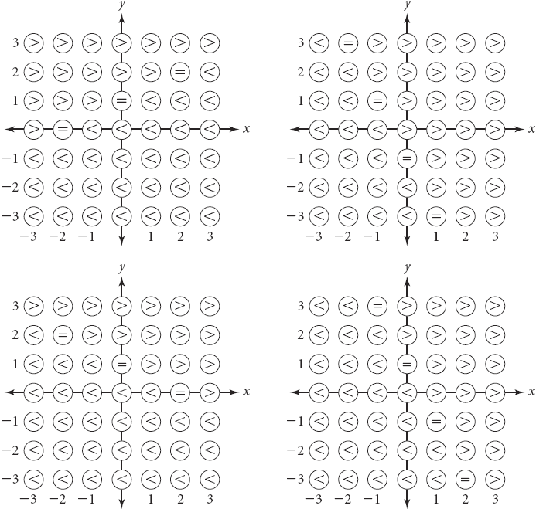
2 Variable Investigation
On all of these graphs, what do you notice about the equal signs?
They are a straight line.

Slide 10
2 Variable Investigation
Where is the straight line?
Along the equation.

Slide 11
2 Variable Investigation
What is above the straight line?
Greater than symbols.

Slide 12
2 Variable Investigation
When given a complete inequality, we shade the region that is true

Slide 13
Two Variable Inequality Summary

Slide 14
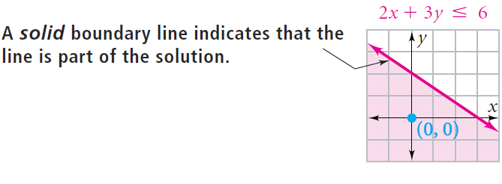

Slide 15
Example

Slide 16
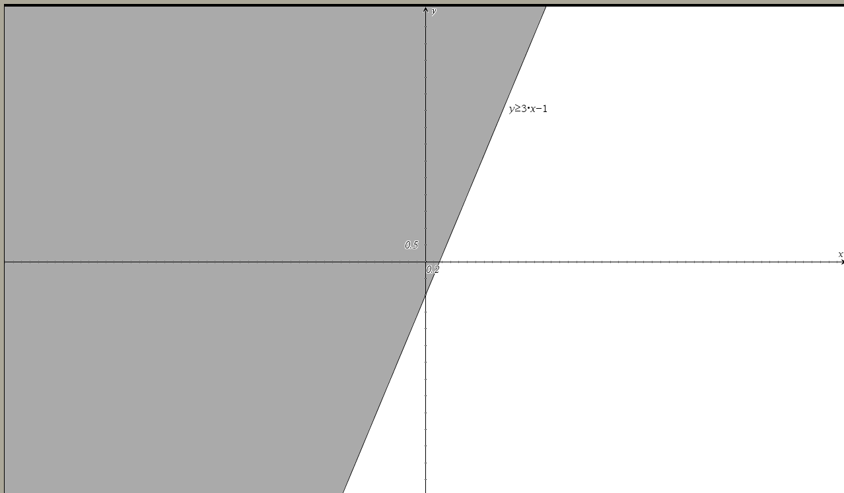
Practice

Slide 17
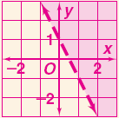
Practice

Slide 18
Example

Slide 19
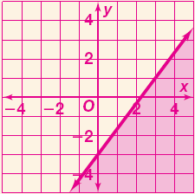
Practice

Slide 20
Homework
Pages 129 - 131
Use Graph Paper
25 – 33, 38 – 40, 43, 58, 62

