Slide 1
Algebra 2 2-8
Solving Absolute Value Equations and Inequalities

Slide 2
Vocabulary
Solution – A number that makes an equation true
Absolute Value – The distance from a number to zero (on a number line).

Slide 3
Absolute Value Inequality

Slide 4
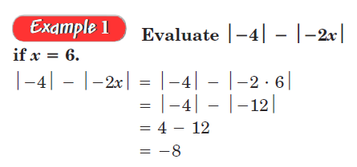
Solving - Example

Slide 5
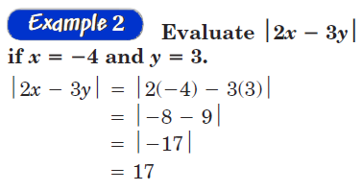
Solving - Example

Slide 6
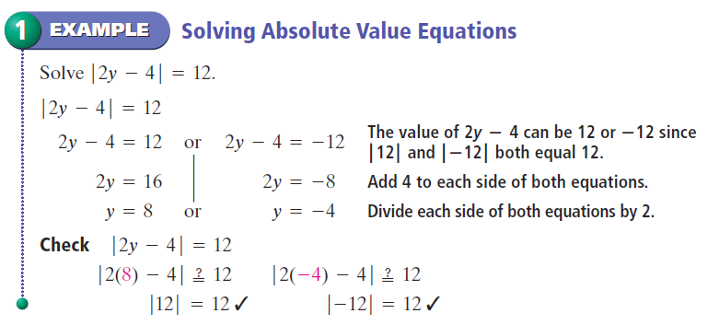
Solving - Example

Slide 7
Solving - Practice

Slide 8
Vocabulary

Slide 9
Solving - Example

Slide 10
Absolute Value - Practice

Slide 11
Solving - Practice

Slide 12
Solving - Practice

Slide 13
Absolute Value Inequality
Greater is OR like an OAR
Less than is AND like a Sandwich

Slide 14
Absolute Value Inequalities
For absolute value inequalities:
“Greater than” treat it like a compound inequality, with “or”
“Less than” treat it like a compound inequality, with “or”

Slide 15
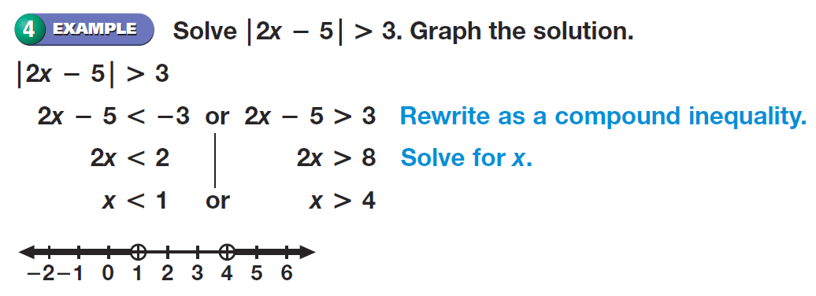
Absolute Value Inequality - Example
Add the solution graph to your notes

Slide 16
Absolute Value Inequality

Slide 17
Absolute Value Inequality

Slide 18
Absolute Value Inequality

Slide 19
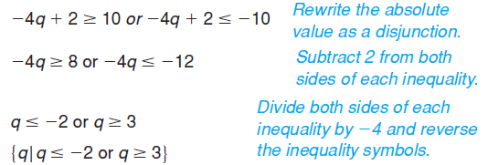
Absolute Value Inequality

Slide 20
Absolute Value Inequality

Slide 21
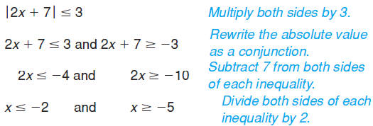
Absolute Value Inequality

Slide 22
Absolute Value Inequality

Slide 23
Absolute Value Inequality - Practice

Slide 24
Absolute Value Inequality

Slide 25
Absolute Value Inequality

Slide 26
Homework
Pages 154 – 156
16 – 19, 32 – 35, 37, 38, 40 – 42, 53, 59, 62

