Slide 1
Algebra 2 4-7
Review Problems
Matrices

Slide 2
Practice
-5
1

Slide 3
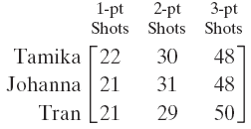
Practice
2

Slide 4
Practice
3

Slide 5
Practice
4

Slide 6
Practice
5

Slide 7
Practice
6

Slide 8
Practice
7

Slide 9
Practice
8

Slide 10
Practice
9

Slide 11
Practice
10

Slide 12
Practice
11

Slide 13
Practice
12

Slide 14
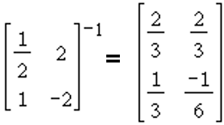
Practice
Given the inverse matrix relationship shown, solve the system of equations
13

Slide 15
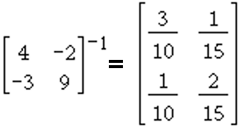
Practice
Given the inverse matrix relationship shown, solve the system of equations
14

Slide 16
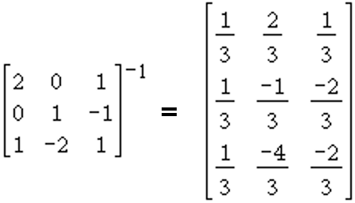
Practice
Given the inverse matrix relationship shown, solve the system of equations
15

Slide 17
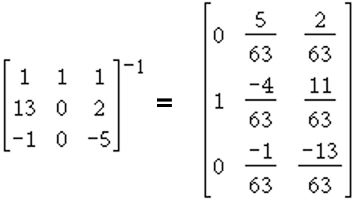
Practice
Given the inverse matrix relationship shown, solve the system of equations
16

Slide 18
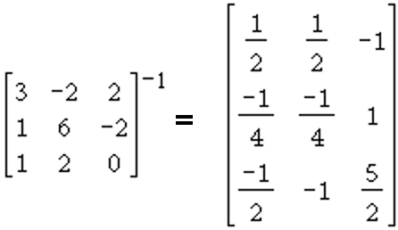
Practice
Given the inverse matrix relationship shown, solve the system of equations
17

Slide 19
Practice
18

Slide 20
Practice
19

Slide 21
Practice
20

Slide 22
Practice
21

Slide 23
Practice
22

Slide 24
Practice
23

Slide 25
Practice
24

Slide 26
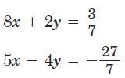
Practice
25

Slide 27
Practice
26

Slide 28
Practice
27

Slide 29
Practice
28

Slide 30
Practice
29

Slide 31
Practice
30

Slide 32
Practice
31

Slide 33
Practice
32

Slide 34
Practice
33

Slide 35
Practice
34

Slide 36
Practice
35

Slide 37
Practice
36

Slide 38
Practice
37

Slide 39
Practice
38

Slide 40
Practice
39

Slide 41
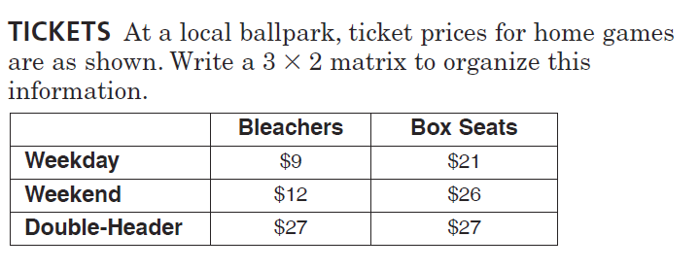
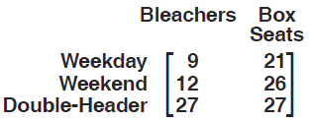
Practice
40

Slide 42
Practice
41

Slide 43
Practice
42

Slide 44
Practice
43

Slide 45
Practice
44

Slide 46
Practice
45

Slide 47
Practice
46

Slide 48
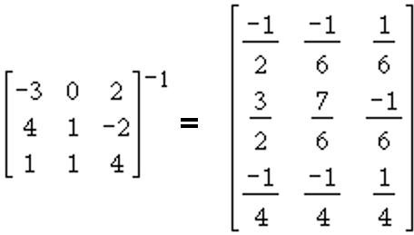
Practice
Given the inverse matrix relationship shown, solve the system of equations
47

Slide 49
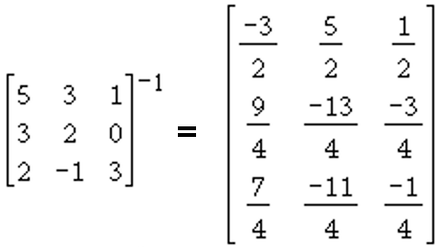
Practice
Given the inverse matrix relationship shown, solve the system of equations
48

Slide 50
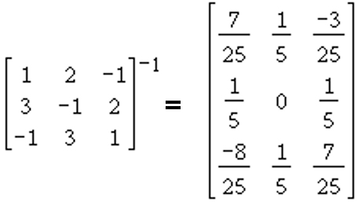
Practice
Given the inverse matrix relationship shown, solve the system of equations
49

Slide 51
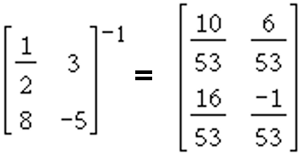
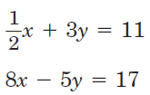
Practice
Given the inverse matrix relationship shown, solve the system of equations
50

Slide 52
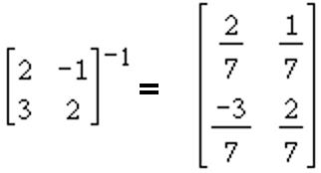
Practice
Given the inverse matrix relationship shown, solve the system of equations
51

Slide 53
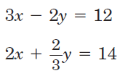
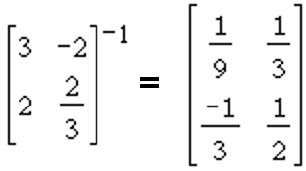
Practice
Given the inverse matrix relationship shown, solve the system of equations
52

Slide 54
Answers
-5

Slide 55
Answers

Slide 56
Answers

