Slide 1
Algebra 2 1-2
Properties of Real Numbers

Slide 2
Warm Up Activity

Slide 3
These are approximations (except for “2”)

Slide 4
Vocabulary
Opposite (Additive Inverse) – the negative of a number. The sum of opposites is zero
Reciprocal (multiplicative inverse) – for any non-zero number it is one divided by the number. The product of reciprocals is one

Slide 5
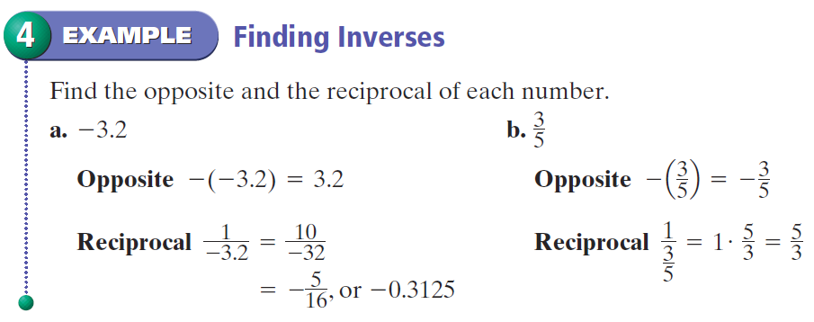
Inverses - Example

Slide 6
Inverses - Practice

Slide 7
Properties of Real Numbers

Slide 8
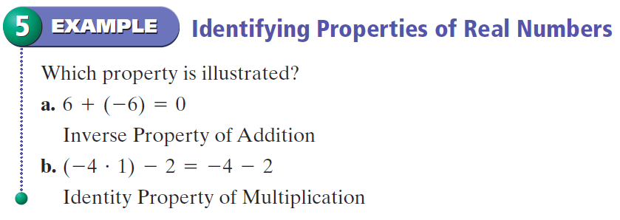
Properties - Example

Slide 9
Properties - Practice

Slide 10
Vocabulary
Absolute Value – The distance of a number from zero on a number line

Slide 11
Absolute Value - Example

Slide 12
Absolute Value - Practice

Slide 13
Practice

Slide 14
Practice

Slide 15
Homework
Pages 17 – 19
15 – 24, 41, 57, 58

