Slide 1
Algebra 2 8-3
Adding and Subtracting Rational Expressions

Slide 2
Addition Subtraction Rationals

Slide 3
Addition Subtraction Rationals

Slide 4
Addition Subtraction Rationals

Slide 5
Addition Subtraction Rationals

Slide 6
Addition Subtraction Rationals

Slide 7
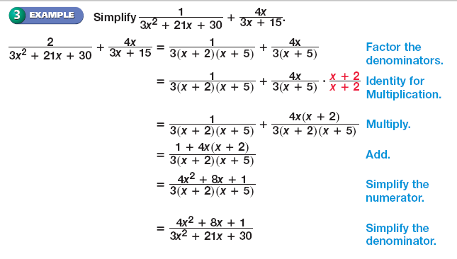
Addition Subtraction Rationals

Slide 8
Addition Subtraction Rationals

Slide 9
Addition Subtraction Rationals

Slide 10
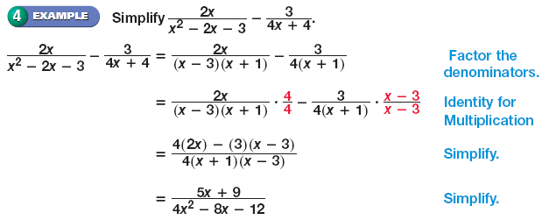
Addition Subtraction Rationals

Slide 11
Addition Subtraction Rationals

Slide 12
Addition Subtraction Rationals
Complex Fractions – A fraction that has a fraction in the numerator or denominator

Slide 13
Addition Subtraction Rationals

Slide 14
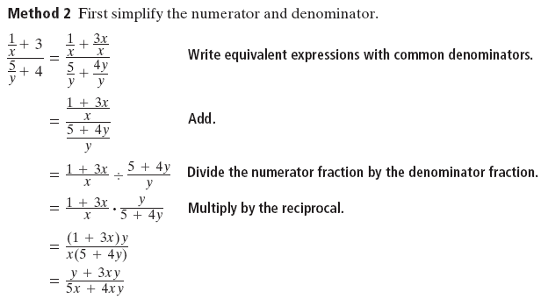
Addition Subtraction Rationals

Slide 15
Addition Subtraction Rationals

Slide 16
Practice Problems

Slide 17
Practice Problems

Slide 18
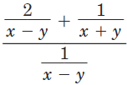
Practice Problems

Slide 19
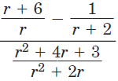
Practice Problems

Slide 20
Homework
Pages 588 - 589
18 – 40 even

