Slide 1
Algebra 2 1-0
Functions

Slide 2
Functions
Function – A function takes an input and alters it in a predictable way to become the output.
INPUT
FUNCTION
OUTPUT

Slide 3
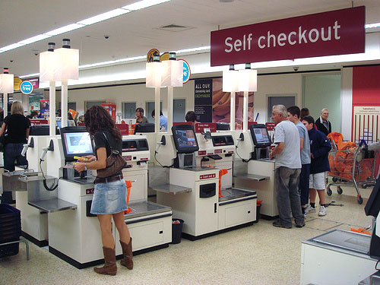
Functions
Lets examine real world functions
Here is one to get you started
UPC Scanner at a store

Slide 4
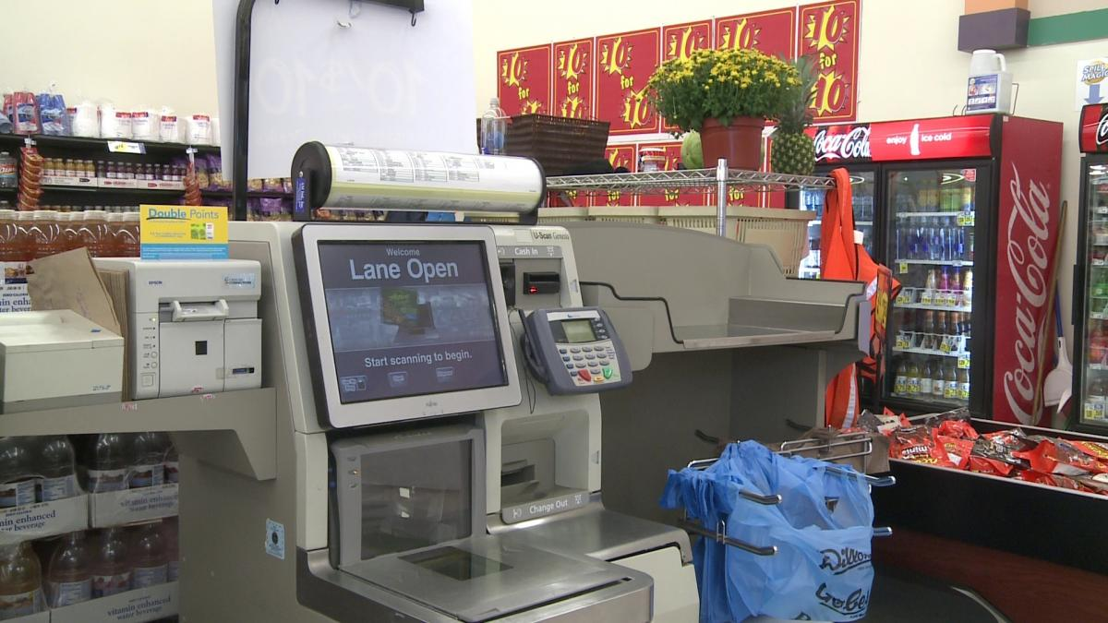
Functions
If you are designing a scanner for your own store, describe some important features of its function.

Slide 5
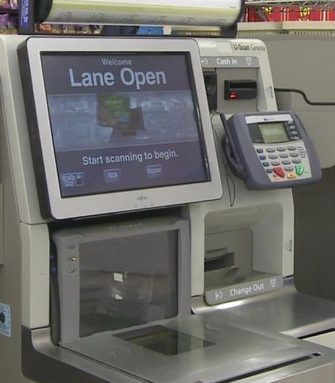
Functions
Here is what I expect from a scanner
Accuracy – reads the input correctly
Maps to the right output
Correct price for each input

Slide 6
Functions
Can an input map to more than one output?
Can more than one input map to the same output?

Slide 7
Functions
Where else might you find something that works like a function?

Slide 8
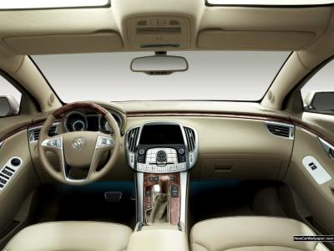
Functions
Lots of parts of a car are functions

Slide 9
Functions
The driver is a function, taking many different inputs and outputting decisions to drive. Humans are great functions, but also very complicated, way more complicated than we plan to model with this class.

Slide 10
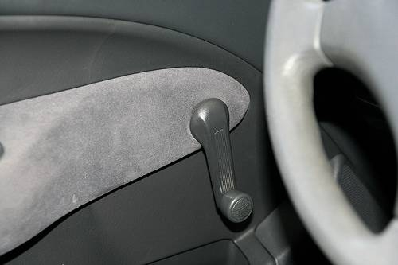
Functions
Some functions within a car.
Window controls
Door Locks
Steering wheel
Radio buttons
Fan speed
Temperature controls
Gear Shift
Turn Signals
Gas gauge
Wiper blade controls
Seat adjustments
Gas pedal
Brake pedal
Emergency brake
Trunk release
Anti-theft lock
Mirror controls
Sunroof controls

Slide 11
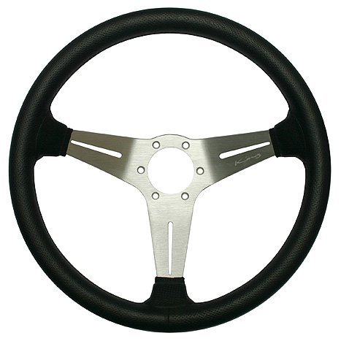
Functions
Lets look in detail at one specific function
The Steering Wheel

Slide 12
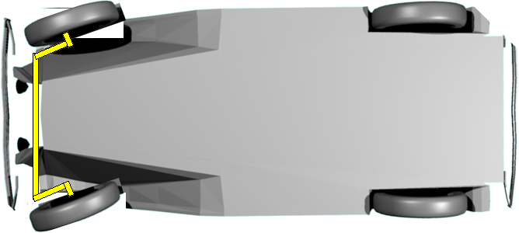
Functions
What is the input?
What is the output?

Slide 13
Functions
What is the input?
The position of the steering wheel is the input
What is the output?
The position of the front tires is the output
Whether the car is driving or not is a part of this function

Slide 14
Functions
As you move the input to the right, what happens to the output?
As you move to the left?
This is considered a positive relationship, could it be negative?
What if we were driving - Backwards

Slide 15
Functions
Do the tires move as far or farther than the wheel when the wheel is moved?
So, functions can alter an input as necessary, as long as the output is predictable based on the input

Slide 16
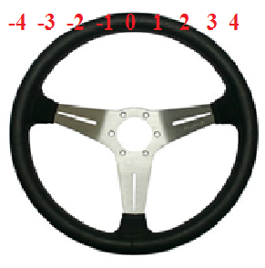
Functions
Lets number our input
When your input is ZERO, you expect the tires to be straight

Slide 17
Functions
If we add four to our input where is the wheel?
Where are the tires

Slide 18
Functions
So… Adding numbers to the input alters the output in the opposite direction

Slide 19
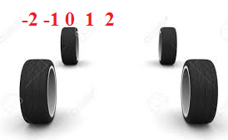
Functions
Lets number our output
What happens when we add to the output?

Slide 20
Functions
Adding to the output adds to the output
Adding to the input alters the output in the opposite direction

Slide 21
Functions
What if the robot team adds a linkage to the steering wheel to multiply your effort?
You would want to move the input less to get the same from your output

Slide 22
Functions
What if the robot team adds a linkage to the steering wheel to divide your effort?
You would want to move the input more to get the same from your output

Slide 23
Functions
If the robot team instead changed the output so that it was multiplied
The output would be greater, as planned
If the robot team changed the output so that it was divided
The output would be less, as expected

Slide 24
Summary
Adding to the input alters the output in the opposite direction
Adding to the output adds to the output
Multiplying the input reduces the input
Dividing the input expands the input
Multiplying the output expands the output
Dividing the output reduces the output

Slide 25
Functions
Could we reverse the input?
Imagine sitting on the dashboard, and turning the steering wheel from the “other” side.
Could we reverse the output?
Imagine the numberline we added to the tires being on the back side of the tires

Slide 26
Summary
Reversing the input reverses the output
Reversing the output reverses the input

Slide 27
Functions
If you were unable to get into the car, or even see in the car, can you look at the position of the tires and determine the position of the steering wheel?
Inversing a function takes the output and finds the input
INPUT
FUNCTION
OUTPUT

Slide 28
Functions
Can every function be inversed?
By seeing if the window is up or down, do you know the position of the window crank?

Slide 29
Functions
The window crank may be in the same position multiple times, each time referring to a different position in the window height

Slide 30
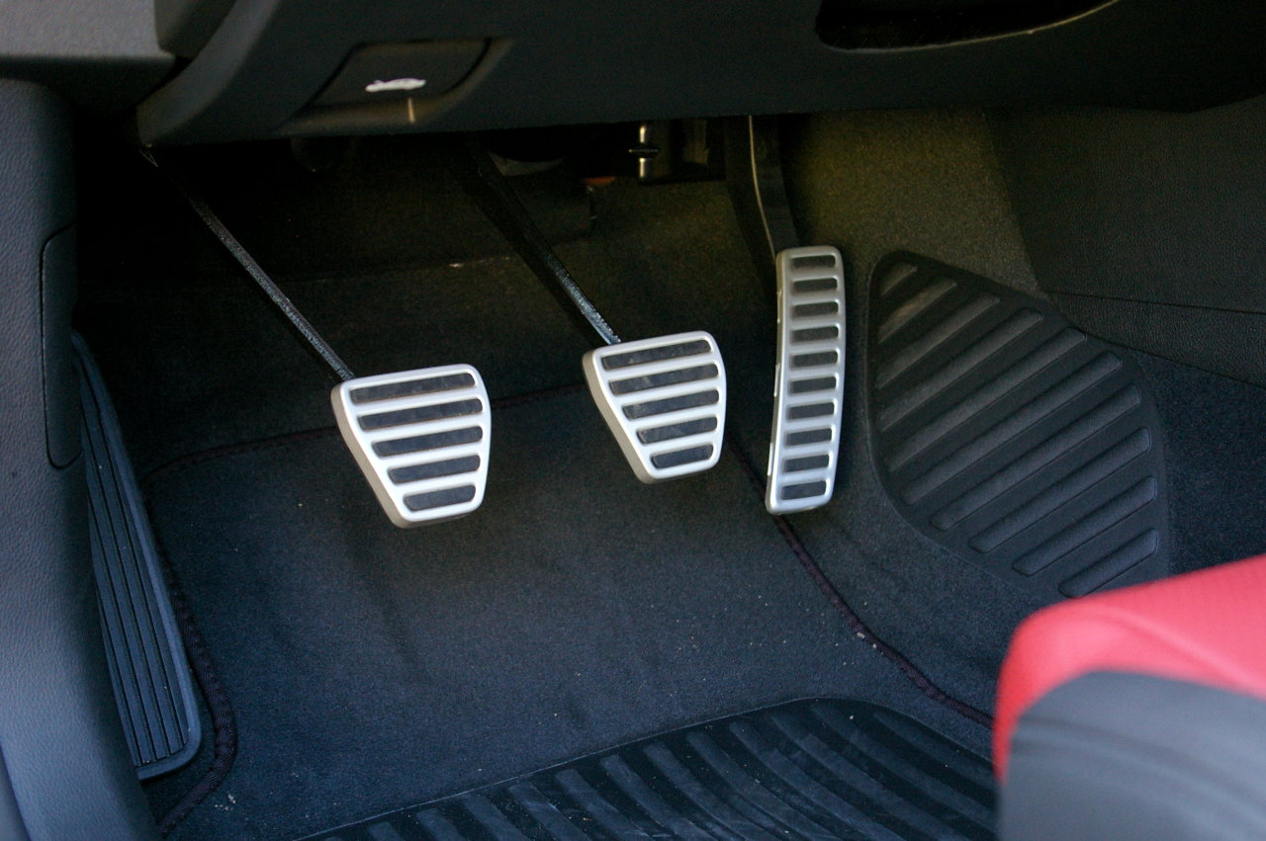
Functions
Can we combine functions, that is can the output of one function be the input for the next function?
Certainly the gear shift changes a lot of things. The gas pedal will have different results in different gears

Slide 31
Functions Summary
Every input to a function results in one predictable output
More than one input to a function may result in the same output

Slide 32
Functions Summary
Adding to the input alters the output in the opposite direction
Adding to the output adds to the output
Multiplying the input reduces the input
Dividing the input expands the input
Multiplying the output expands the output
Dividing the output reduces the output

Slide 33
Functions
Reversing the input reverses the output
Reversing the output reverses the input
Inversing a function takes the output and finds the input
Not all functions can be inversed

Slide 34
Homework
Describe the following parts of a function
What happens if you add to the input
What happens if you add to the output
Can this function be inversed
Complete the questions for the following two functions, and for two functions you find on your own
Your grade in this class
A thermostat in a classroom

