Slide 1
Algebra 2 8-R1
Unit 8-A
Rational Functions
Review Problems

Slide 2
Practice Problems
Solve
1

Slide 3
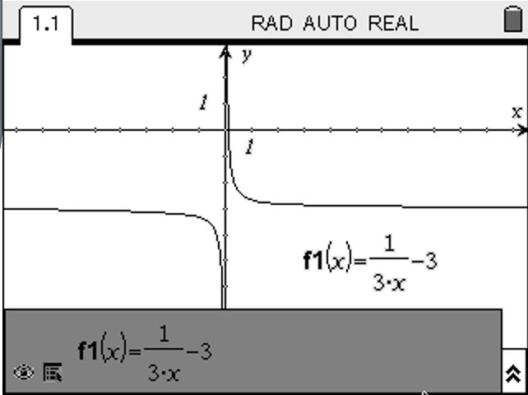
Practice Problems
2

Slide 4
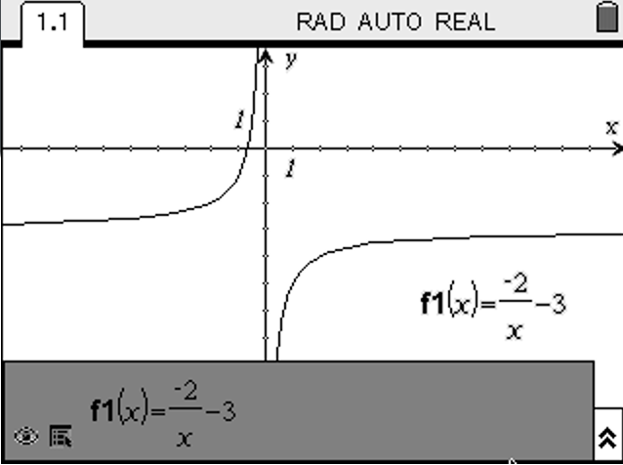
Practice Problems
3

Slide 5
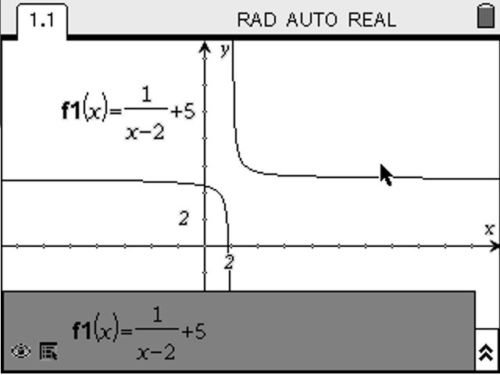
Practice Problems
4

Slide 6
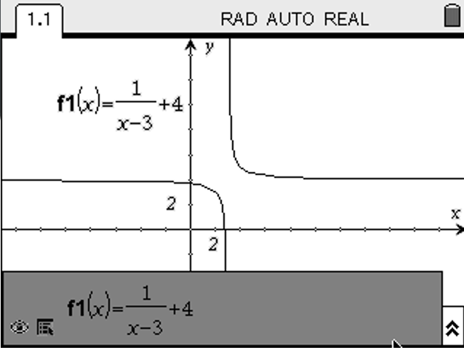
Practice Problems
5

Slide 7
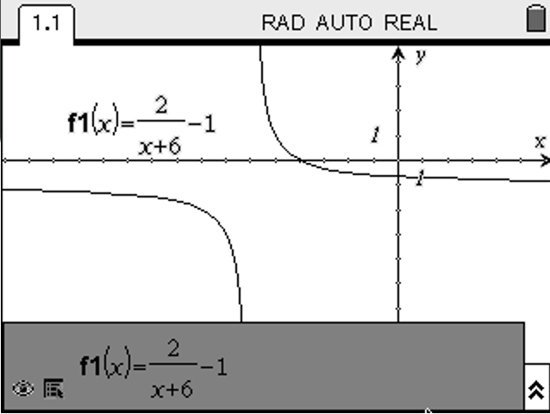
Practice Problems
6

Slide 8
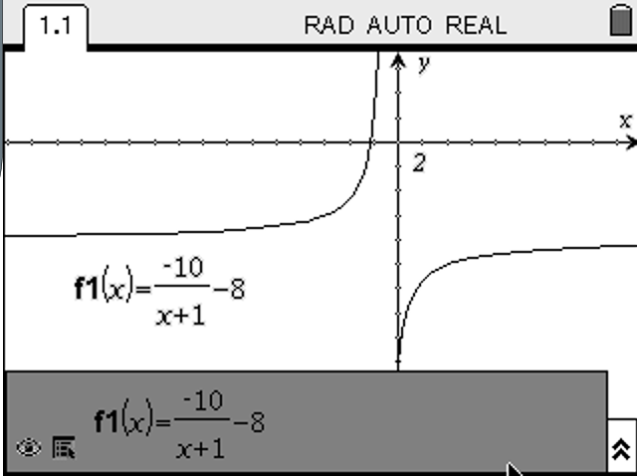
Practice Problems
7

Slide 9
Practice Problems
Vertical Asymptote : x = 1
Horizontal Asymptote : y = 1
Holes : None
Vertical Asymptote : None
Horizontal Asymptote : None
Holes : x = -3
8

Slide 10
Practice Problems
Vertical Asymptote : x = -1
Horizontal Asymptote : y = 0
Holes : x = 2
Vertical Asymptote : x = 2, -2
Horizontal Asymptote : y = 2
Holes : None
9

Slide 11
Practice Problems
Vertical Asymptote : x = -2
Horizontal Asymptote : y = 3
Holes : None
Vertical Asymptote : x = 2
Horizontal Asymptote : y = 1
Holes : None
10

Slide 12
Practice Problems
Vertical Asymptote : x = 5
Horizontal Asymptote : None
Holes : None
Vertical Asymptote : x = 3
Horizontal Asymptote : None
Holes : x = -2
11

Slide 13
Practice Problems
12

Slide 14
Practice Problems
13

Slide 15
Practice Problems
14

Slide 16
Practice Problems
15

Slide 17
Practice Problems
16

Slide 18
Practice Problems
17

Slide 19
Practice Problems
18

Slide 20
Practice Problems
19

Slide 21
Practice Problems
20

Slide 22
Practice Problems
21

Slide 23
Practice Problems
22

Slide 24
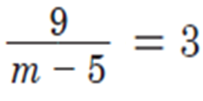
Practice Problems
23

Slide 25
Practice Problems
24

Slide 26
Practice Problems
25

Slide 27
Practice Problems
26

Slide 28
Practice Problems
27

Slide 29
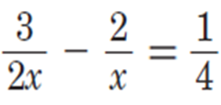
Practice Problems
Solve
28

Slide 30
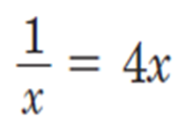
Practice Problems
Solve
29

Slide 31
Practice Problems
Solve
30

Slide 32
Practice Problems
Solve
31

Slide 33
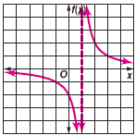
Practice Problems
32

Slide 34
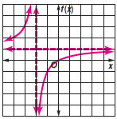
Practice Problems
33

Slide 35
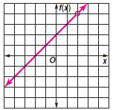
Practice Problems
34

Slide 36
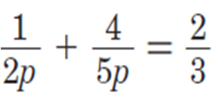
Practice Problems
Solve
35

Slide 37
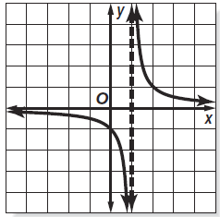
Practice Problems
36

Slide 38
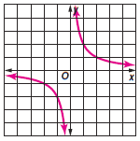
Practice Problems
37

Slide 39
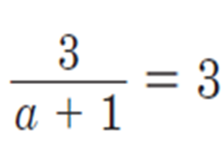
Practice Problems
Solve
38

Slide 40
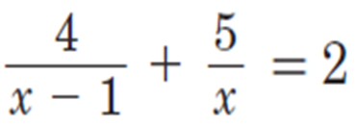
Practice Problems
Solve
39

Slide 41
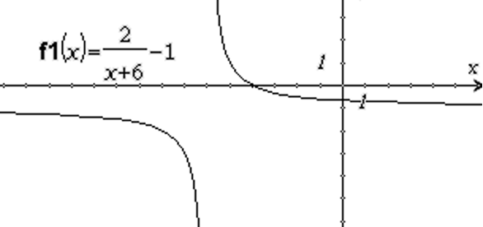
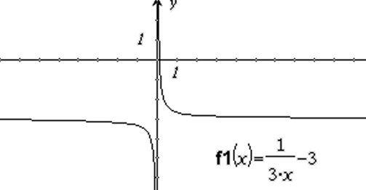
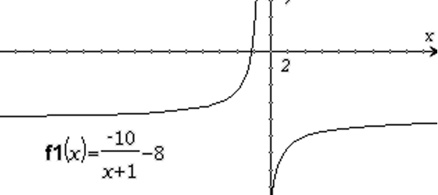
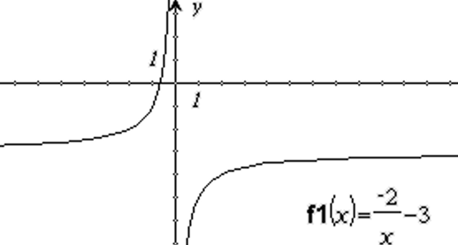
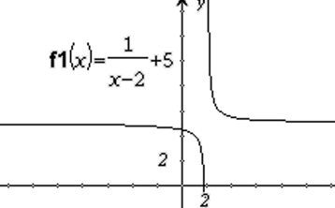
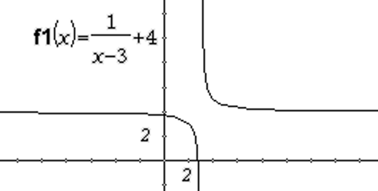
Answers
VA: x = 1 HA: y = 1 Holes : None
VA: None HA: None Holes : x = -3
VA: x = -1 HA: y = 0 Holes : x = 2
VA: x = 2, -2 HA: y = 2 Holes : None
VA: x = -2 HA: y = 3 Holes : None
VA: x = 2 HA: y = 1 Holes : None
VA: x = 5 HA: None Holes : None
VA: x = 3 HA: None Holes : x = -2

Slide 42
Answers

Slide 43
Answers

Slide 44
Answers

