Slide 1
Algebra 2 3-3
Solving Systems of Linear Inequalities

Slide 2
Example

Slide 3
Example

Slide 4
Rules for graphing inequalities
Dashed line – for less than or greater than
Solid line – for less or greater than AND equal to
When in y= format, greater than always shades above the line, and less than always shades below the line

Slide 5
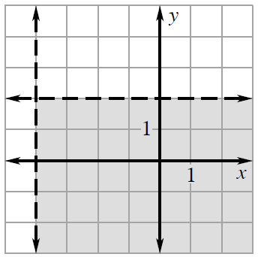
Practice

Slide 6
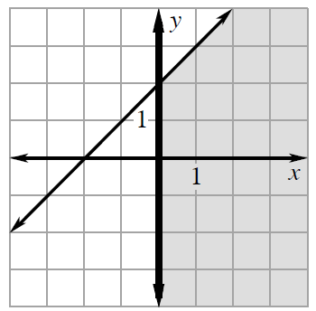
Practice

Slide 7
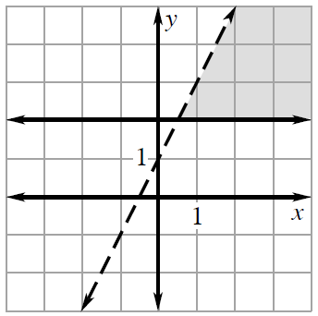
Practice

Slide 8
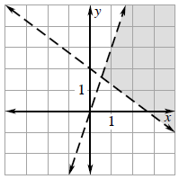
Practice

Slide 9
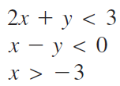
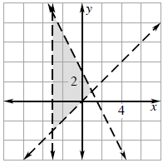
Practice

Slide 10
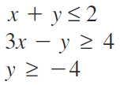
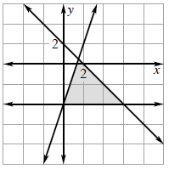
Practice

Slide 11
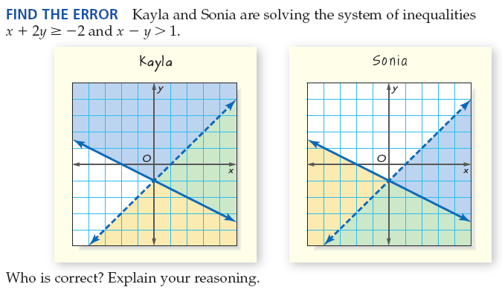
Find the Error

Slide 12
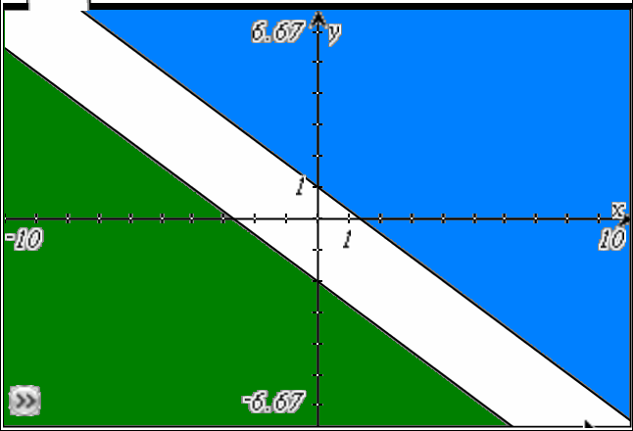
Example
Solve the system of inequalities by graphing
No
Solution

Slide 13
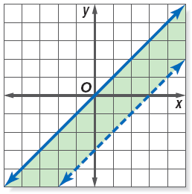
Practice

Slide 14
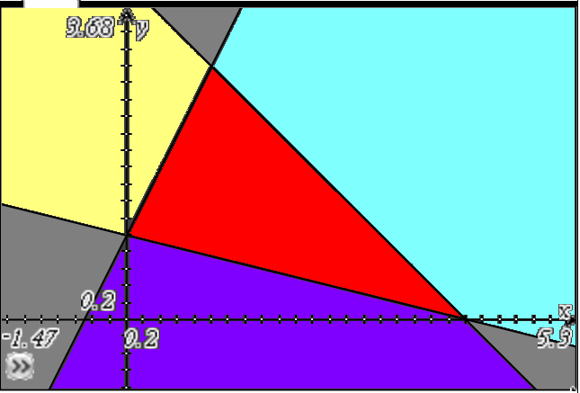
Example
Find the coordinates of the vertices of the figure formed by the following equations
(1,3)
(0,1)
(4,0)

Slide 15
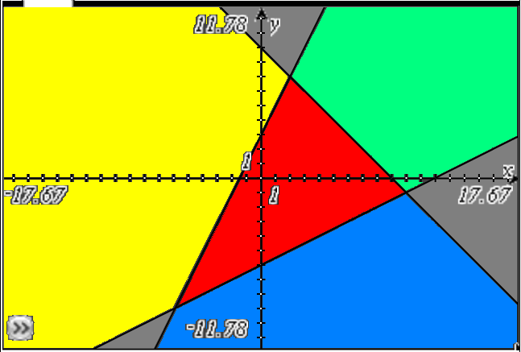
Practice
Find the coordinates of the vertices of the figure formed by the following equations
(2,7)
(10,-1)
(-6,-9)

Slide 16
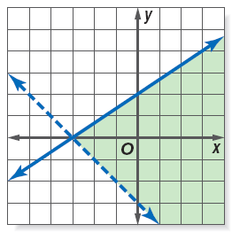
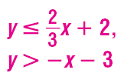
Practice

Slide 17
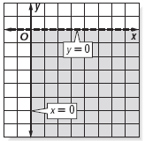
Practice

Slide 18
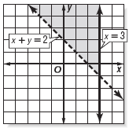
Practice

Slide 19
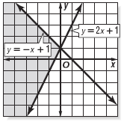
Practice

Slide 20
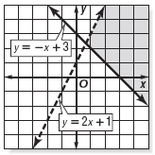
Practice

Slide 21
Homework
Pages 202 – 204
Use graph paper
12, 13, 16, 19, 26, 48, 49

