Slide 1
Algebra 2 8-7
Radical Functions

Slide 2
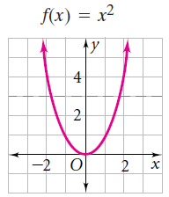
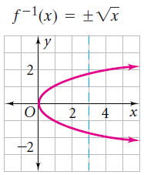
Inverse of Functions
If a horizontal line crosses this function twice, how will that affect the inverse of this function
The inverse is NOT a function

Slide 3
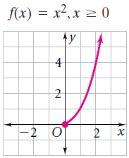
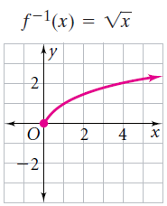
Inverse of Functions
You must restrict the domain of the function
So that the inverse is a function

Slide 4
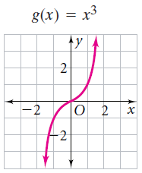
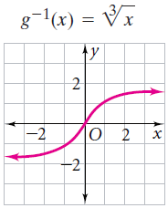
Inverse of Functions
Is the inverse of this a function?
Yes

Slide 5
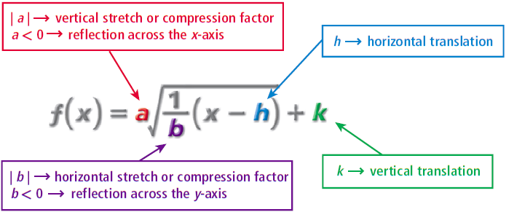
Transformations

Slide 6
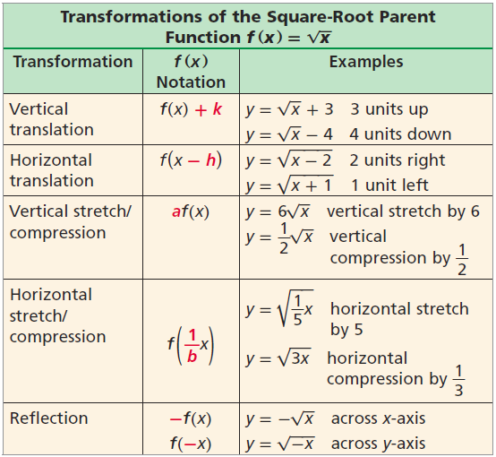
Summary

Slide 7
Summary

Slide 8
Square Root - Example

Slide 9
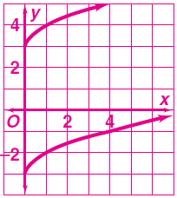
Square Root - Practice

Slide 10
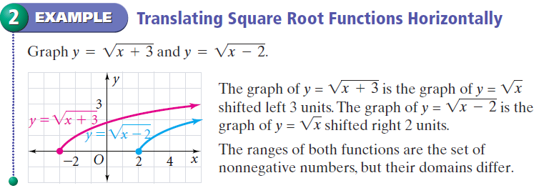
Square Root - Example

Slide 11
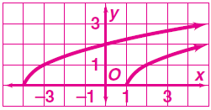
Square Root - Practice

Slide 12
Stretch and Shrink

Slide 13
Square Root - Example

Slide 14
Example

Slide 15
Example

Slide 16
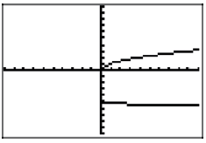
Example

Slide 17
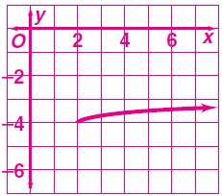
Square Root - Practice

Slide 18
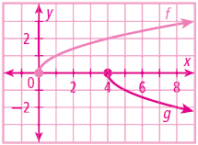
Practice

Slide 19
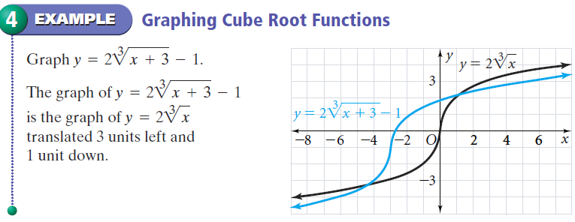
Radical - Example

Slide 20
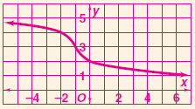
Radical- Practice

Slide 21
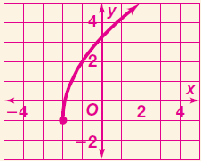
Radical- Practice

Slide 22
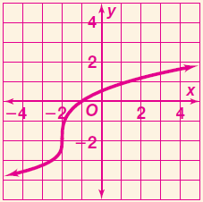
Radical- Practice

Slide 23
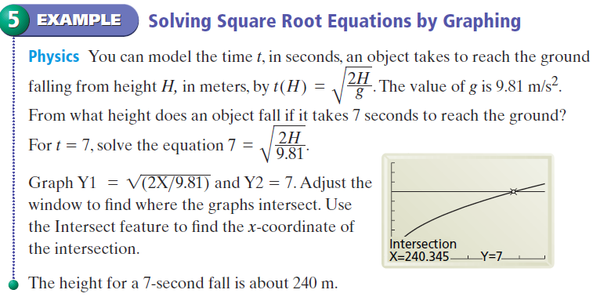
Radical - Example

Slide 24
Radical- Practice

Slide 25
Radical - Example

Slide 26
Radical- Practice
2

Slide 27
Calculator Investigation
Can a number be smaller than its own square root?

Slide 28
Calculator Investigation
Can a number be smaller than its own square root?
Graph the following

Slide 29
Calculator Investigation
Can a number be smaller than its own square root?
Add a third graph
When is a number small than its own square root?

Slide 30
Calculator Investigation
What are the domains of the following?
When solving the following, what are the only values that need to be considered?

Slide 31
Calculator Investigation
Solve the inequality graphically?

Slide 32
Homework
Pages 624 – 627
Completed on graph paper, use desmos.com as a graphing calculator to aid graphing
24 – 38 even, 44, 51 – 54, 87

