Slide 1
PreCalculus 2-7
Rational Functions and Asymptotes

Slide 2
Rational Functions

Slide 3
Rational Functions

Slide 4
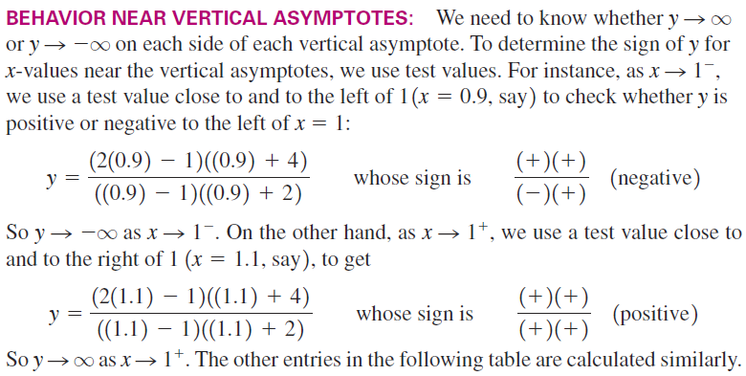
Rational Functions

Slide 5
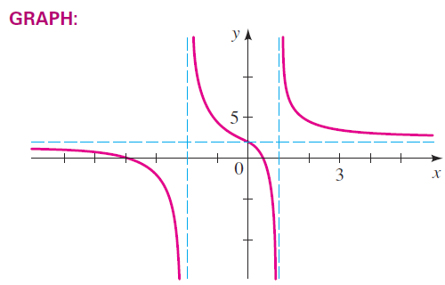
Rational Functions

Slide 6
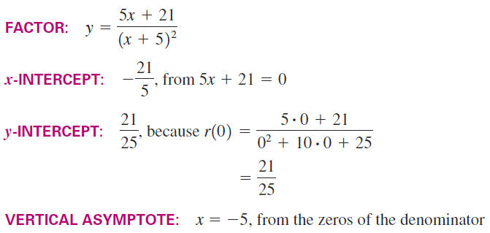
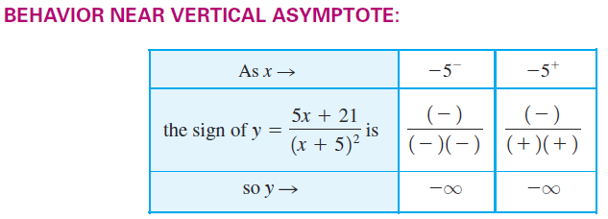
Rational Functions

Slide 7
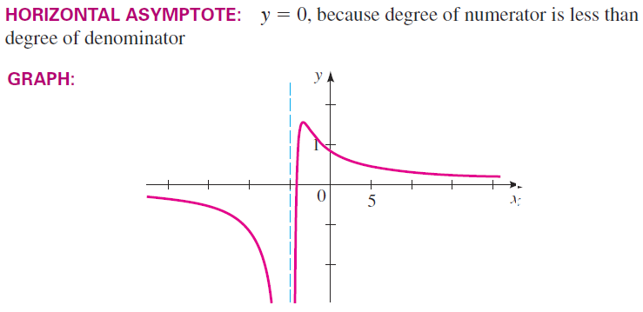
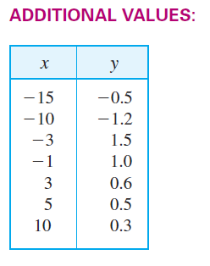
Rational Functions

Slide 8
Rational Functions
Graph the function
Factor
X-Intercept: – 2
Y-Intercept: 3/2
Vertical asymptote: x=2
Behavior near asymptote:
Horizontal asymptote y=0

Slide 9
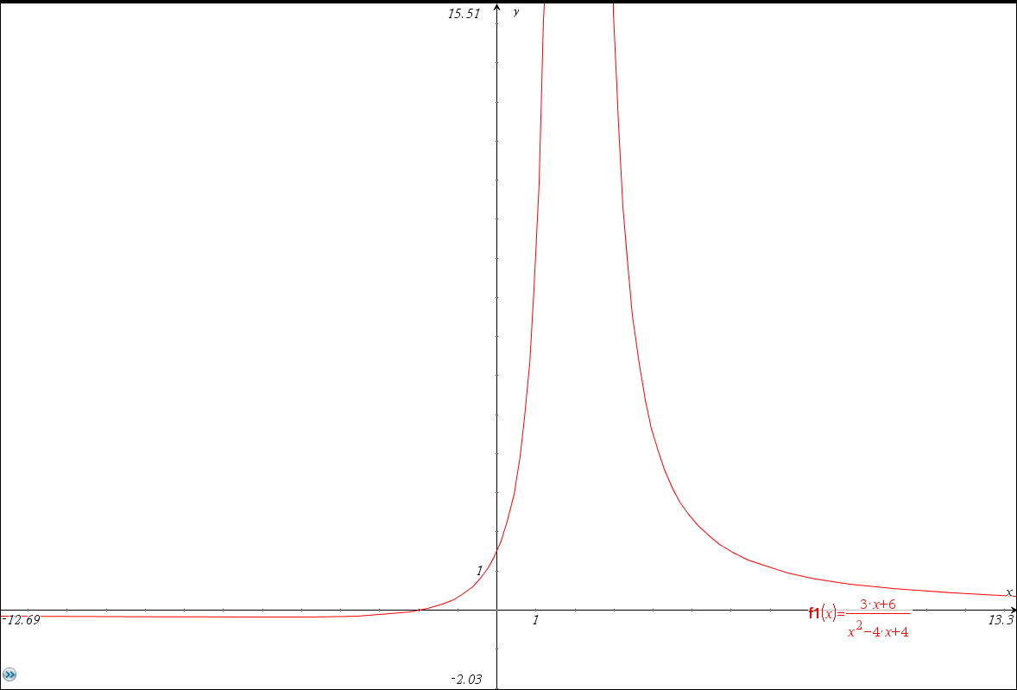
Rational Functions

Slide 10
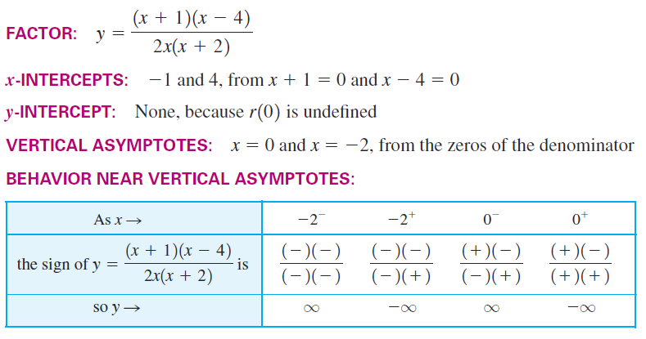
Rational Functions

Slide 11
Rational Functions

Slide 12
Rational Functions
Slant Asymptote: When the degree of the numerator is one higher than the degree of the denominator
For large values of x, the function approaches ax + b

Slide 13
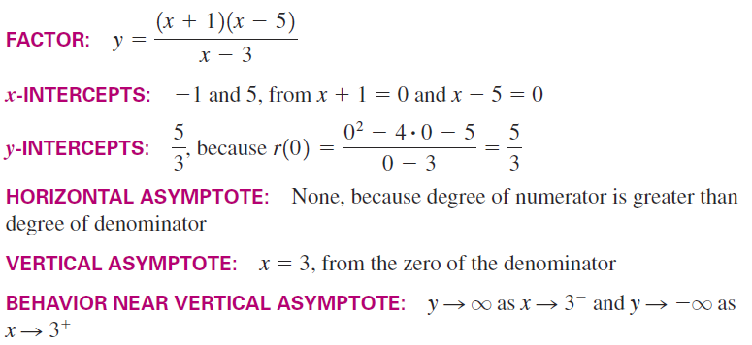
Rational Functions

Slide 14
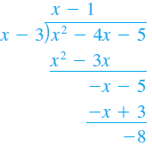
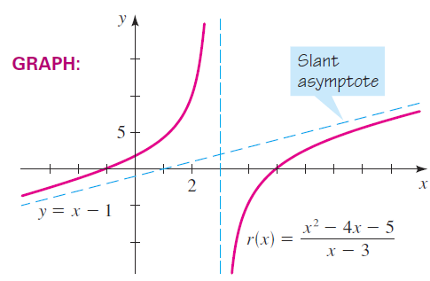
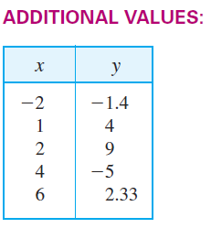
Rational Functions

Slide 15
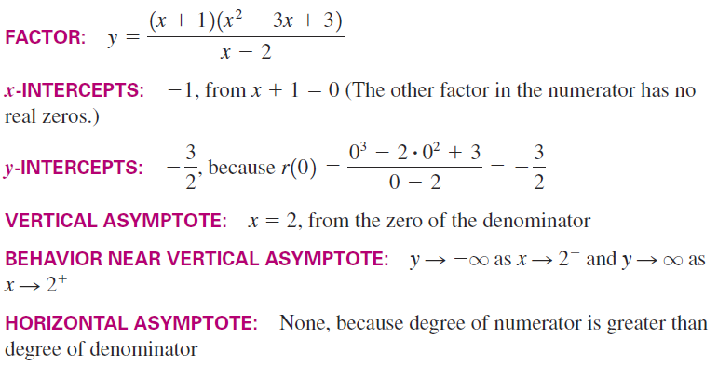
Rational Functions

Slide 16
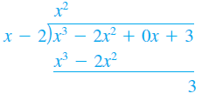
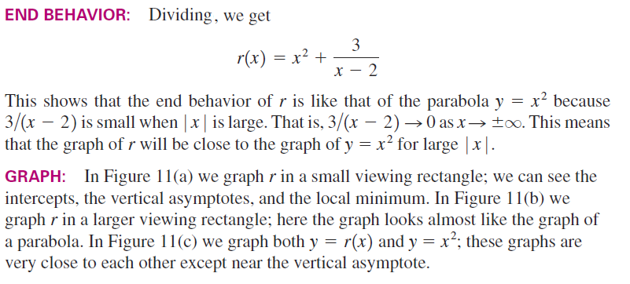
Rational Functions

Slide 17
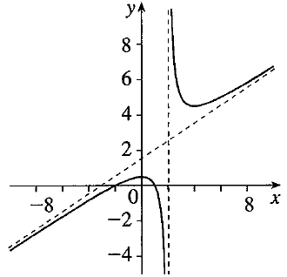
Rational Functions
Graph the function

Slide 18
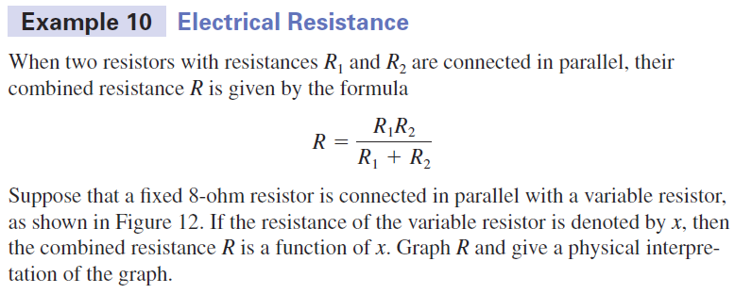
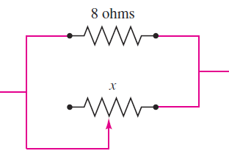
Rational Functions

Slide 19
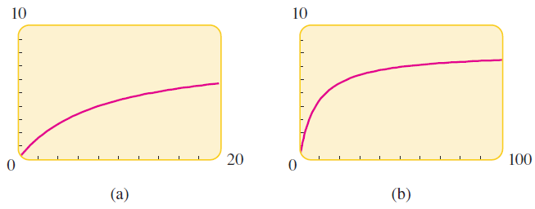
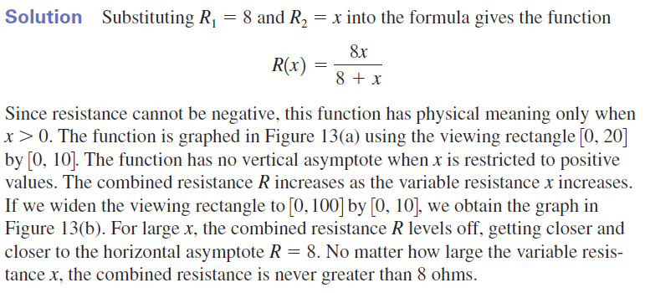
Rational Functions

Slide 20
Rational Functions

Slide 21
Homework
Page 157 – 159
14, 17, 22, 24, 44, 47, 48, 65, 66

