Slide 1
PreCalculus 1-4
Shifting, Reflecting and Sketching Graphs

Slide 2
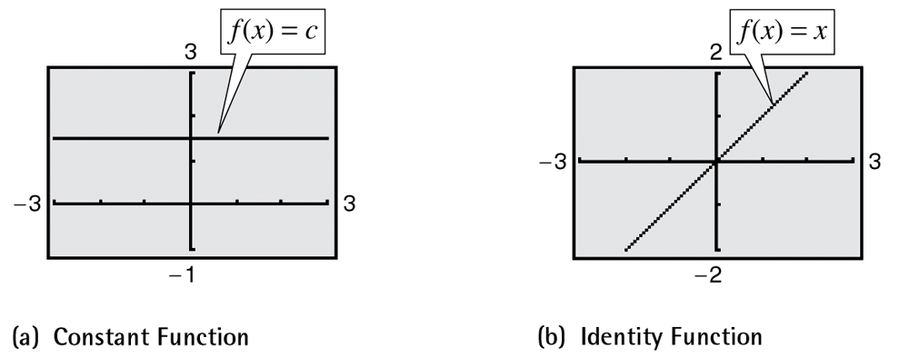
Transformation of Functions

Slide 3
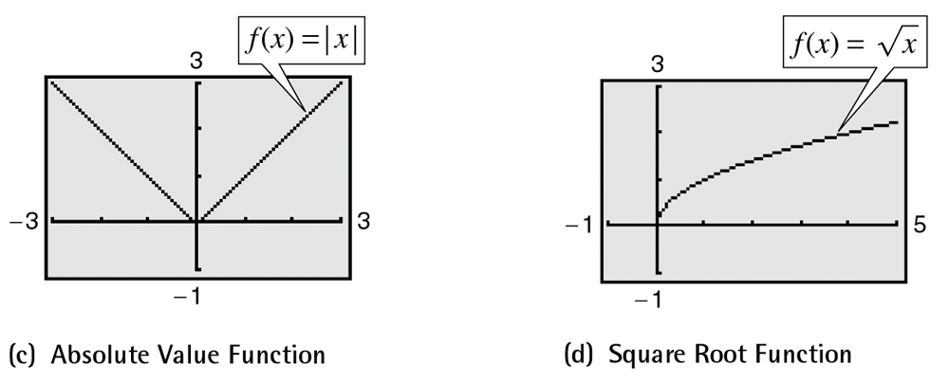
Transformation of Functions

Slide 4
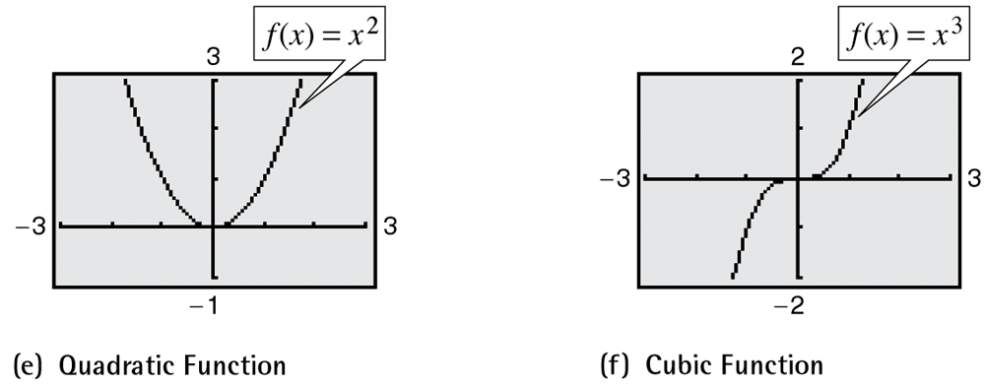
Transformation of Functions

Slide 5
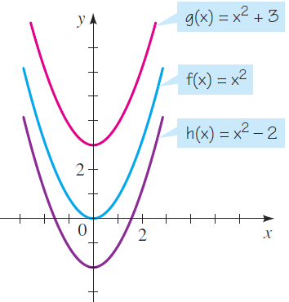
Transformation of Functions

Slide 6
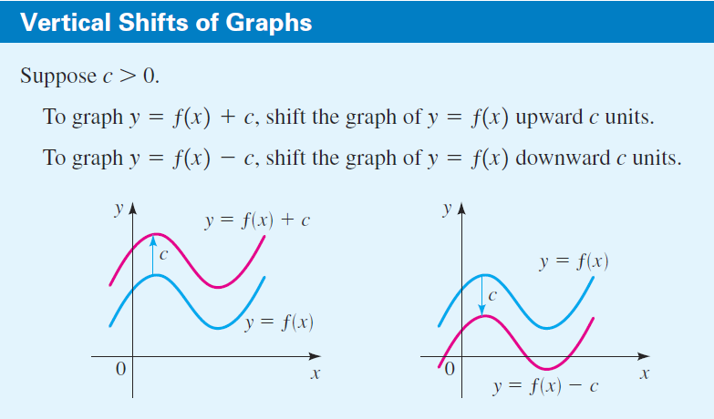
Transformation of Functions

Slide 7
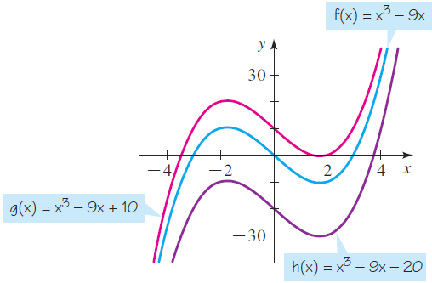
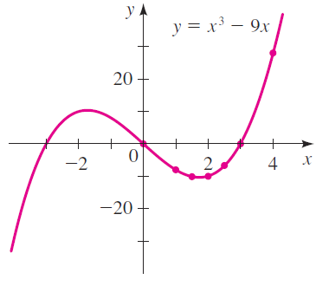
Transformation of Functions

Slide 8
Transformation of Functions

Slide 9
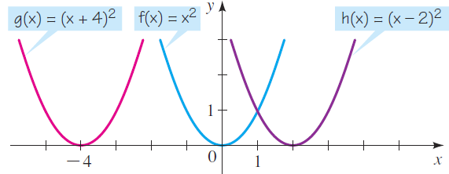
Transformation of Functions

Slide 10
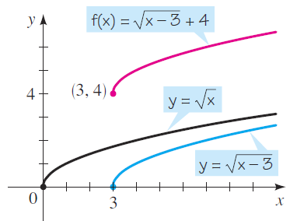
Transformation of Functions

Slide 11
Transformation of Functions
Find the direction and the value of the horizontal and vertical shirts of the graph of the function
to obtain the function
Left 5, Down 4

Slide 12
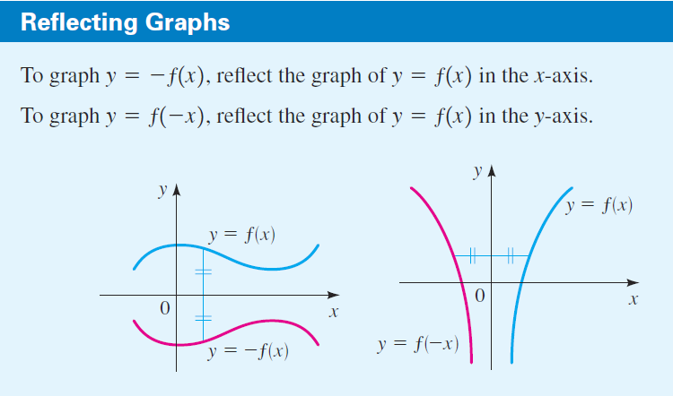
Transformation of Functions

Slide 13
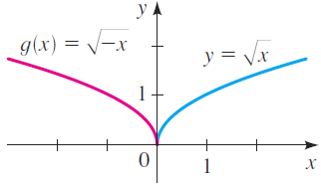
Transformation of Functions

Slide 14
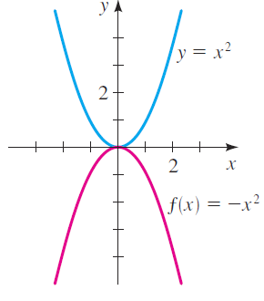
Transformation of Functions

Slide 15
Transformation of Functions
Find the axis of reflection needed to obtain the graph of the function
from the graph of the function
x-axis

Slide 16
Transformation of Functions

Slide 17
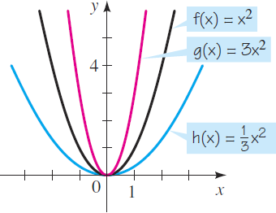
Transformation of Functions

Slide 18
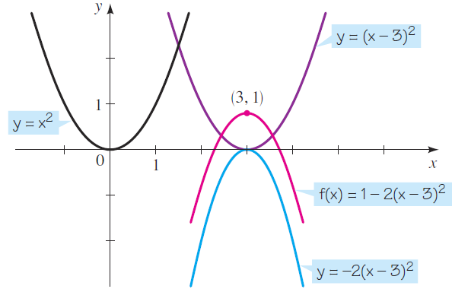
Transformation of Functions

Slide 19
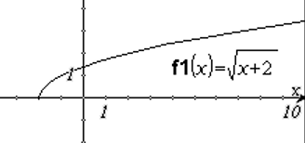
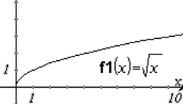
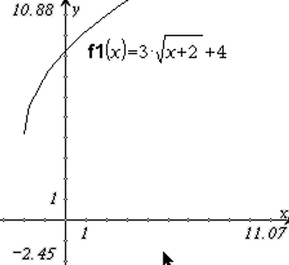
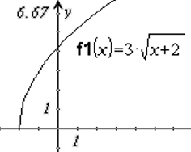
Transformation of Functions
Sketch the graph of the function

Slide 20
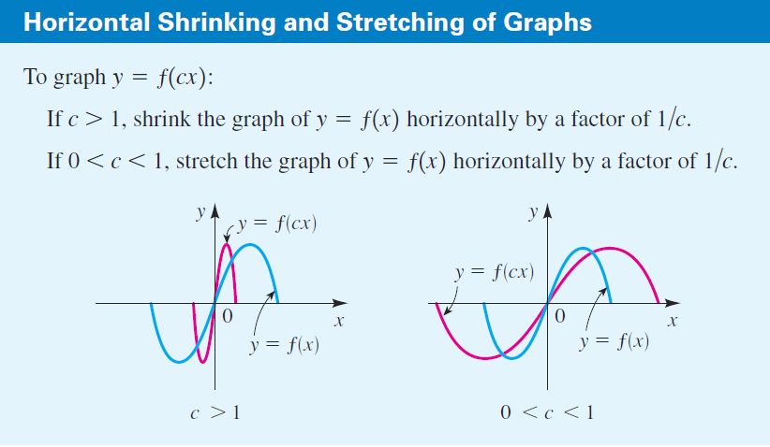
Transformation of Functions

Slide 21
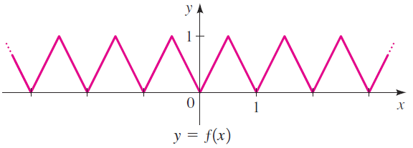
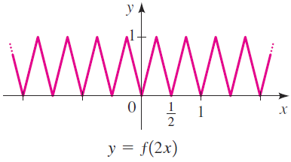
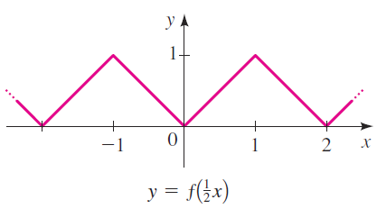
Transformation of Functions

Slide 22
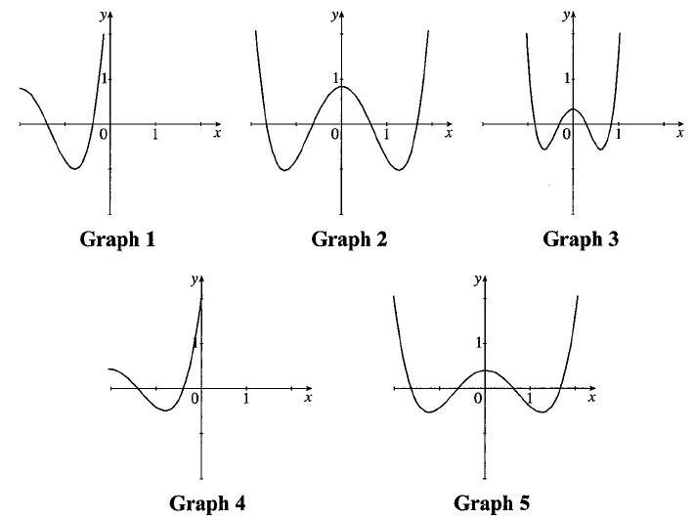
Exploration
Below are five graphs. One is the graph of a function f(x) and the others include the graphs of 2f(x), f(2x), f(x+2), and 2f(x+2). Determine which is the graph of f(x) and match the other functions with their graphs.
2f(x)
2f(x+2)
f(2x)
f(x)
f(x+2)

Slide 23
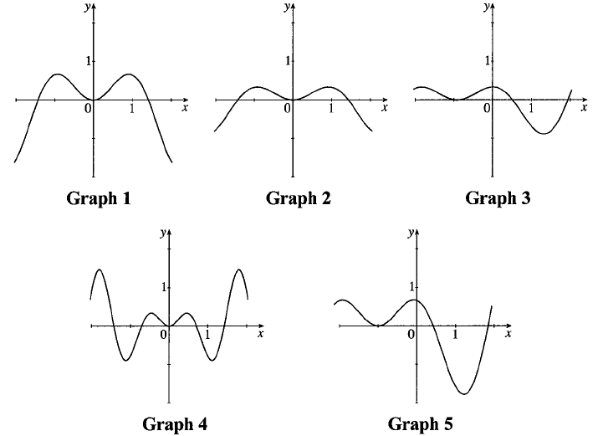
Exploration
Below are five graphs. One is the graph of a function f(x) and the others include the graphs of 2f(x), f(2x), f(x+2), and 2f(x+2). Determine which is the graph of f(x) and match the other functions with their graphs.
2f(x)
f(x)
f(x+2)
f(2x)
2f(x+2)

Slide 24
Transformation of Functions
Homework
1-4 Shifting, Reflecting, and Sketching Graphs
pg. 48 – 50
6, 13, 19-26, 32, 42, 48, 70

