Slide 1
PreCalculus 4-7
Inverse Trigonometric Functions

Slide 2
Inverse Trigonometric Functions
What is an inverse functions?
f⁻¹(f(x))=x
Reflected across the line y=x
Domain may need to be restricted to be a function

Slide 3
Inverse Trigonometric Functions

Slide 4
Inverse Trigonometric Functions
Note:

Slide 5
Inverse Trigonometric Functions

Slide 6
Inverse Trigonometric Functions

Slide 7
Inverse Trigonometric Functions

Slide 8
Inverse Trigonometric Functions

Slide 9
Inverse Trigonometric Functions
Find approximate values for sin⁻¹ 0.71 and sin⁻¹ 6/7
Express answer in radians, five decimal places
0.7895
1.0297

Slide 10
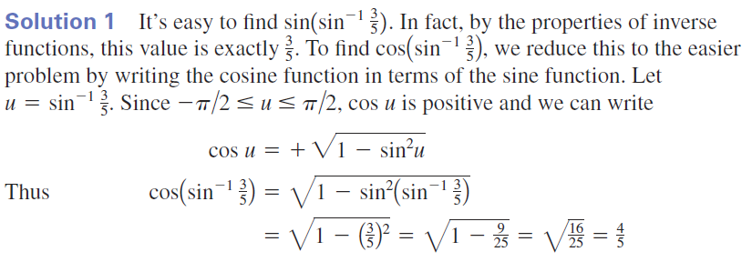
Inverse Trigonometric Functions

Slide 11
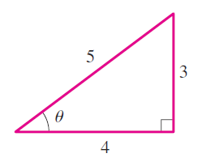
Inverse Trigonometric Functions

Slide 12
Inverse Trigonometric Functions
Find the exact value of cos(sin⁻¹ 5/13)
12/13

Slide 13
Inverse Trigonometric Functions

Slide 14
Inverse Trigonometric Functions

Slide 15
Inverse Trigonometric Functions

Slide 16
Inverse Trigonometric Functions

Slide 17
Inverse Trigonometric Functions

Slide 18
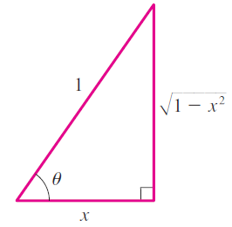
Inverse Trigonometric Functions

Slide 19
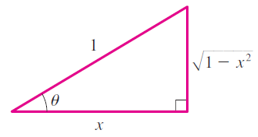
Inverse Trigonometric Functions

Slide 20
Inverse Trigonometric Functions
Write cos( 2 sin ⁻¹ x) as an algebraic expression in x for -1 < x < 1
12x²

Slide 21
Inverse Trigonometric Functions

Slide 22
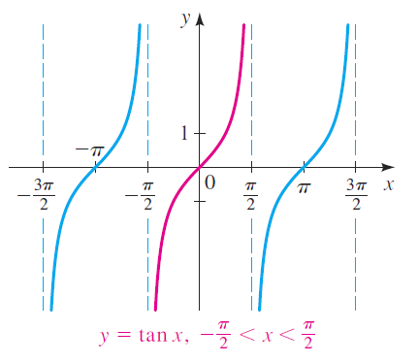
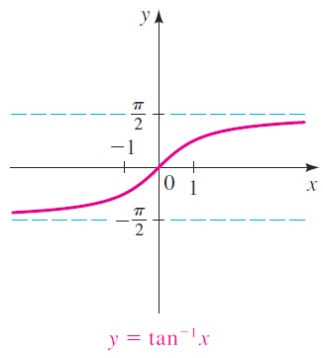
Inverse Trigonometric Functions

Slide 23
Inverse Trigonometric Functions

Slide 24
Inverse Trigonometric Functions

Slide 25
Inverse Trigonometric Functions

Slide 26
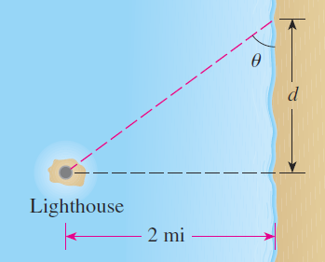
Inverse Trigonometric Functions

Slide 27
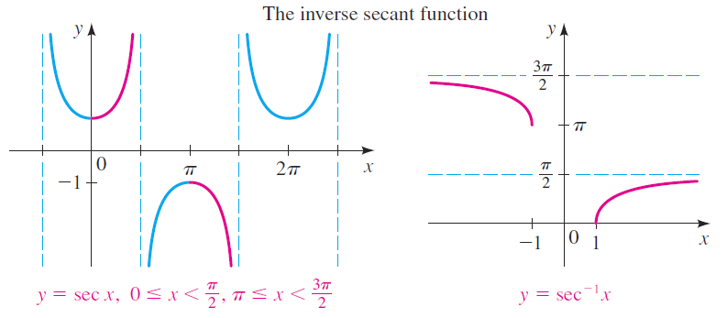
Inverse Trigonometric Functions

Slide 28
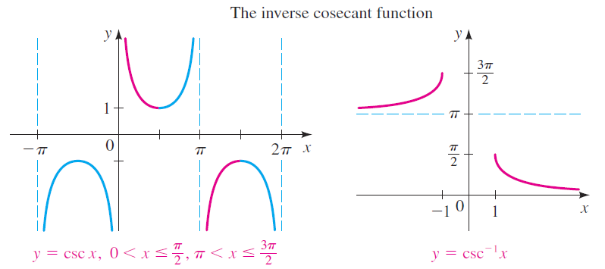
Inverse Trigonometric Functions

Slide 29
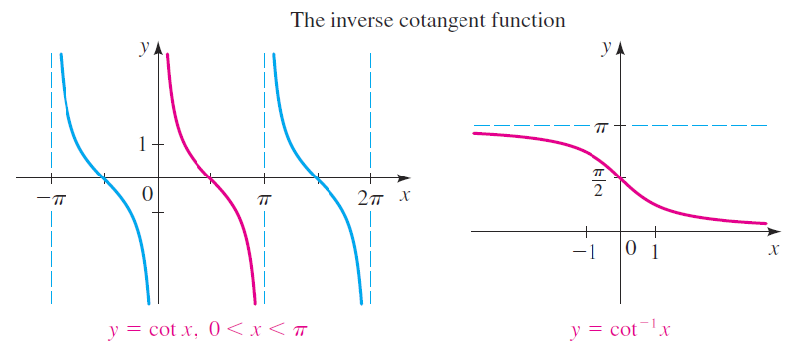
Inverse Trigonometric Functions

Slide 30
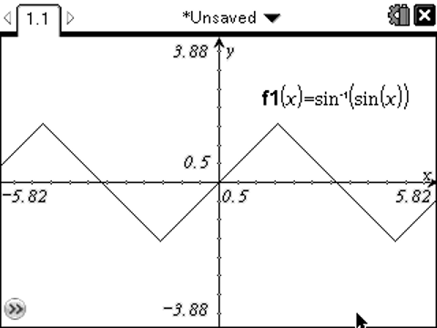
Inverse Trigonometric Functions
Exploration
Sketch the following without your calculator

Slide 31
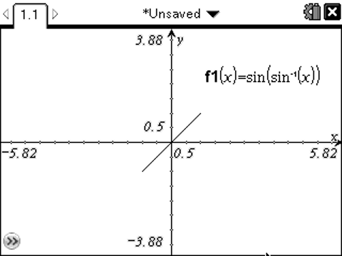
Inverse Trigonometric Functions
Exploration
What do you expect for this?

Slide 32
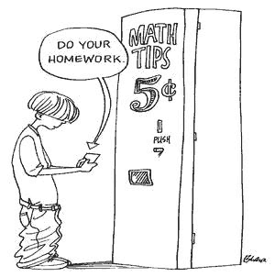
Inverse Trigonometric Functions

Slide 33
Inverse Trigonometric Functions
Homework
pg 316-319
2-8 even,11,12,13-23 odd,27,28,32-52even,73,76

