Slide 1
Unit 7, Lesson 3
Trigonometry / Pre-Calculus
Multivariable Linear Systems

Slide 2
Do Now
1
2
3
4

Slide 3
Do Now
1
2

Slide 4
Do Now
3

Slide 5
Do Now
4

Slide 6
Homework
Check Homework

Slide 7
Multivariable Systems
This lesson is only for Linear Equations

Slide 8
Multivariable Systems

Slide 9
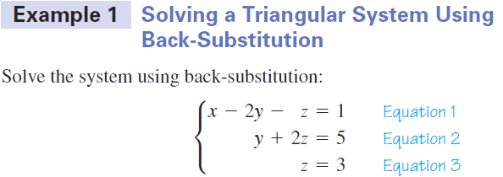
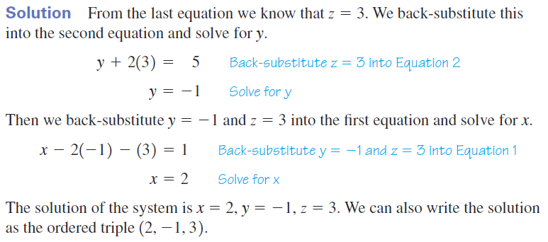
Multivariable Systems

Slide 10
Multivariable Systems
Solve the system of equations
x – 5y – z = 22
y + 4z = 8
z = 3
(5, -4, 3)

Slide 11
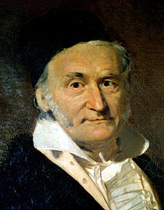
Multivariable Systems
Create triangular form equations with row operations
Friedrich Gauss

Slide 12
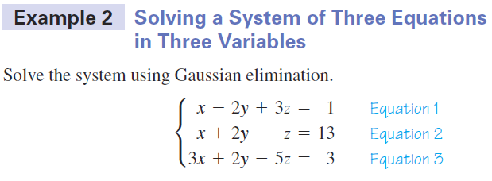
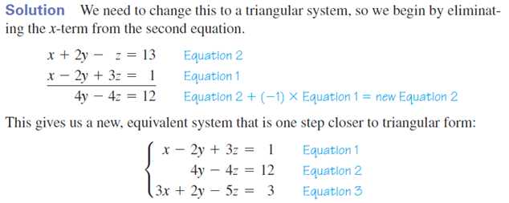
Multivariable Systems

Slide 13
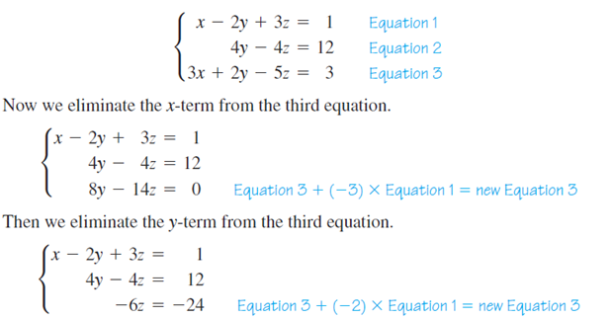
Multivariable Systems

Slide 14
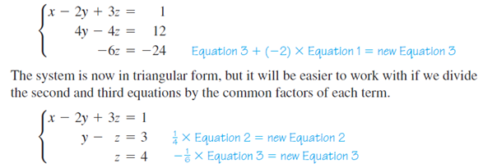
Multivariable Systems

Slide 15
Multivariable Systems

Slide 16
Multivariable Systems
Solve the system of equations
x – 2y + 3z = 1
x + 2y – z = 13
2x + 4y – 7z = 11
(4, 6, 3)

Slide 17
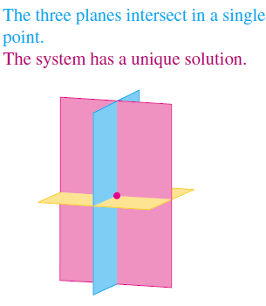
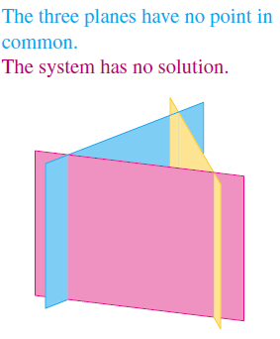
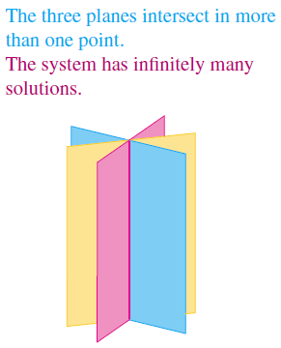
Multivariable Systems

Slide 18
Multivariable Systems

Slide 19
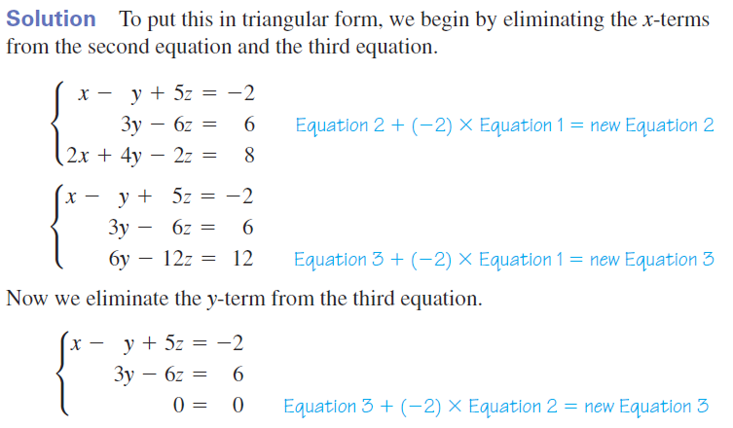
Multivariable Systems

Slide 20
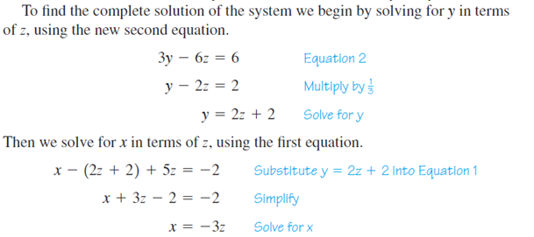
Multivariable Systems

Slide 21
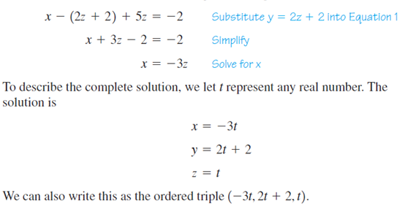
Multivariable Systems

Slide 22
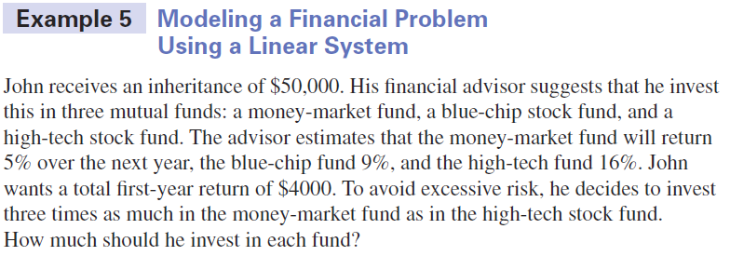
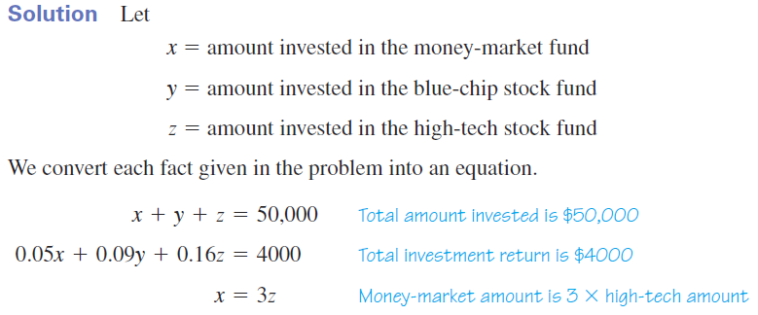
Multivariable Systems

Slide 23
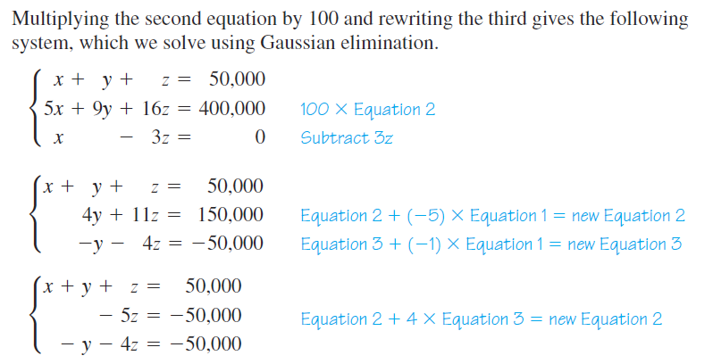
Multivariable Systems

Slide 24
Multivariable Systems

Slide 25
Multivariable Systems
Solve the system of equations
x + 7y - 7z = 3
3x + 14y - 16z = 17
2x + 7y - 9z = 10
Inconsistent

Slide 26
Multivariable Systems
Solve the system of equations
x – y + 5z = –2
3x + y + 3z = 2
3x + 9y – 21z = 18
(-2t, 3t+2, t)

Slide 27
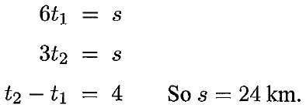
Multivariable Systems

Slide 28
Multivariable Systems
3, 4, 5
4, 7, ð65

Slide 29
Multivariable Systems

Slide 30
Multivariable Systems

Slide 31
Multivariable Systems

Slide 32
Multivariable Systems

Slide 33
Multivariable Systems
Find the partial fraction decomposition of:

Slide 34
Multivariable Systems

Slide 35
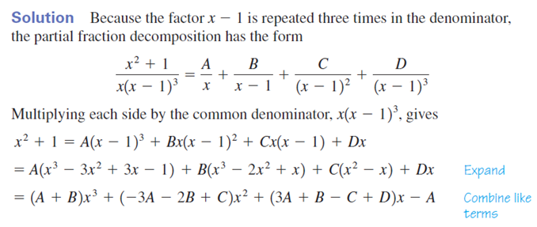
Multivariable Systems

Slide 36
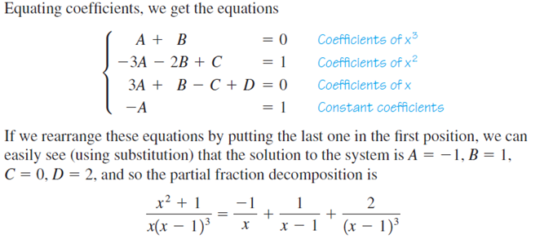
Multivariable Systems

Slide 37
Multivariable Systems
Find the partial fraction decomposition of:

Slide 38
Multivariable Systems

Slide 39
Multivariable Systems

Slide 40
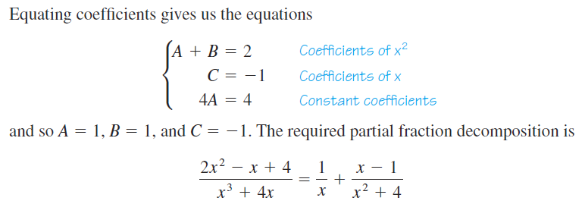
Multivariable Systems

Slide 41
Multivariable Systems
Find the partial fraction decomposition of:

Slide 42
Multivariable Systems

Slide 43
Multivariable Systems

Slide 44
Multivariable Systems
Find the form of the partial fraction decomposition of:

Slide 45
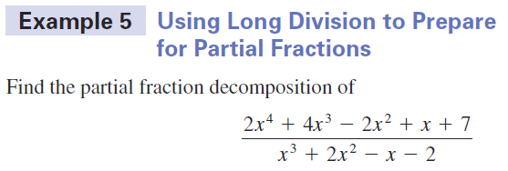
Multivariable Systems

Slide 46
Multivariable Systems
Partial Fractions Practice

Slide 47
Multivariable Systems

Slide 48
Multivariable Systems

Slide 49
Multivariable Systems

Slide 50
Multivariable Systems
Homework
Page 483 – 485
5, 17, 21, 22, 27, 39
47, 49, 51, 57, 61, 66, 67, 77

Slide 51
Do Now
1
2
3

Slide 52
Do Now
1
2
3

Slide 53
Do Now
Homework Check

