Slide 1
PreCalculus 1-1
Lines in the Plane

Slide 2
Do Now
Sketch an example graph of each of the parent functions listed below
Linear
Quadratic
Cubic
Polynomial
Rational
Radical

Slide 3
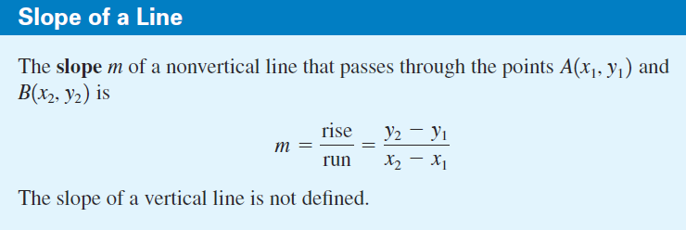
Lines

Slide 4
Slopes
Quickly Estimate the following slopes

Slide 5
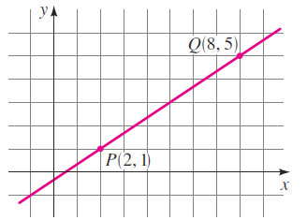
Lines

Slide 6
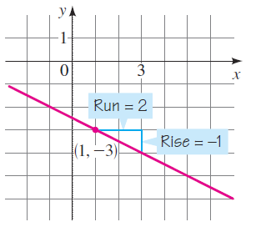
Lines

Slide 7
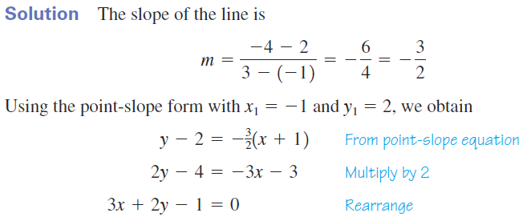
Lines

Slide 8
Quick Questions
Name real life things that are slopes

Slide 9
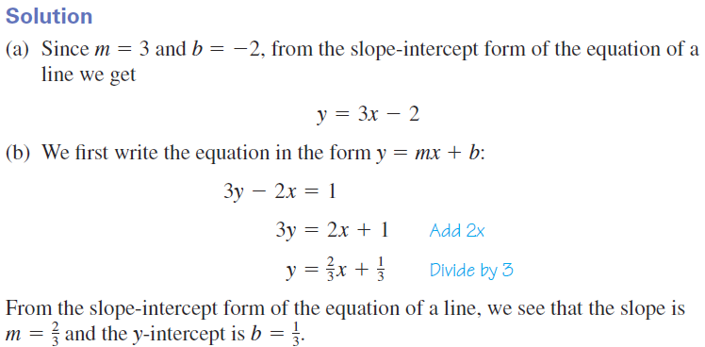
Lines

Slide 10
Lines

Slide 11
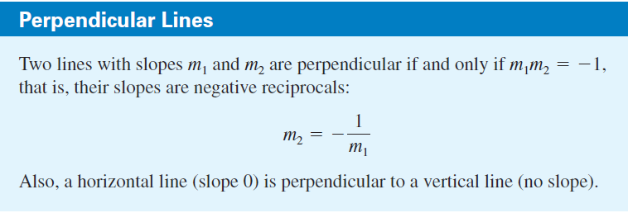
Lines

Slide 12
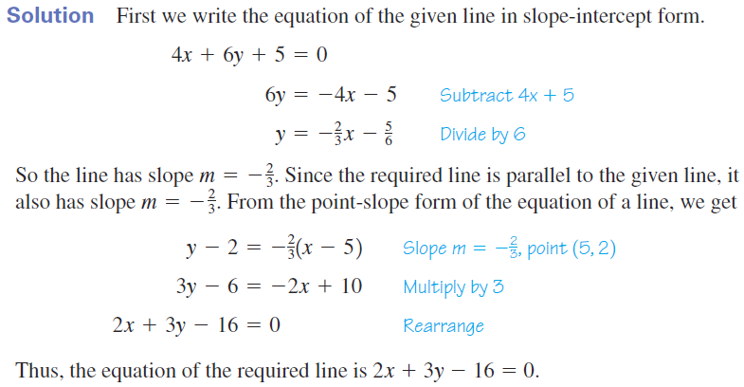
Lines

Slide 13
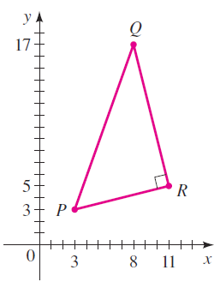
Lines

Slide 14
Lines

Slide 15
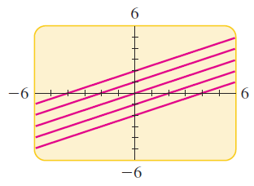
Lines

Slide 16
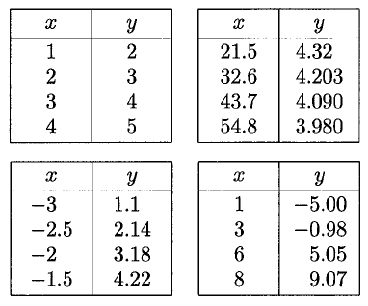
Exploration
Three of the following four tables of data have something in common: Linear growth. By trying to find equations of lines, determine which of them represents linear growth. Which table has the slowest growth?

Slide 17
Exploration
Write a sentence to describe a property of linear growth that can be determined from a table of values.

Slide 18
Homework
pgs 12 - 14
19, 20, 28, 29, 32, 52, 67, 81

