Slide 1
PreCalculus 8-4
Mathematical Induction

Slide 2
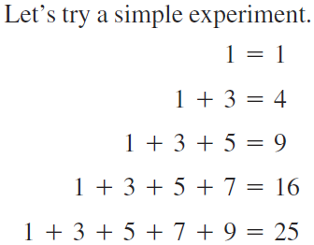
Mathematical Induction

Slide 3
Mathematical Induction
Is this true for all possible sums of odd numbers?

Slide 4
Mathematical Induction
Start by making a conjecture
But, we still don’t know this to be true for ALL possible numbers

Slide 5
Mathematical Induction
Start by making a conjecture
There are an INFINITE number of possibilities to check. We need a process to prove this for ALL numbers

Slide 6
Mathematical Induction
Mathematical Induction - Method of proving a given property true for a set of numbers by proving it true for 1 and then true for an arbitrary positive integer by assuming the property true for all previous positive integers
Induction Step – A logical statement that leads from one true statement to the next

Slide 7
Mathematical Induction
Instead of proving an infinite number of statements to be true, we prove that if one is true, the next one must be true also

Slide 8
Mathematical Induction

Slide 9
Mathematical Induction

Slide 10
Mathematical Induction

Slide 11
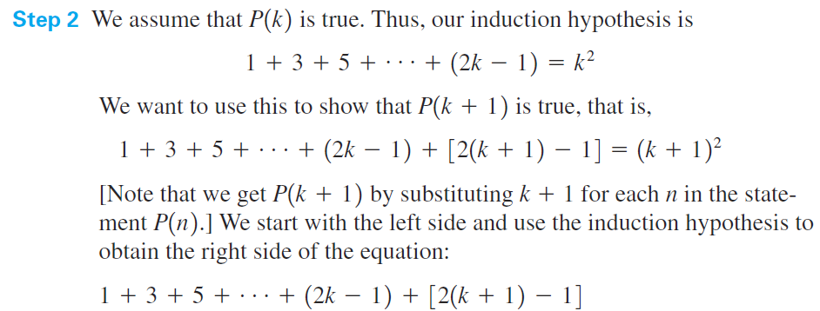
Mathematical Induction

Slide 12
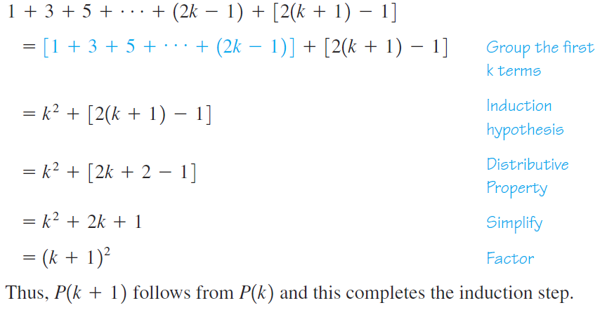
Mathematical Induction

Slide 13
Mathematical Induction
Practice – Use induction to show
2 + 6 + 10 + ... + (4n-2) = 2n²

Slide 14
Mathematical Induction
Practice – Use induction to show
1 + 2 + 3 + ... + n = ½ n(n + 1)

Slide 15
Mathematical Induction
Practice – Use induction to show
3 + 6 + 9 + ... + 3n = ½ 3n(n + 1)

Slide 16
Mathematical Induction
Practice – Use induction to show
5 + 7 + 9 + 11 + ... + (3 + 2n) = n(n + 4)

Slide 17
Mathematical Induction

Slide 18
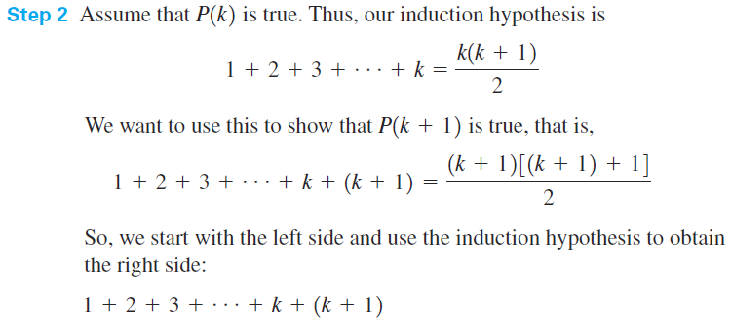
Mathematical Induction

Slide 19
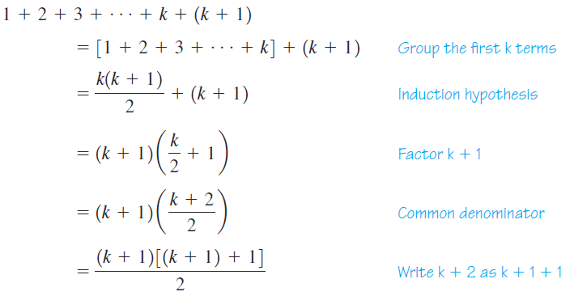
Mathematical Induction

Slide 20
Mathematical Induction
Your book also has formulas for the fourth and fifth power

Slide 21
Mathematical Induction

Slide 22
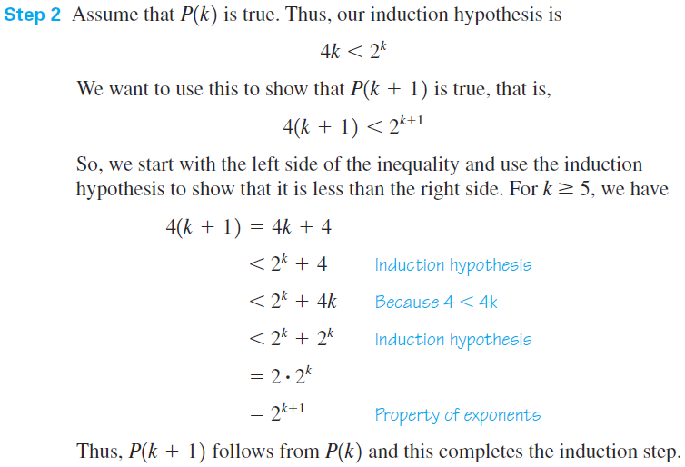
Mathematical Induction

Slide 23
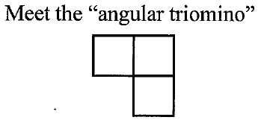
Mathematical Induction

Slide 24
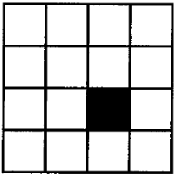
Mathematical Induction

Slide 25
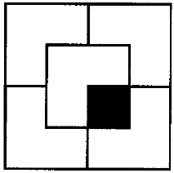
Mathematical Induction

Slide 26
Mathematical Induction
As fate would have it, I could tile the board regardless of where the missing square is. In fact I can do it for an 8 x 8 chessboard, a 16 x 16 chessboard, etc. As long as there is one square missing. In fact, I can even prove that I can tile any 2^{n} x 2^{n} chessboard, with one square missing with my friend angular triomino.
Go ahead, and you try to prove it, work in groups

Slide 27
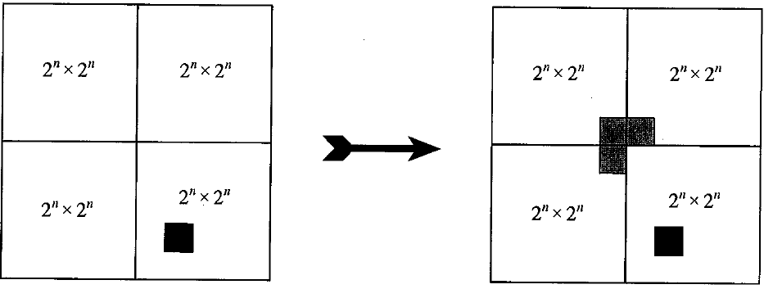
Mathematical Induction
Base Case: Trivial
Inductive Step: Divide the 2^{n+1} x 2^{n+1} checkerboard into four equal pieces as shown, then temporarily remove three squares

Slide 28
Mathematical Induction
As we have four 2n x 2n boards with one square missing in each, we can tile what is left by induction, and then we can tile the removed squares with on angular triomino

Slide 29
Mathematical Induction
Homework
Page 592
7-15odd, 19, 23, 25

