Slide 1
PreCalculus 8-7
Probability

Slide 2
Probability
Probability – Probability is the chance that something will happen – how likely it is that some event will happen
Probability has two properties
Probability is nonnegative
The sum of all probabilities equals one

Slide 3
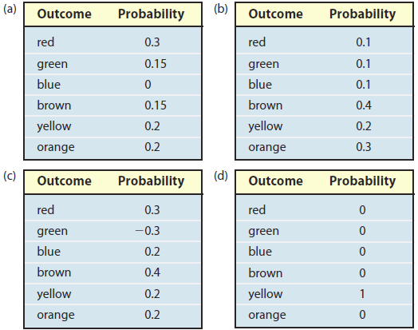
Probability

Slide 4
Probability
Sums to more than one
Probability models
Negative probability

Slide 5
Probability

Slide 6
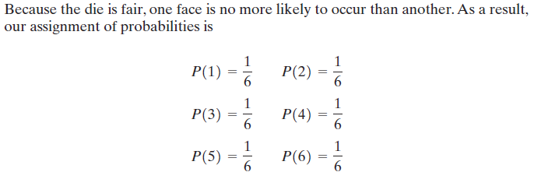
Probability

Slide 7
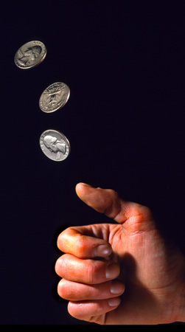
Probability

Slide 8
Probability

Slide 9
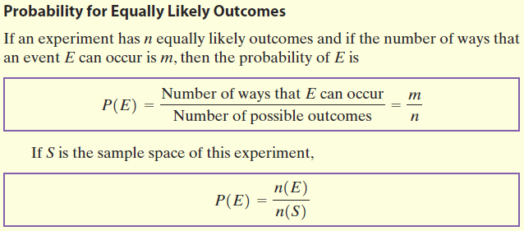
Probability

Slide 10
Probability

Slide 11
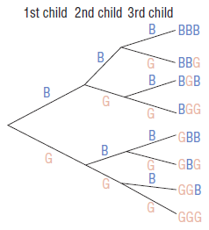
Probability

Slide 12
Probability

Slide 13
Probability

Slide 14
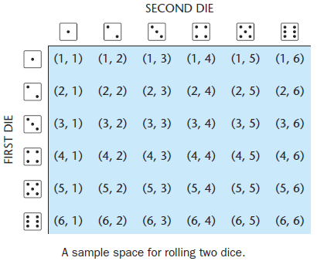
Probability

Slide 15
Probability

Slide 16
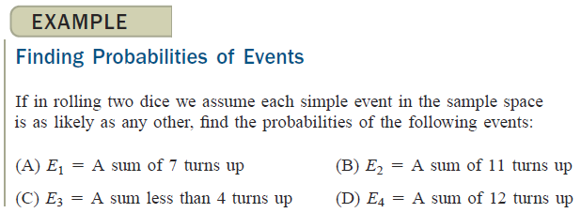
Probability

Slide 17
Probability

Slide 18
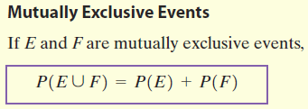
Probability

Slide 19
Probability

Slide 20
Probability

Slide 21
Probability

Slide 22
Probability
Complement of an Event – All outcomes in a sample space that are not outcomes in the event E. Note: your book uses E’ for a complement

Slide 23
Probability

Slide 24
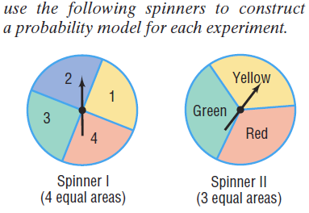
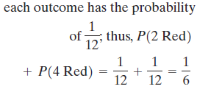
Probability
Practice Problems

Slide 25
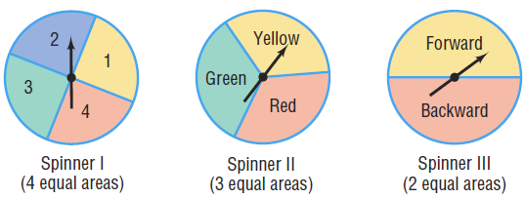
Probability
Practice Problems

Slide 26
Probability
Practice Problems

Slide 27
Probability
Practice Problems

Slide 28
Probability
Practice Problems

Slide 29
Probability
Practice Problems

Slide 30
Probability
Practice Problems

Slide 31
Probability
Practice Problems

Slide 32
Probability
Practice Problems

Slide 33
Probability
Practice Problems

Slide 34
Probability
Practice Problems

Slide 35
Probability
Practice Problems

Slide 36
Probability
Practice Problems

Slide 37
Probability
Homework
Pages 620 – 622
15 – 29odd, 33, 41, 43

