Slide 1
Calculus 3-3
Increasing & Decreasing Functions First Derivative Test

Slide 2
Increasing & Decreasing Functions

Slide 3
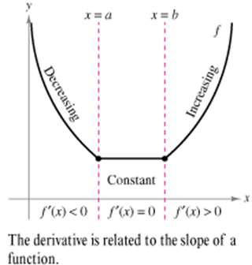
Increasing & Decreasing Functions

Slide 4
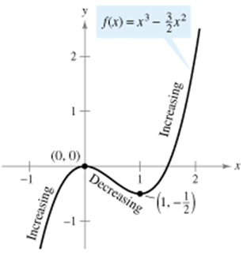
Increasing & Decreasing Functions

Slide 5
Increasing & Decreasing Functions

Slide 6
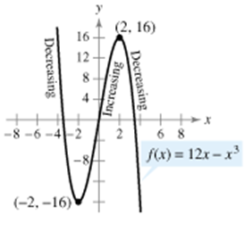
Increasing & Decreasing Functions

Slide 7
Increasing & Decreasing Functions

Slide 8
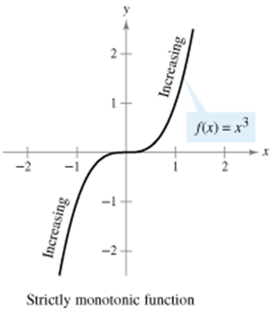
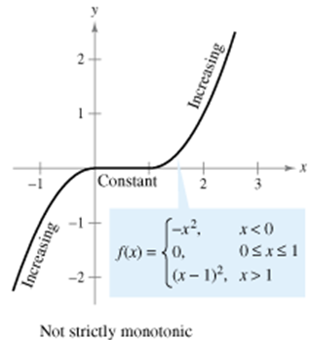
Increasing & Decreasing Functions

Slide 9
First Derivative Test

Slide 10
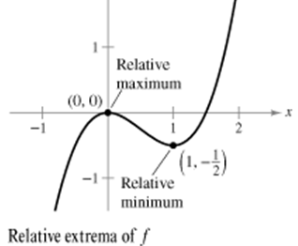
First Derivative Test

Slide 11
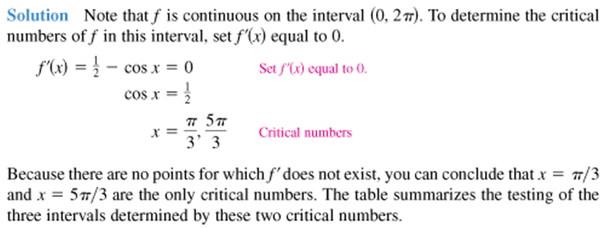
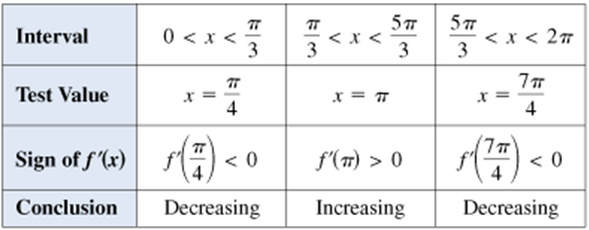
First Derivative Test

Slide 12
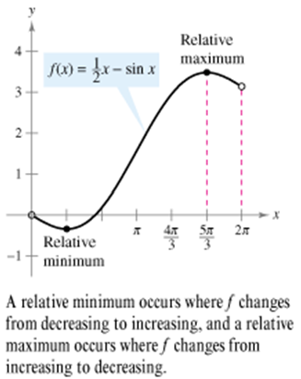
First Derivative Test

Slide 13
First Derivative Test

Slide 14
First Derivative Test

Slide 15
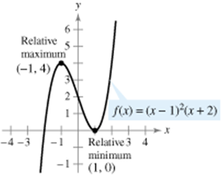
First Derivative Test

Slide 16
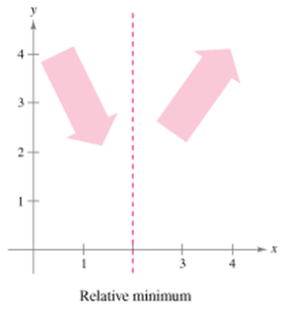
First Derivative Test

Slide 17
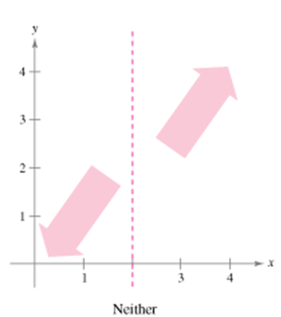
First Derivative Test

Slide 18
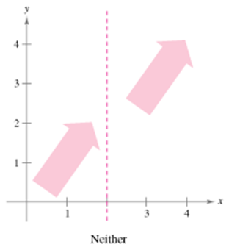
First Derivative Test

Slide 19
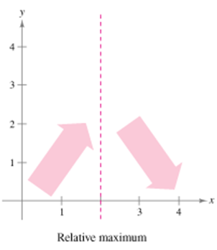
First Derivative Test

Slide 20
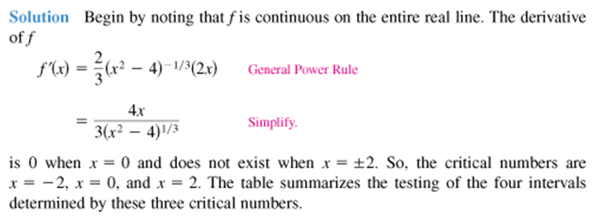
First Derivative Test

Slide 21
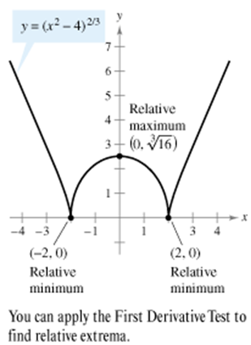
First Derivative Test

Slide 22
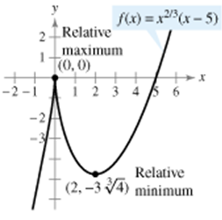
First Derivative Test

Slide 23
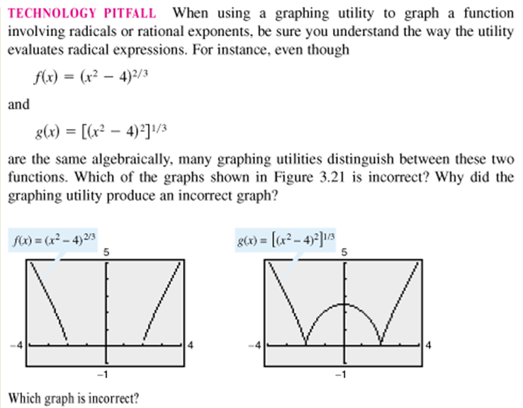
First Derivative Test

Slide 24
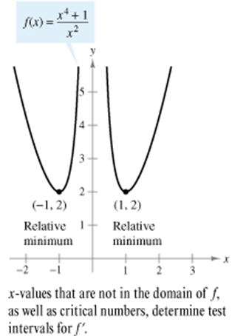
First Derivative Test

Slide 25
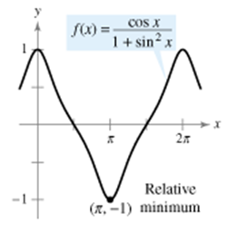
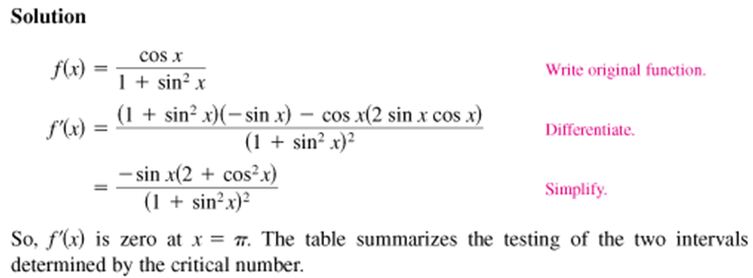
First Derivative Test

Slide 26
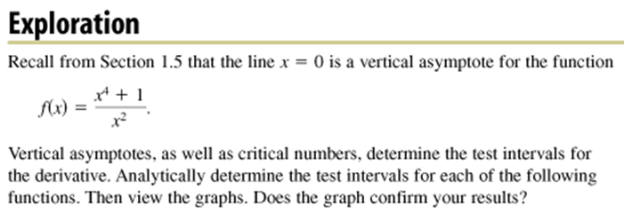
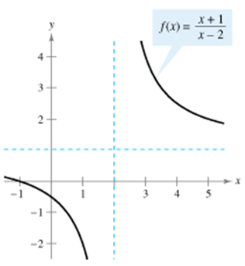
First Derivative Test

Slide 27
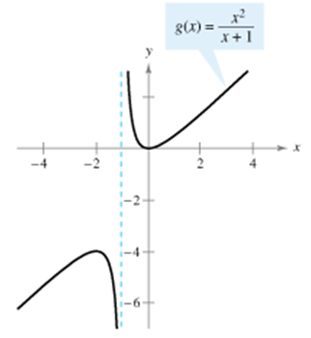
First Derivative Test

Slide 28
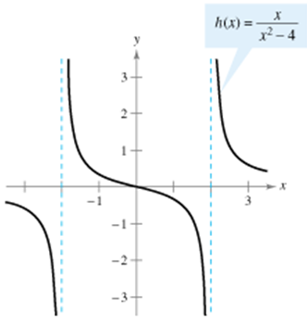
First Derivative Test

Slide 29
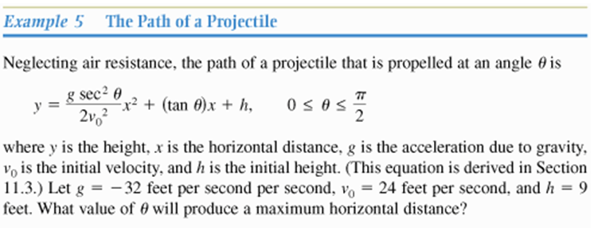
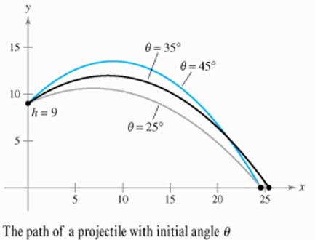
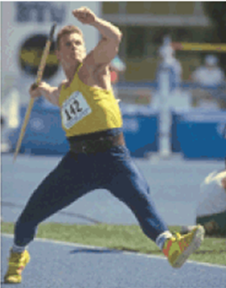
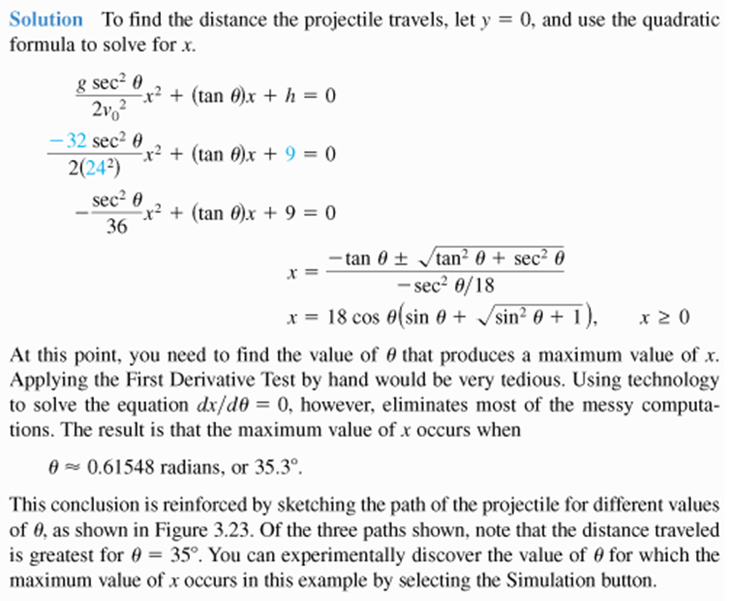
First Derivative Test

Slide 30
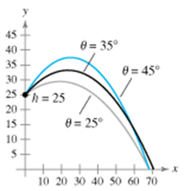
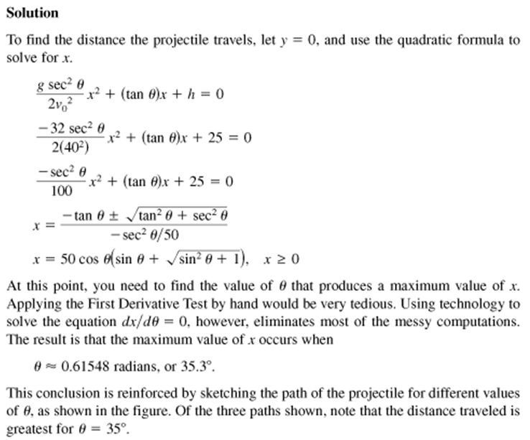
First Derivative Test

Slide 31
First Derivative Test
Homework
pg. 181 – 182
4, 13, 21, 31, 33, 43, 44, 45, 49, 51, 55, 56, 62

