Slide 1
Calculus 3-1
Extrema on an Interval, and Critical Points

Slide 2
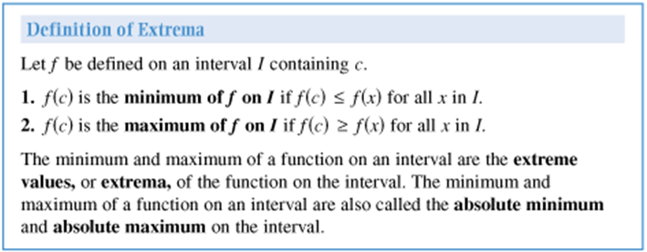
Extrema, Critical Points

Slide 3
Extrema, Critical Points

Slide 4
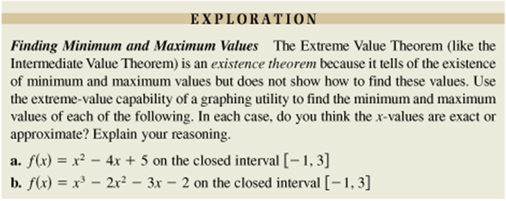
Extrema, Critical Points

Slide 5
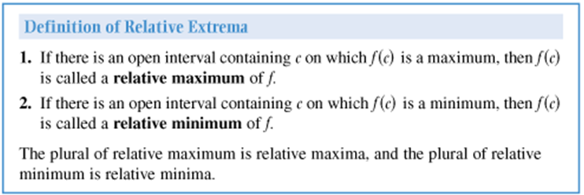
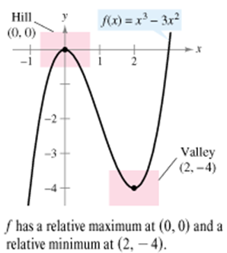
Extrema, Critical Points

Slide 6
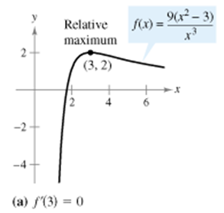
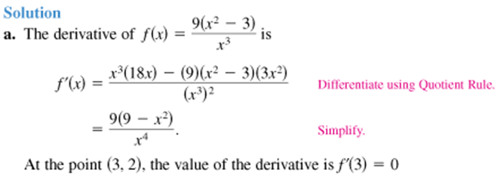
Extrema, Critical Points

Slide 7
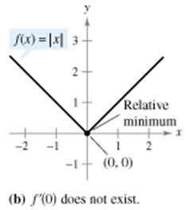
Extrema, Critical Points

Slide 8
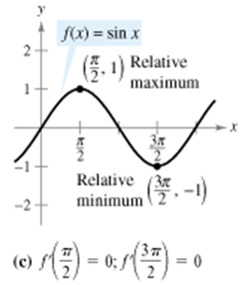
Extrema, Critical Points

Slide 9
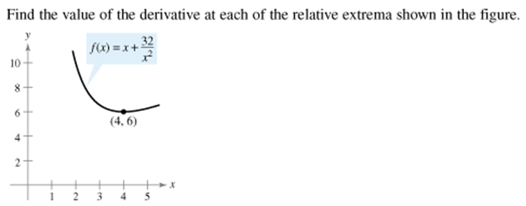
Extrema, Critical Points

Slide 10
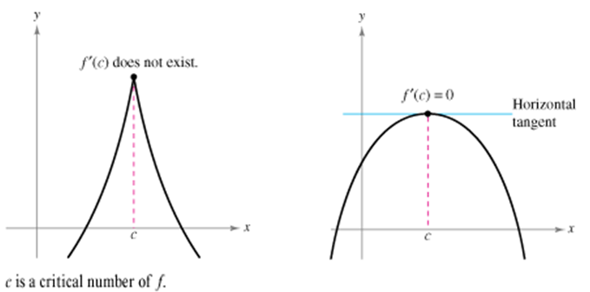
Extrema, Critical Points

Slide 11
Extrema, Critical Points

Slide 12
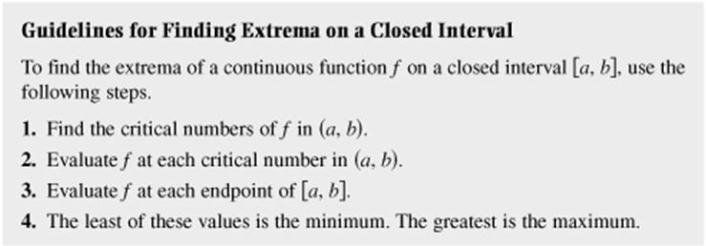
Extrema, Critical Points

Slide 13
Extrema, Critical Points

Slide 14
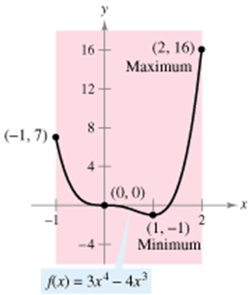
Extrema, Critical Points

Slide 15
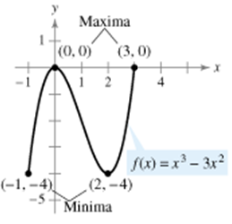
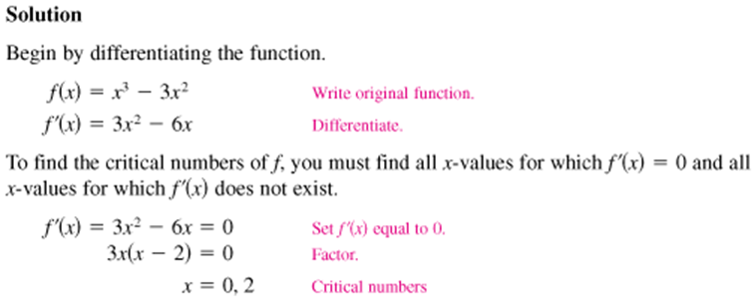
Extrema, Critical Points

Slide 16
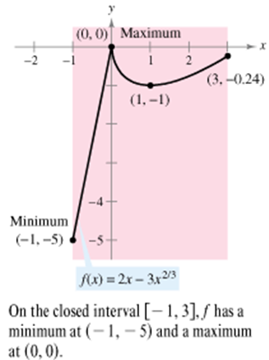
Extrema, Critical Points

Slide 17
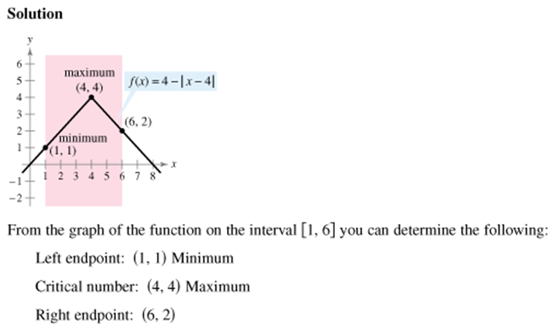
Extrema, Critical Points

Slide 18
Extrema, Critical Points

Slide 19
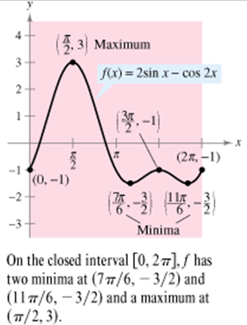
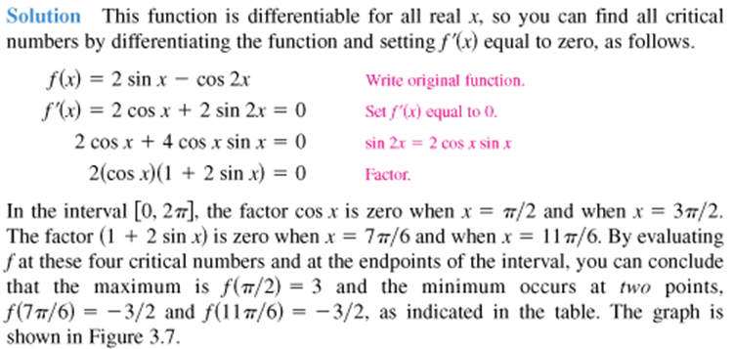
Extrema, Critical Points

Slide 20
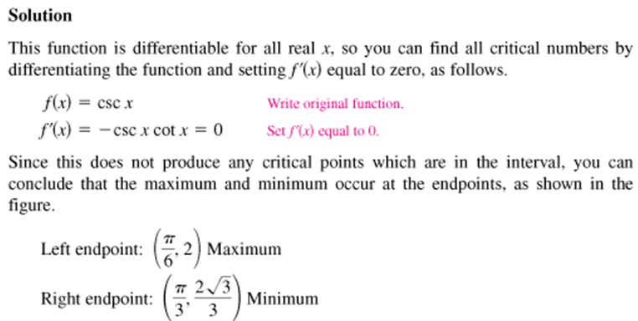
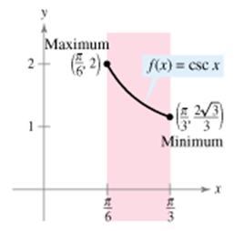
Extrema, Critical Points

Slide 21
Extrema, Critical Points
Homework
pg. 165-167
3, 11, 15, 19,25, 29, 33, 37, 51- 54, 61, 62, 63

