Slide 1
Calculus 4-4
The Fundamental Theorem of Calculus

Slide 2
Fundamental Theorem of Calculus

Slide 3
Fundamental Theorem of Calculus

Slide 4
Fundamental Theorem of Calculus

Slide 5
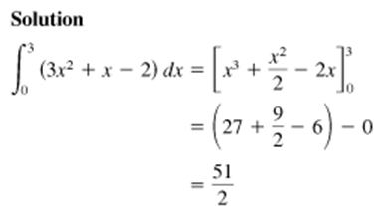
Fundamental Theorem of Calculus

Slide 6
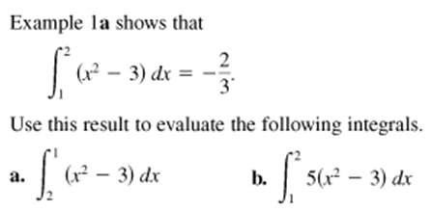
Fundamental Theorem of Calculus

Slide 7
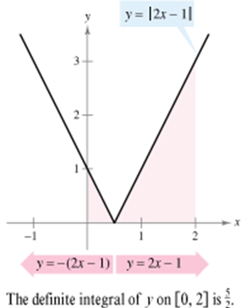
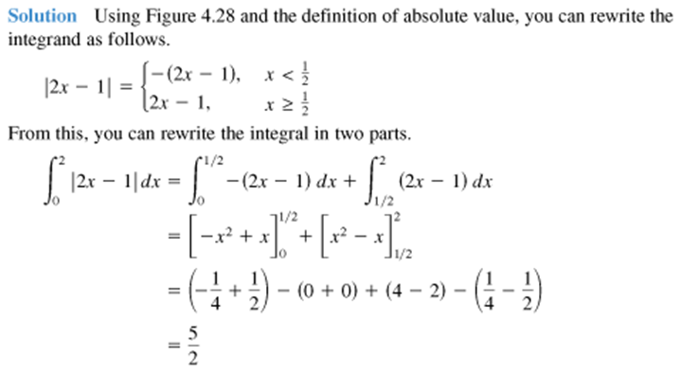
Fundamental Theorem of Calculus

Slide 8
Fundamental Theorem of Calculus

Slide 9
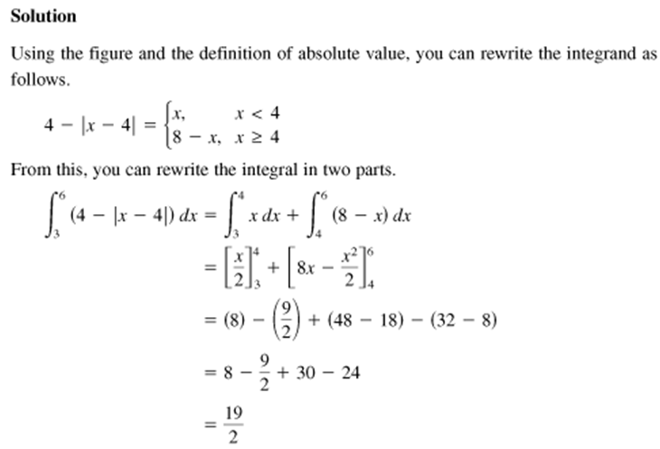
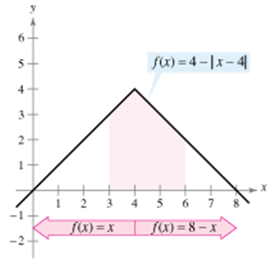
Fundamental Theorem of Calculus

Slide 10
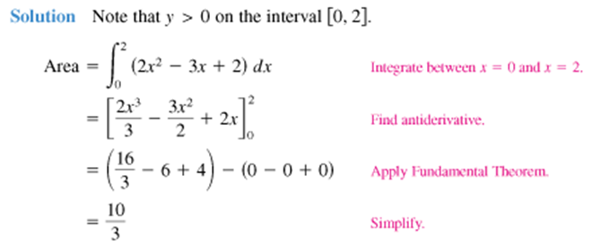
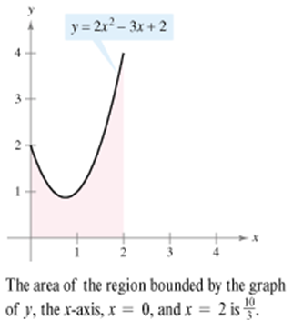
Fundamental Theorem of Calculus

Slide 11
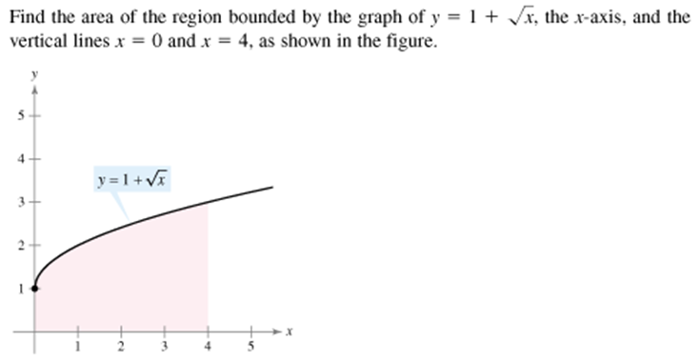
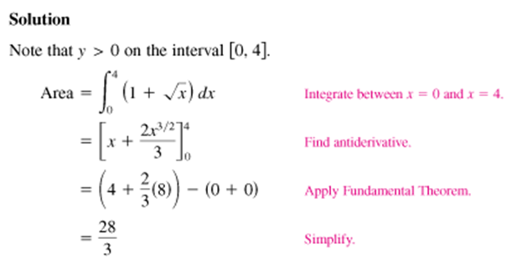
Fundamental Theorem of Calculus

Slide 12
Fundamental Theorem of Calculus

Slide 13
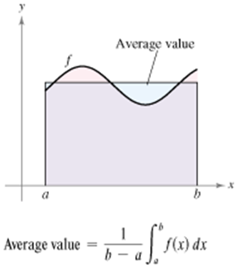
Fundamental Theorem of Calculus

Slide 14
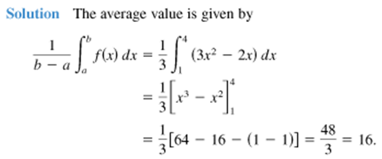
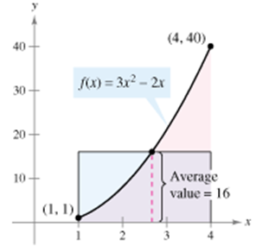
Fundamental Theorem of Calculus

Slide 15
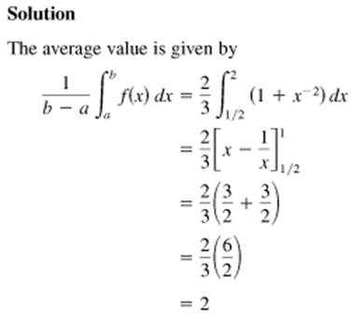
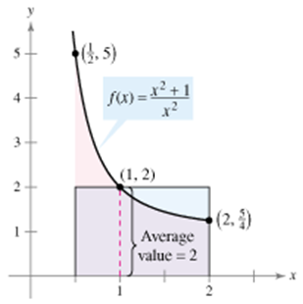
Fundamental Theorem of Calculus

Slide 16
Fundamental Theorem of Calculus

Slide 17
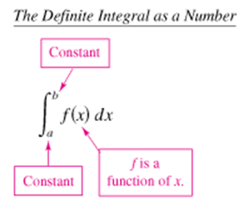
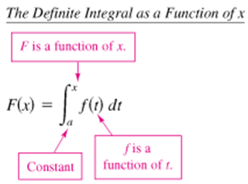
Fundamental Theorem of Calculus

Slide 18
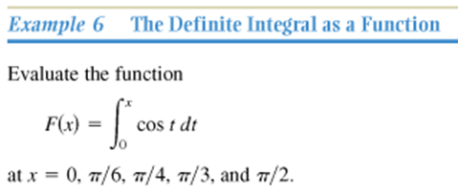
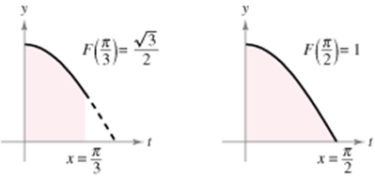
Fundamental Theorem of Calculus

Slide 19
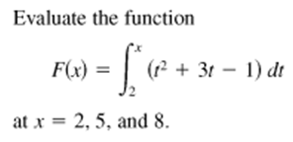
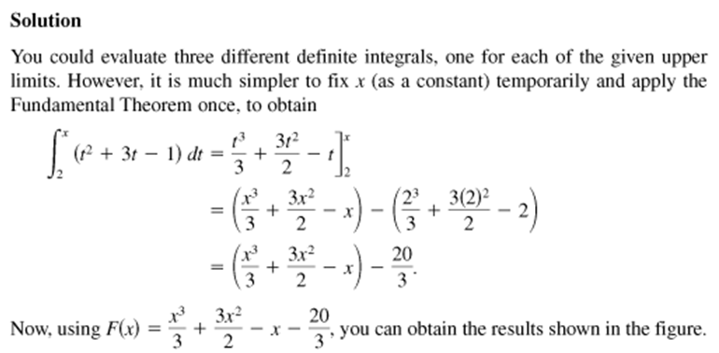
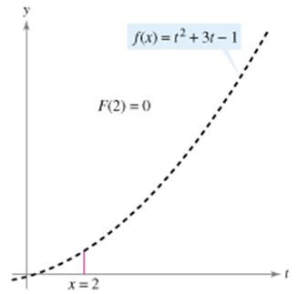
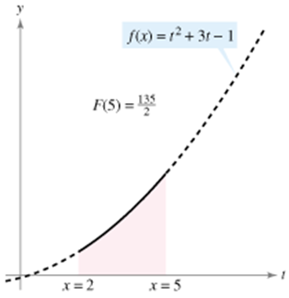
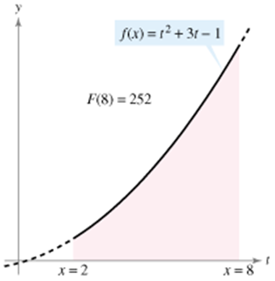
Fundamental Theorem of Calculus

Slide 20
Fundamental Theorem of Calculus

Slide 21
Fundamental Theorem of Calculus

Slide 22
Fundamental Theorem of Calculus

Slide 23
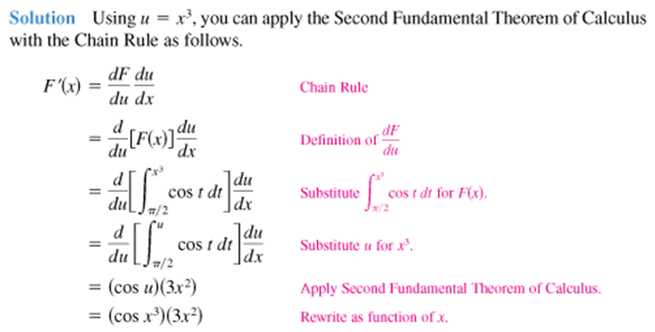
Fundamental Theorem of Calculus

Slide 24
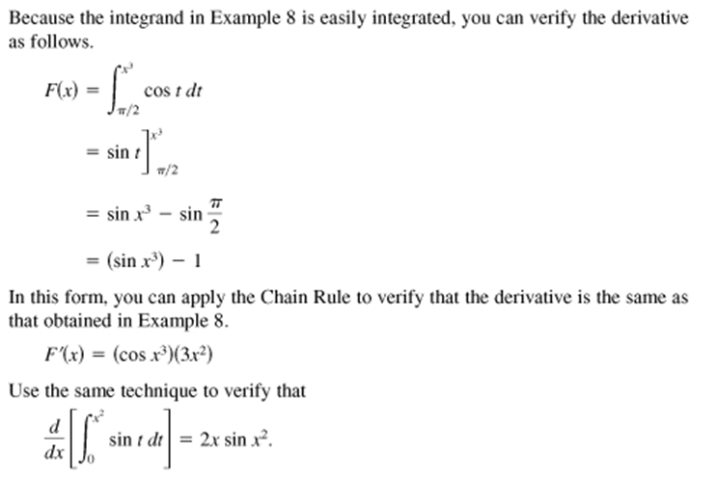
Fundamental Theorem of Calculus

Slide 25
Fundamental Theorem of Calculus

Slide 26
Fundamental Theorem of Calculus
Homework
4-4 The Fundamental Theorem of Calculus
pg 284 – 285
5, 9, 13, 15, 20, 29, 35, 37, 40, 45, 49, 55-59, 63

